Slide 1
COMMUNITY ENGAGEMENT, PARENTAL AND OTHER STAKEHOLDER INVOLVEMENT IN GIRLS’ RETENTION IN AND COMPLETION OF SCHOOLING
Prof. M.B.Shitu
Global Community Development Ambassador @ International Association for Community Development
(www.iacdglobal.org )
President, Institute of Community Development Practitioners’ Nigeria
(www.icdpnigeria.org )
Professor, Department of Adult Education & Community Services, Bayero University Kano, Nigeria

Slide 2
KEY OBJECTIVES OF THE PRESENTATION
Raise awareness of/on/about concerns for Girl Child and women education issues in Nigeria for noting at the Kano Education Summit 2024
Encourage innovative initiatives towards the promotion of actions by all to address key concerns/issues about the transition, retention and completion of girls
Advocate for support to empower the girl child, adolescent girls and women by individuals, parents, communities, and other stakeholders’ at large

Slide 3
SOME DATA/INFORMATION
Over 1 million children (boys and girls) are out-of-school (UNESCO, 2023)
40% women and 28% men have never attended school
The Net Enrolment Rate at primary school level and JSS for girls is encouraging (has leap frog)
Drop-out rates are highest at the sixth grade of primary school, JSS and SSS among girls than boys

Slide 4
WHEN WE KNOW, IT WILL HELP
% OF FEMALE PUPILS/STUDENTS IN
Primary schools
JSS
SSS
Tertiary Education
% OF FEMALE TEACHERS AT
Primary school level
JSS
SSS
Tertiary

Slide 5
SOME CONCERNS
Majority of the out of school children are
- In hard to reach locations,
Not reached populations
the poorest and
most marginalised
Main examples are: Children in poor urban neighbourhoods, nomadic and pastoral children, children with disabilities, street children, orphans and vulnerable children, children in conflict areas etc.

Slide 6
ADDITIONAL CONCERNS
Poor literacy rate among children (32% boys; 24% girls)
Low primary school attendance ratio for girls
High number cannot read in mother tongue HAUSA
Much higher number not able to read in English
Parents dissatisfied with these outcomes

Slide 7
SAFETY CONCERNS
Girls too often suffer disproportionately in the aftermath of disasters.
They are frequently forced to make greater sacrifices and take on more responsibility.
They are more likely than boys to be pulled out of school... and less likely to return.
The lost potential comes at great cost to their communities.
… DABAZARMU REPORT

Slide 8
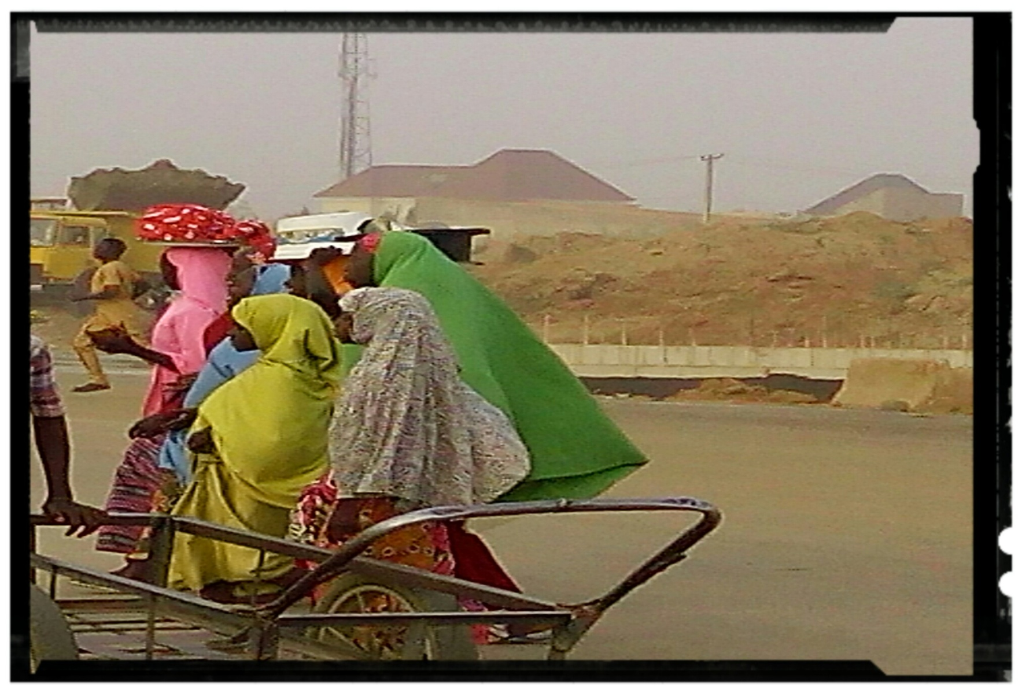
Street Hawking by school age girls

Slide 9
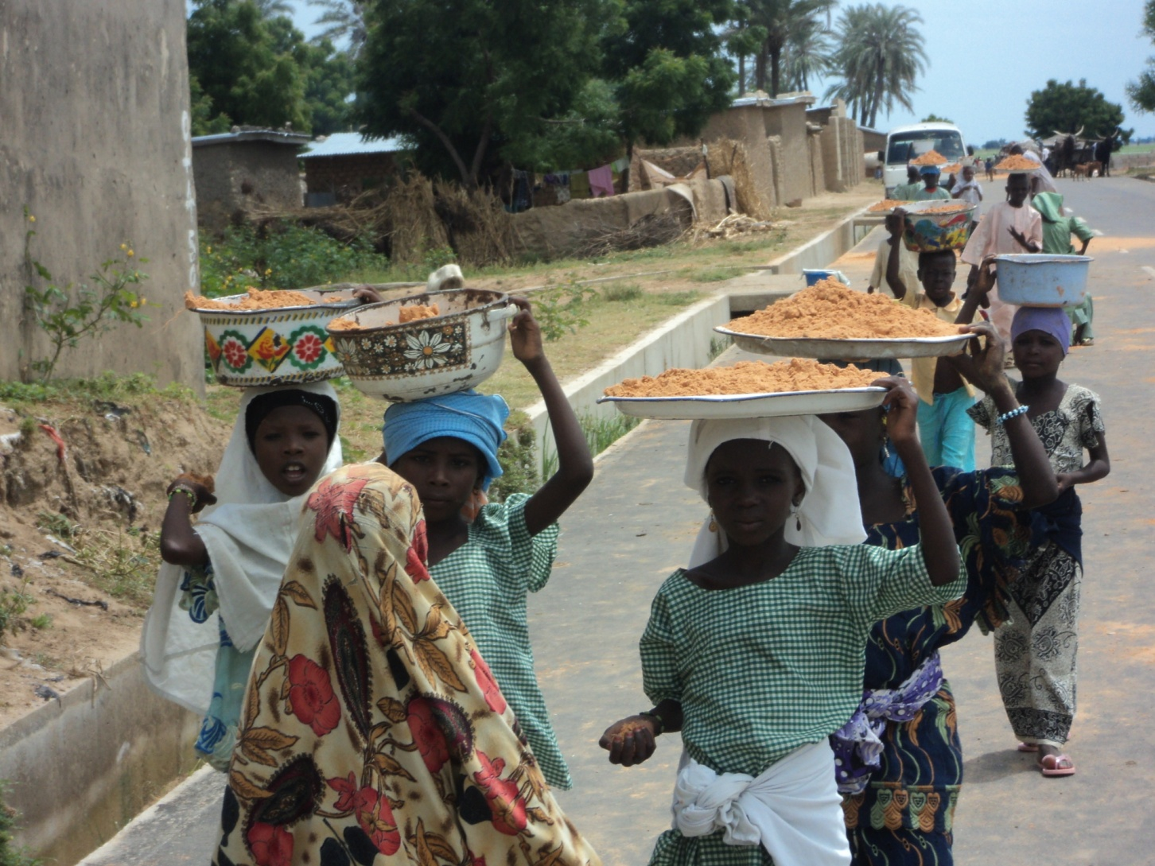
Child Labour inhibits schooling opportunities

Slide 10
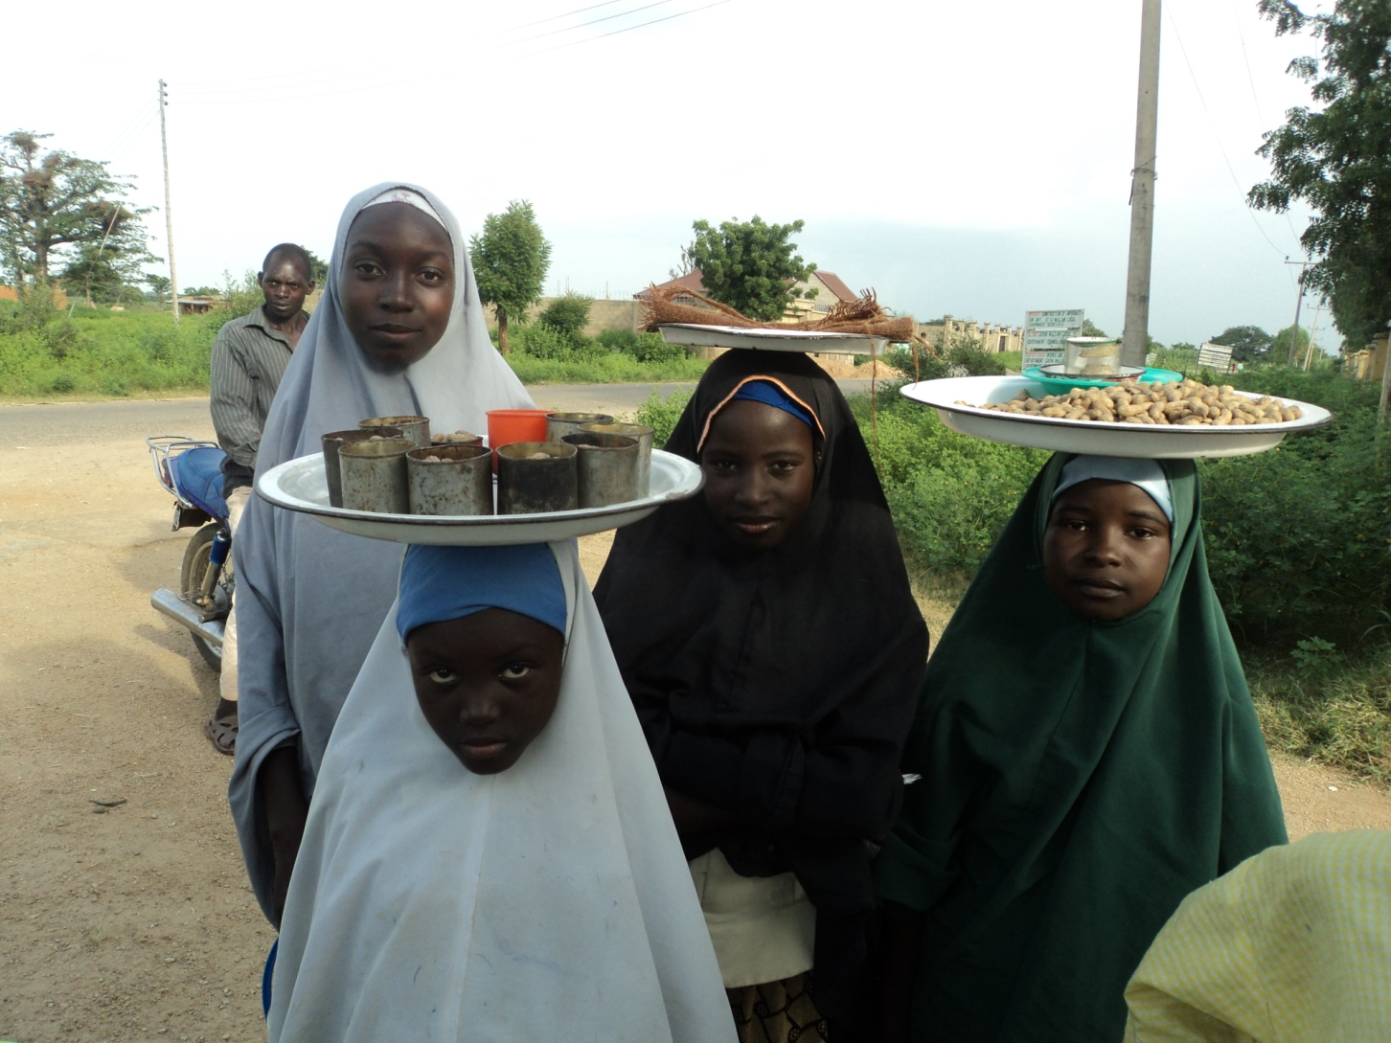
Vulnerable and exposed to risks

Slide 11
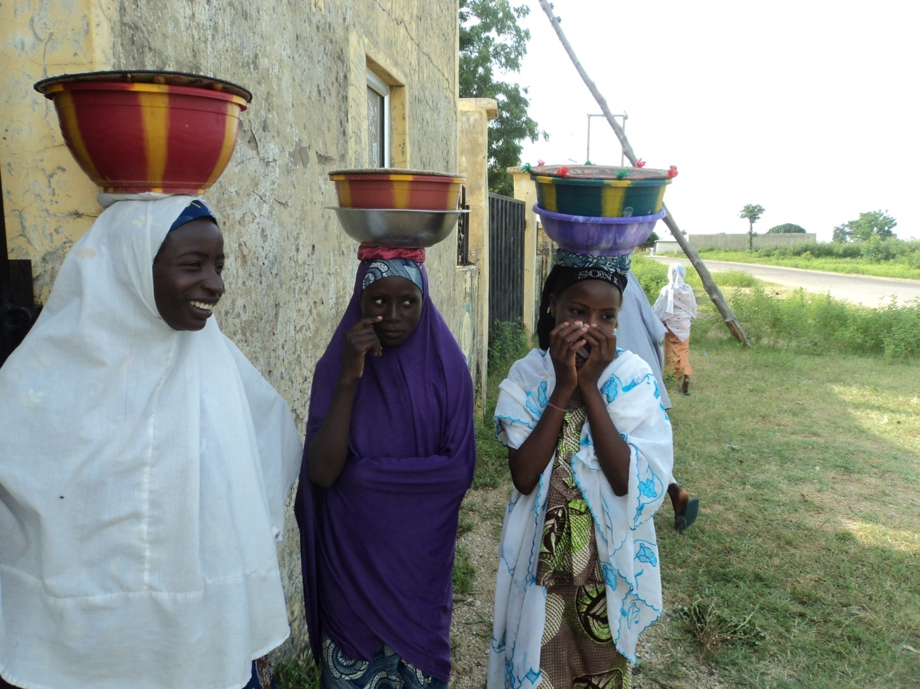
Kept out of school and hawking. Also live nomadic life

Slide 12
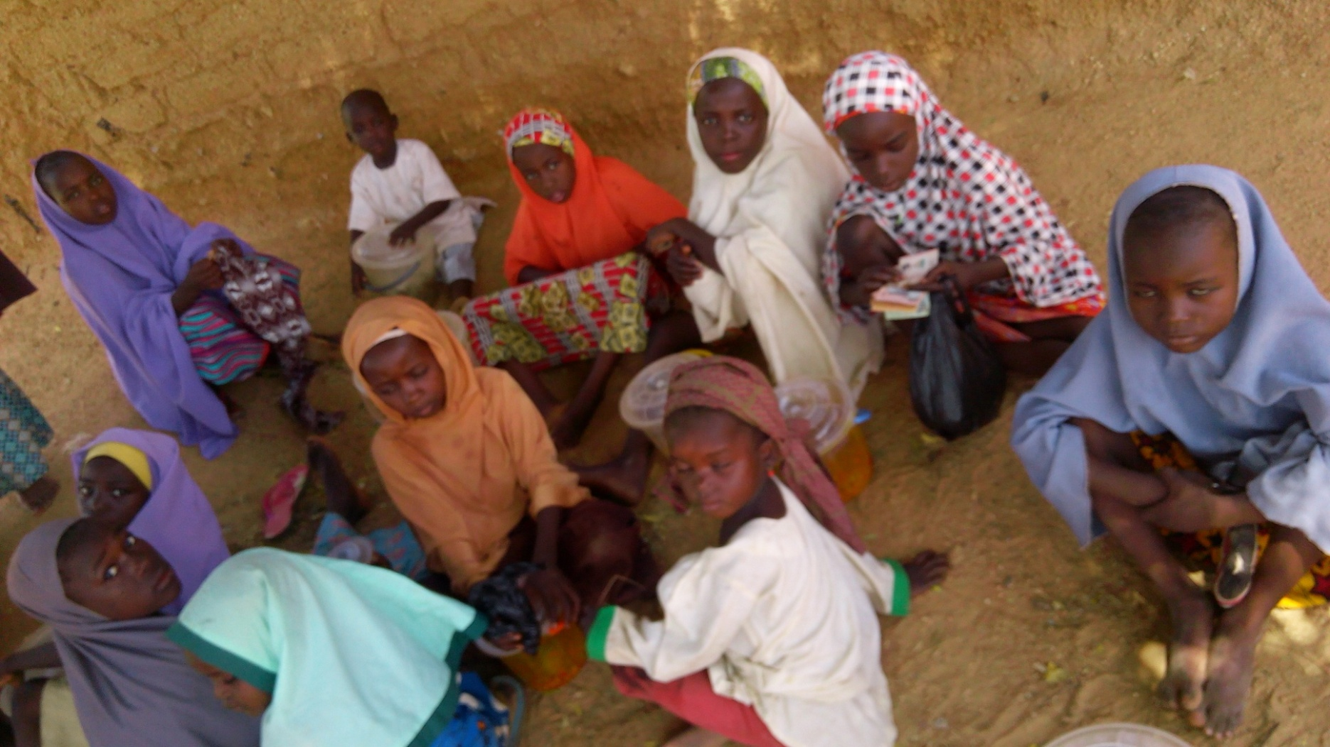
School age girls hawking around school premises during school hours

Slide 13
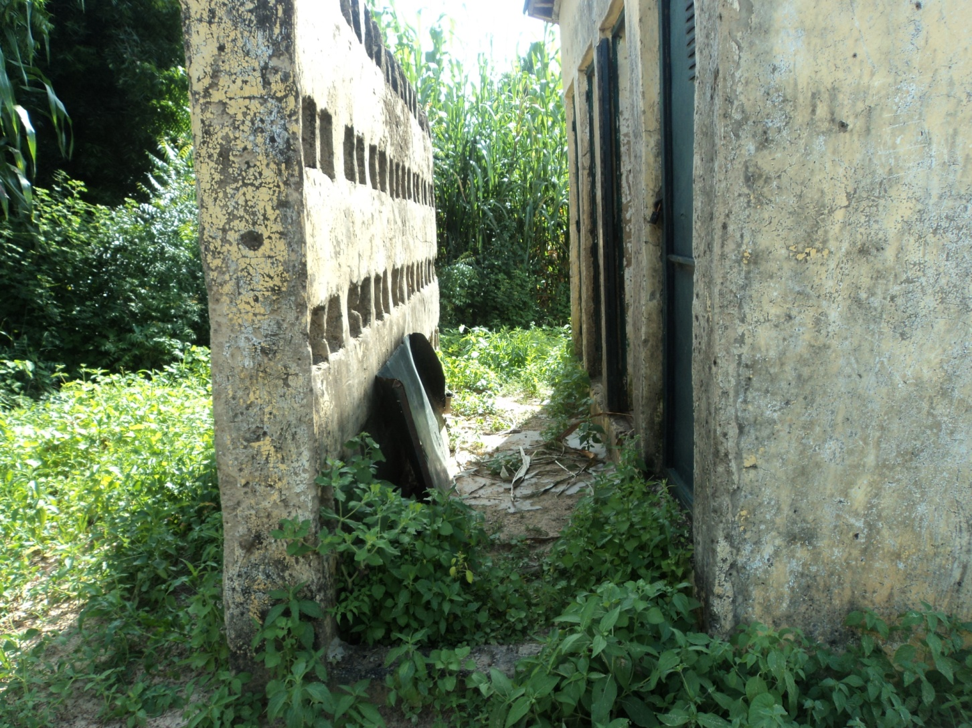
Sanitation, hygiene and safety issues

Slide 14
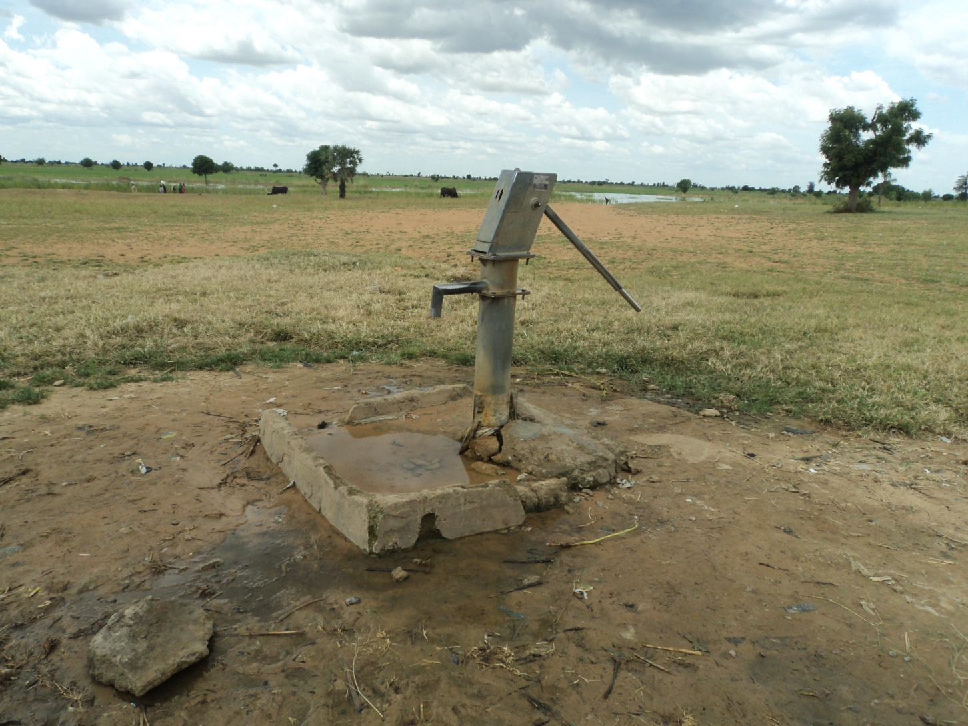
Availability, ease of access, distance to water supply points

Slide 15
Some Amazing Facts
Girls who go to school see immediate benefits beyond the things they are learning in school.
Being a student enhances their status in the community. It improves their health and makes them safer.
Even though educating a girl is a great investment, in a lot of the world school isn't free. And when parents have to choose they usually choose to educate the boys. So girls have less opportunity.
33 million fewer girls than boys are in school in primary school worldwide. With less education than boys – girls suffer more hunger more violence and more disease. It is a simple fact – there is nobody more vulnerable than a girl.

Slide 16
Summary of Barriers to Girls’ Education
Source: World Girls’ Report Plan International
1. The cost of education – Though education should be free, there are many costs associated with sending children to school. The cost of uniforms, textbooks or bus fare can be too much to bear for a family living in poverty. Too often, parents choose to keep their girls at home and send the boys to school instead.
2. Distance to school – In many parts of the developing world, the nearest primary school to a particular community might be a 4 or 5 hour long walk away. On top of that, girls may face dangers or violence on the long way to school; so many parents opt to keep their daughters at home and out of harm’s way.
3. Violence at school – Once arriving to school, girls may face various forms of violence at the hands of teachers, peers and other people in the school environment. If parents find out school isn’t safe for their daughters, they may remove them from school.

Slide 17
Summary of Barriers to Girls’ Education
Source: World’ Girls Report: Learning for Life, Plan International
4. Gender norms – Typically, girls are asked to fetch the water, take care of their younger siblings and to help their mothers cook and clean. Due to this, girls may not have the opportunity to attend school because their contributions to the household are valued more than their personal education.
5. Poverty – In many parts of the developing world, children’s health is a big concern, especially if they’re facing poverty. If there’s not enough food or sufficient clean water to keep girls nourished and healthy, they may not be well enough to attend school.
6. Early marriage and pregnancy – When girls are forced to marry young, they are often pulled out of school at a very critical age in their development. The transition from primary to secondary education is key for girls to gain the life skills they need to escape the cycle of poverty. Yet, this is often the same time that many girls leave school due to early marriages or pregnancy. Girls who become pregnant are often discouraged from attending school because of the stigma surrounding them

Slide 18
SOME DIRECTION
SDG 4: Ensure inclusive and equitable quality education and promote lifelong learning opportunities for all
To achieve goal 4
Every child should receive 12 years of education
Girls should have free and compulsory 12 years of schooling
Non Formal Education opportunities for early leavers and disaster victims necessary
Prior learning assessment mechanisms for early leavers including adolescent girls/women for placements
Access, retention, transition and completion for girls essential

Slide 19
NOW CITIZENS AND CITIZENS GROUP MUST DO SOMETHING
COMMUNITY ENGAGEMENT AS A
‘MAFITA’
HOW? WHEN? WHERE?

Slide 20
COMMUNITY STAKEHOLDERS
(Internal and External)
citizens
Parents
Citizens’ Groups NFP (PTAs, SBMC, CRC, Ms’A, OSA, CBOs, CSOs, NGOs etc)
Institutions (social, eco, pol., cultural, financial etc)
Private for Profit

Slide 21
WHAT CAN BE DONE
Existing community structures initiate action
Identify helping factors for promoting transition, retention and completion
Identify hindrances to effective girls’ transition, retention and completion
Identify and support alternative learning centres (Community Learning Centres)
Information and skills sharing
Understand and appreciate need for/to support girls education
Contribute resources: human, material, financial, time, effort etc.
Contribute to SDPs that is gender sensitive/inclusive
Work to implement SDPs
Monitor progress and provide feedback to all stakeholders

Slide 22
THE HOW OF THE PROCESS
Engage all appropriate parties in a meaningful manner.
Be purpose-driven toward an agreed upon goal or set of goals.
Operate within an agreed upon framework.
Integrate facts and nurtures ideas.
Reach an outcome only after all issues have been fully exhausted.
(Innes & Booher, 1999, p. 419)

Slide 23
SOME INNOVATIVE PRACTICES FOR EFFECTIVE STAKEHOLDER ENGAGEMENTS
Regular meetings
Proper networking, partnerships, collaborations
Effective coordination
Appropriate media/channels of communication
Effective planning
Focused interventions

Slide 24
SOME INNOVATIVE PRACTICES FOR EFFECTIVE STAKEHOLDER ENGAGEMENTS
Address parents’ concerns in relation to social norms especially marriage expenses
Address poverty concerns in the community
Make learning more functional and effective: skills not certificates
Strengthen school community relations
Inter-ministerial coordination on girls’ support for literacy, digital skills, livelihoods

Slide 25
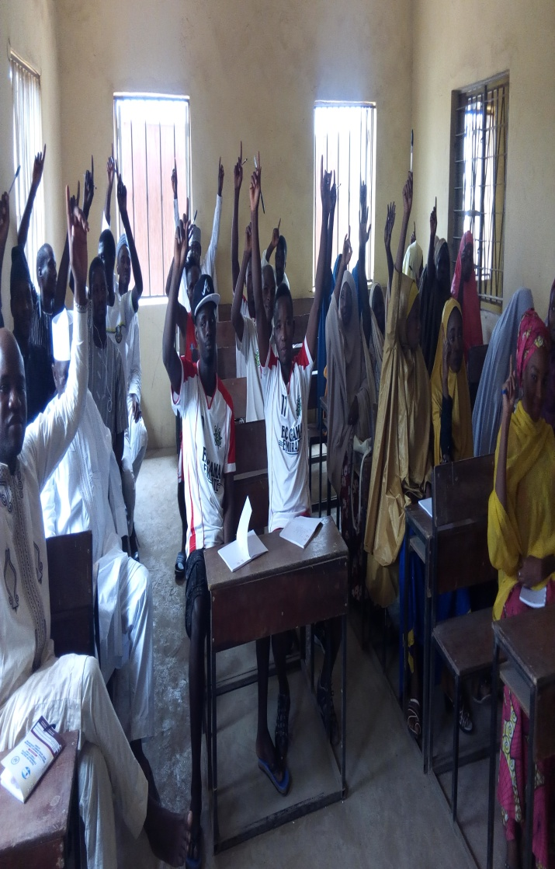
Gender inclusive engagement

Slide 26
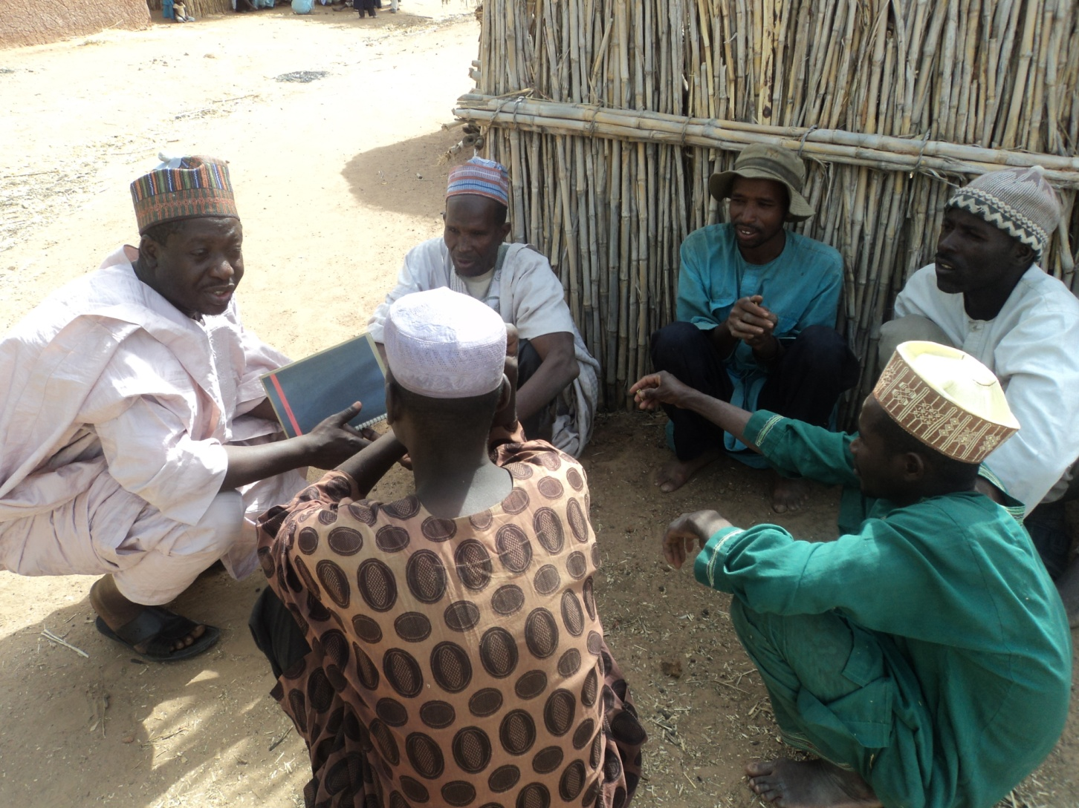
consultation

Slide 27
CONCLUDING REMARKS
The idea of citizen participation is a little like eating spinach: no one is against it in principle because it is good for you - Sherry R. Arnstein
In order to address social and economic influences negatively affecting girls and women in our communities, purposeful dialogue determined by community power dynamics is important
‘”… Without dialogue there is no communication and without communication there can be no true education” (Freire, 1982)

Slide 28
CONCLUDING REMARKS
Support communities to support girls’ education especially improvements in transition, retention and completion
Communities to support schools and learning centres to address transition, retention and completion issues in girls’ education
Schools to support communities and other stakeholders to enhance school transition, retention and completion among girls

Slide 29
Change begins with us now, so we now pledge for action ---
I ................. Hereby pledge or undertake to contribute towards addressing education and safety challenges affecting girls and women in my community from today
I pledge to support at least one girl in my community or fund the support for one or more
I pledge to support transition, retention and completion of girls at all levels of education especially secondary education
So Help me GOD

Slide 30
NAGODE
THANK YOU
MIYYETI
ALHAMDULLI LLAH
*ACTION TO START NOW WITH YOU

