Slide 1
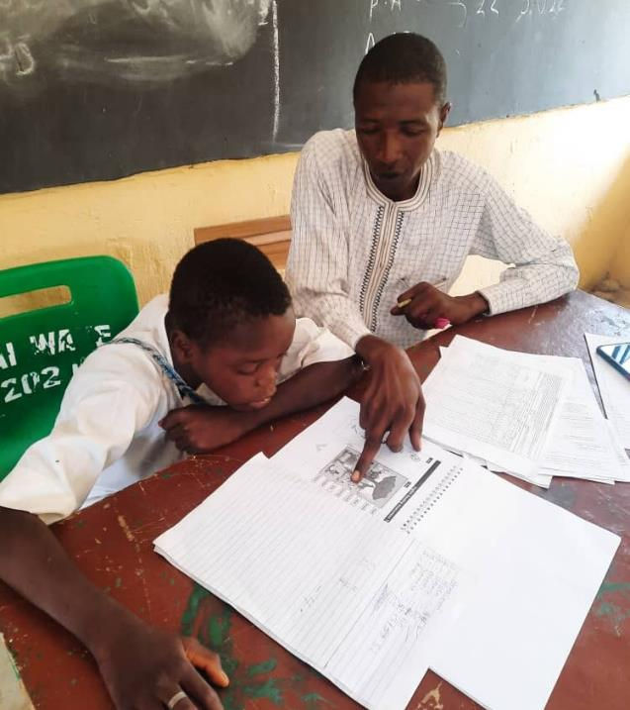
PLANE AL
Dissemination
November2023

Slide 2
How it started
The journey so far
Overview
Overall Endline Results
Home-based learning
Case studies
Challenges and way forward
Recommendation
Contents

Slide 3
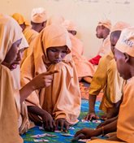
KANO Literacy and Maths Accelerator (KaLMA)
Country: Nigeria
Client: FCDO
Value: £3,24m
Lifecycle: 2019-2021
The British Council, TaRL Africa, Kano SUBEB, and the Sa’adatu Rimi College of Education partnered to implement KaLMA which built foundational Maths, Hausa, and English literacy skills for more than 37,000 Primary 4 to Primary 6 girls and boys in two full local government areas, Dawakin Tofa and Wudil in Kano State; using the TaRL and British Council dual-language approaches
Provided TPD to 1,200 teachers, 100 student teachers, 255 headteachers, 50 school support officers and 33 master trainers
Developed a package of teaching, learning, and assessment tools for each subject area.
A strong gender component, with all learning materials created with a gender lens and strengthened teachers' capacity to utilize gender-responsive pedagogies
During the COVID-19 crisis, Home-Based Learning was delivered to over 4.8 million households via radio broadcasts, text messages, AVM on a toll-free line, and worksheets for HBL, which increased learning time for girls.
The number of students able to read and do foundational maths at grade 1 level increased by 18pp while the number of students who cannot read basic words and recognize 2-digit numbers was reduced by 37pp.
Built grassroots accountability through working with headteachers and SBMCs to share report cards of students’ performance at townhall meetings, involving parents/caregivers in supporting children’s learning and instituting a weekly phone-in radio programme advocating for foundational skills’ acquisition and community support for girls’ education.
Notes:
Delivered in a context where there is a learning crisis exacerbated for girls where the female primary net enrolment rate is 47%
Working on a sustainability model to hand project over to Kano State
One of the findings from the independent evaluation of KaLMA was that excluding English literacy in Wudil hampered children’s progress in English compared to non-KaLMA schools. As a response to this finding, extension of the dual language approach to Wudil, where it had not previously been implemented, was recommended. During a sustainability workshop held in Kano in mid-September 2021, the government expressed interest in adopting the dual language approach in Wudil

Slide 4
The Journey So Far
2019
2020
2021
2022
2023
2023/24
181-school pilot starts, reaching 1,200 teachers, 37,000 pupils
Pilot pivoted to HBL in the face of the COVID 19 school closures
Pilot resumes reaching 30,000+ pupils
Scaling up starts, reaching 7 LGAs, 580 schools, 110,000+ pupils
Implementation continues in 7 LGAs
Transition to Sustainability Strategy

Slide 5
Overview
Whom and where did we assess?

Slide 6
Assessment Cycles
Baseline
Sept 2022
Midline-1
Nov/Dec 2022
Endline
July 2023
Midline-2
March 2023
Baseline was done at the start of the programme, before classes began in schools.
Midline-1 was done after 2 months of the programme, before the end of the first term.
Midline-2 was done after the programme had been implemented for ~5 months.
The Endline was done at the end of the programme, after PLANE-AL had been implemented for 7 months.

Slide 7




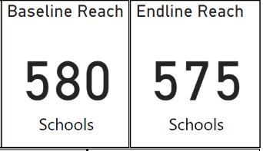
SAMPLE & ASSESSMENT
7
LGAs
3
Classes
(P4, P5, P6)
113,472
Pupils
The Endline assessment was conducted between 5th to 15th of July 2023 but this extended into the week of 17th due to rainfall and absenteeism of pupils.
5 schools could not conduct the assessment (2 in Bunkure, 2 in Warawa, and 1 Dawakin Tofa ). This is due to pupil absenteeism, migration and fire incident in a school since baseline.

Slide 8
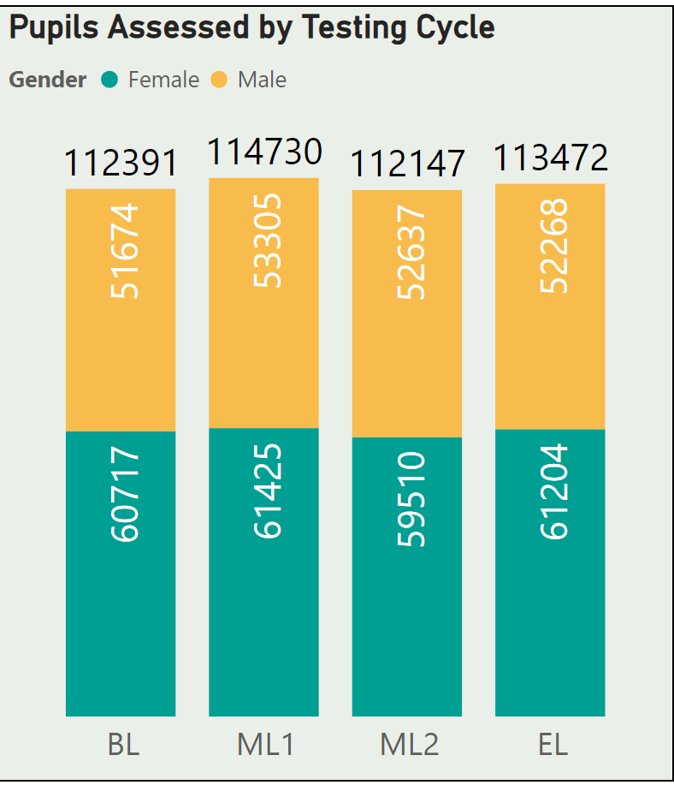
Student Profile
While attendance seems better at Endline compared to Baseline, highest attendance was recorded during Midline-1 due to reduced farming activities, advocacy efforts and school feeding.
Attendance dropped in term 2 (Midline-2 in March) when school feeding stopped.
Consistent drop in attendance was recorded in Bunkure and Warawa all through the session (More at the Endline - 14% and 12% respectively) due to the nomadic nature of some schools and all year-round farming activities in Bunkure.

Slide 9
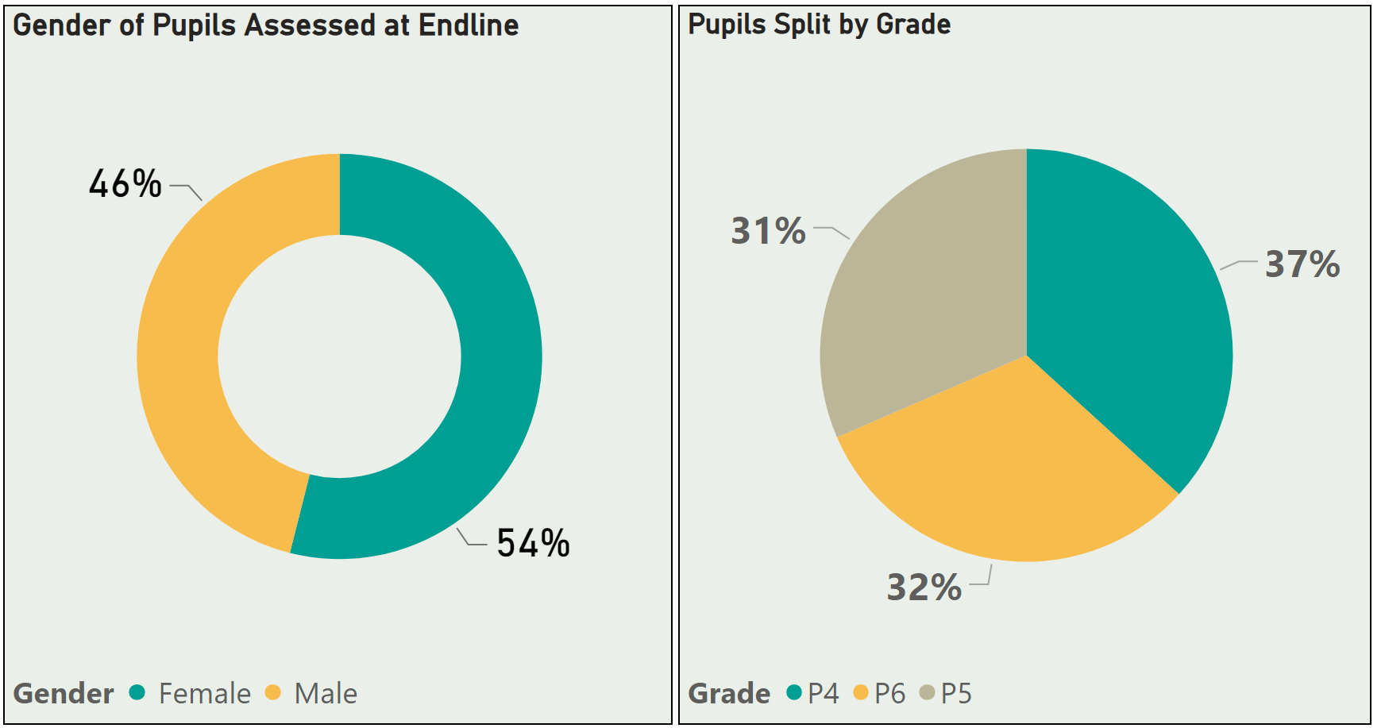
Gender/Grade Profile
Female attendance was higher than male.
54% of pupils tested at endline were females - this pattern was observed across all the assessment cycles.

Slide 10
Endline Assessment Results

Slide 11
Logframe targets
Milestone 2 targets have been achieved with more gains at the lower learning levels. Milestones were over-achieved across all subjects.
Level | PLANE-AL 2022/23
 | Baseline | Endline | Change Achieved (pp) | Target for Milestone 2
Cannot respond to simple greeting in English | 63% | 16% | -47 | -25pp
Can read English words | 9% | 52% | 43 | 15pp
Cannot recognize 2 digit numbers | 68% | 27% | -41 | -25pp
Can solve 2x2 subtraction | 4% | 26% | 22 | 15pp
Cannot read Hausa words | 87% | 38% | -49 | -25pp
Can read at least grade 1 text in Hausa | 6% | 32% | 26 | 15pp

Slide 12
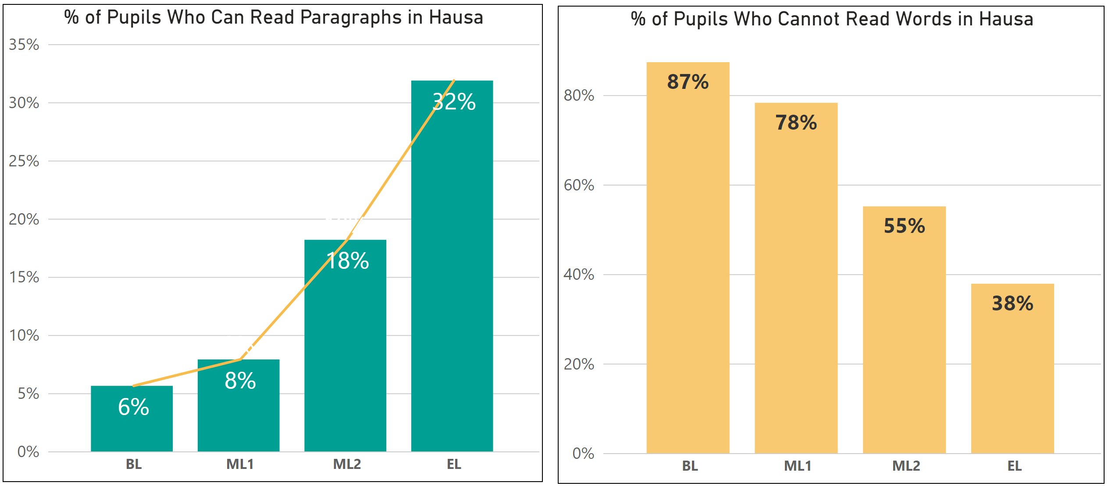
Assessment Results: Hausa Reading
Pupils who can Read Paragraph in Hausa
Improvement: 26 percentage points
Pupils who cannot Read Words in Hausa
Reduction: 49 percentage points

Slide 13
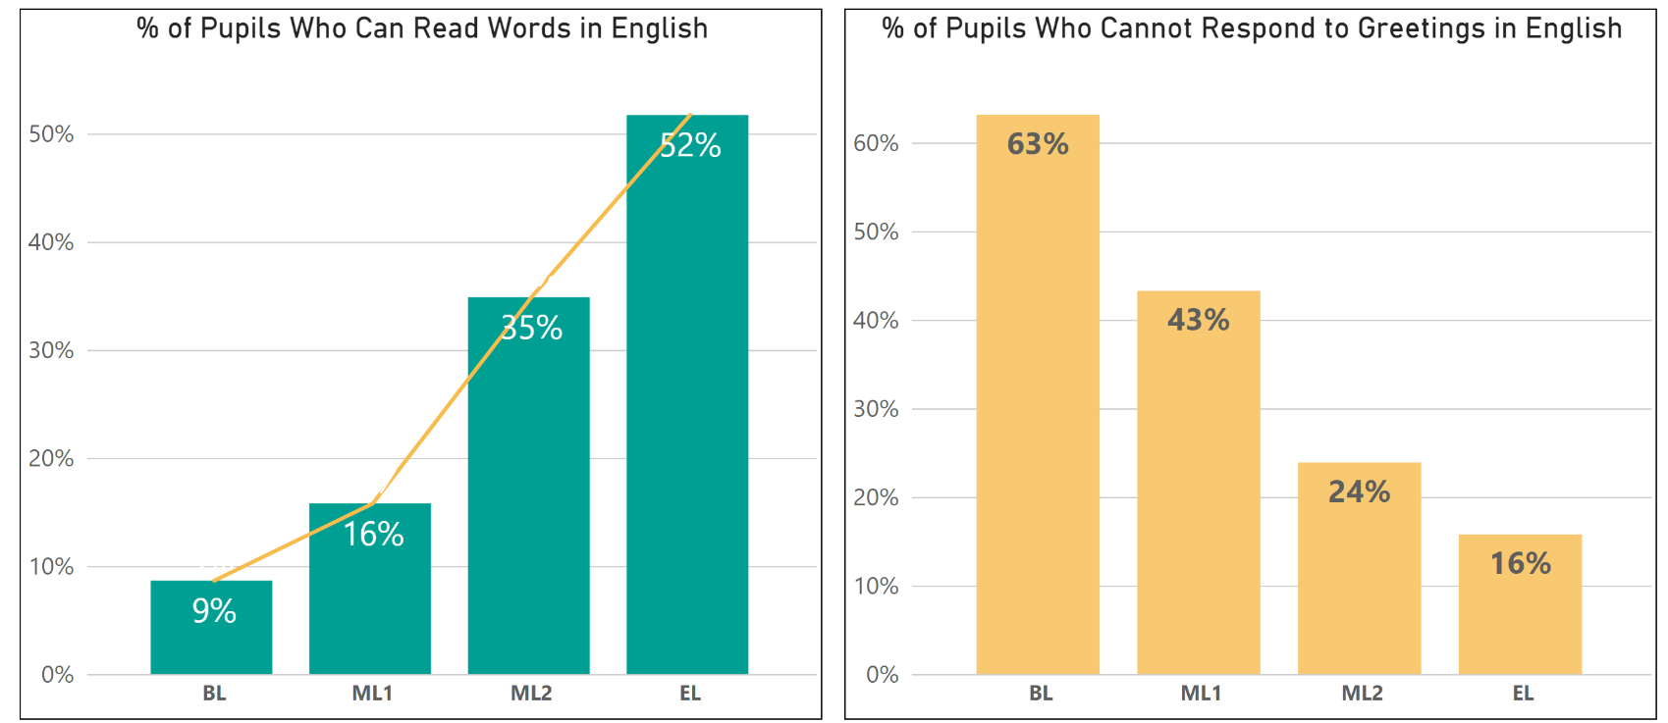
Assessment Results: English Reading
Pupils who can Read Words in English
Improvement: 43 percentage points
Pupils who cannot Respond to Greetings in English
Reduction: 47 percentage points

Slide 14
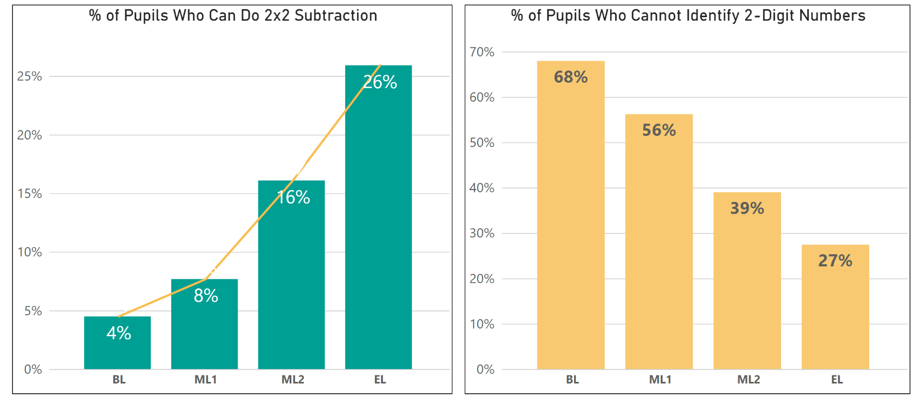
Assessment Results: Mathematics
Pupils who can solve a 2x2 subtraction problem
Improvement: 22 percentage points
Pupils who cannot identify 2-digit numbers
Reduction: 41 percentage points

Slide 15

Home Based Learning (HBL)

Slide 16
Supporting Access to Education
Home-based learning (HBL)
Many children are OOS and,
a large number of children in school are not learning due to a significant amount of in-class learning time that is lost for various reasons such as:
  some schools are in remote rural areas and children and teachers don’t always attend to them due to the long distance.
  one-man teacher-and-headteacher schools.
  not all schools are in a good state of repair, so parents may not want to send their children there.
  Classes can also be large. It is then not easy for one teacher to attend to all pupils’ learning needs.
  Migration of nomadic communities
HBL provides an alternative pathway to learning and helps make up for lost learning time
Prepares OOS learners to be re-integrated into school.

Slide 17
The Home-Based Learning (HBL) study
340 randomly selected pupils
Bichi LGA
7 randomly sampled schools
The Home-Based Learning (HBL) study seeks to assess the benefits to children's learning
of providing them with HBL materials - alongside TaRL classroom activities.
The full resource package consists of a learning-by-radio series of broadcasts; an SD card
pre-loaded with literacy and numeracy audio content; level-graded worksheets for Hausa, Maths and English; and home support visits by volunteer teachers from local schools.
A small team of research assistants monitors the HBL and collects data on it.

Slide 18
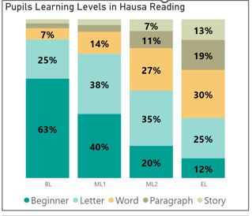
HBL Study Pupils & all AL Pupils – Hausa Endline Results
HBL Study Pupils
All PAL Learners
Broadly similar performances by groups at baseline, with a higher acceleration rate of HBL pupils in the first six months (‘til M2)
4 percentage point (pp) larger fall in HBL pupils & AL ones unable to read letters as a minimum: 55 pp Vs 51 pp reduction
5 pp more HBL than AL pupils at endline who can read at least a paragraph: 37% HBL & 32% AL
10 pp more HBL pupils able to read story at endline 23% HBL & 13% AL

Slide 19
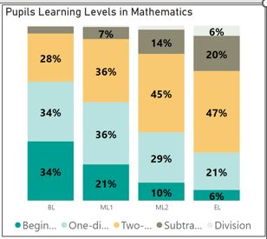
HBL Study Pupils & all AL Pupils – Maths Endline Results
HBL Pupils
All PAL Learners
Fewer HBL pupils at beginner level
in baseline assessment: 20% & 34%
Smaller proportion of HBL & AL pupils at beginner level by endline: 1 in 100 HBL pupils & 1 in 17 AL ones
10 pp more HBL pupils & AL ones
at endline who can at least identify
two-digit numbers: 83% & 73%
5 pp more HBL pupils can do 2x2 subtractions as minimum: 31% & 26%
2 pp more HBL than AL pupils who can solve 2x2 division tasks: 8% & 6%

Slide 20
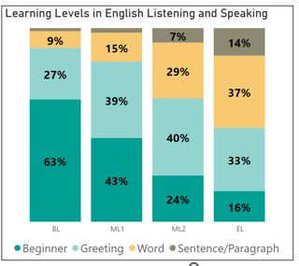
HBL Study Pupils & all AL – English Listening & Speaking
HBL Study Pupils
All PAL Pupils
Broadly similar performance levels at baseline
Greater drop by endline in HBL
Vs AL pupils at beginner level: reduction of 58 pp & 47 pp
3 pp more AL pupils at endline can at least answer short questions about themselves
(Word Level): 51% AL & 48% HBL
3 pp more AL pupils able to give an extended response in a short dialogue (Sentence / Para. Level): 14% AL & 11% HBL

Slide 21
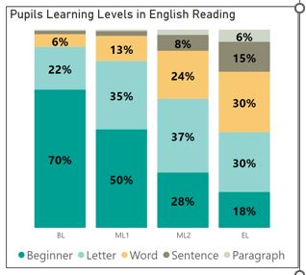
HBL Study Pupils & all AL – English Reading EL Results
HBL Study Pupils
All PAL Learners
Larger proportion of beginners at baseline in HBL Study Group:
81% HBL & 70% AL
Despite this, a higher drop in HBL pupils at the beginner level by endline assessment: HBL down 65 pp & AL drop of 52 pp
No difference in the proportion of pupils who can read sentences as a minimum at endline: 21% in each group
Only 1 pp more AL pupils able to read a paragraph by endline: 6% AL & 5% HBL

Slide 22
What do these HBL study pupils' results tell us?
Have pupils overall performed significantly better? - Yes
Does gender improve performance? - We found no significant differences in results between girls and boys at baseline, midline 1, midline 2 or endline (other than one isolated case at midline 1).
Did all grades improve significantly from baseline to endline? Yes

Slide 23
Summary
Comparison of results from Baseline, Midline and Endline Assessments suggests that
Combining TaRL activities at school with home-based learning has a positive effect in boosting progression of pupils’ foundational skills across all three subjects.
This effect is particularly evident during the first six months of Accelerated Learning, which period represents three-quarters of the total intervention time.
By Midline 2 (March 2023), HBL support to Hausa, Maths and English, is associated with a significantly higher progression rate of 10 pp on the part of HBL study pupils compared with all P4 – P6 pupils who are taking part in Accelerated Learning.
By Endline (July 2023), this effect had reduced by 7 pp, though HBL study pupils were still ahead of their AL peers at most levels in Maths and at the highest level in Hausa (story reading). There were also proportionately fewer HBL pupils at beginner’s level in all subjects by endline (cf AL pupils overall), in some cases significantly so.

Slide 24
CASE STUDIES

Slide 25
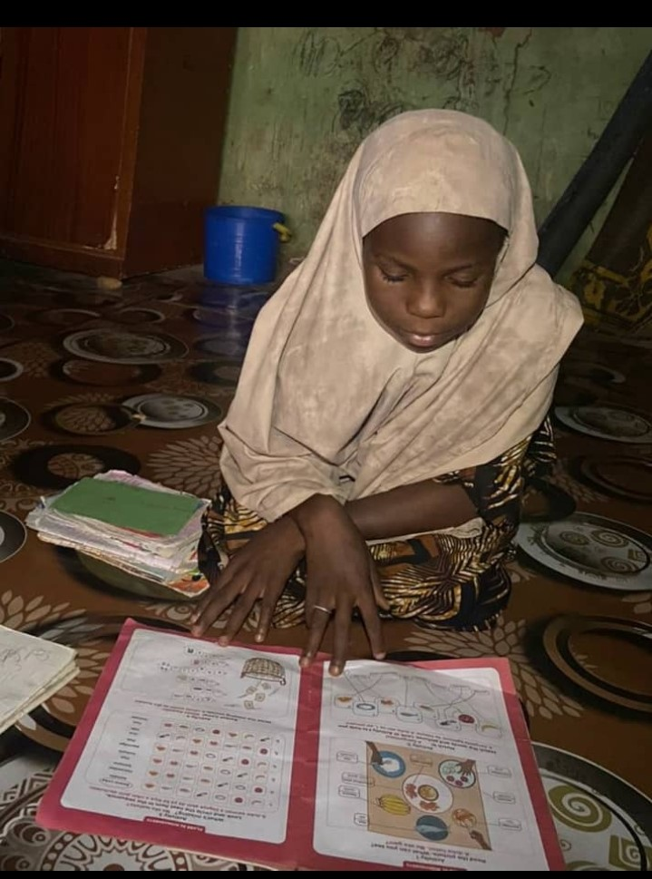
Case Study One
Rahma Sunusi: P4 pupil at Sabon Layi PS
Enjoys learning through HBL Resources
Has the support of her whole family
Her mother loans her phone for HBL and ensures Rahma has enough time to learn
“My listening to and working with the SD content is what helps me learn to read and write. I understand the stories and answer the questions following them”.

Slide 26
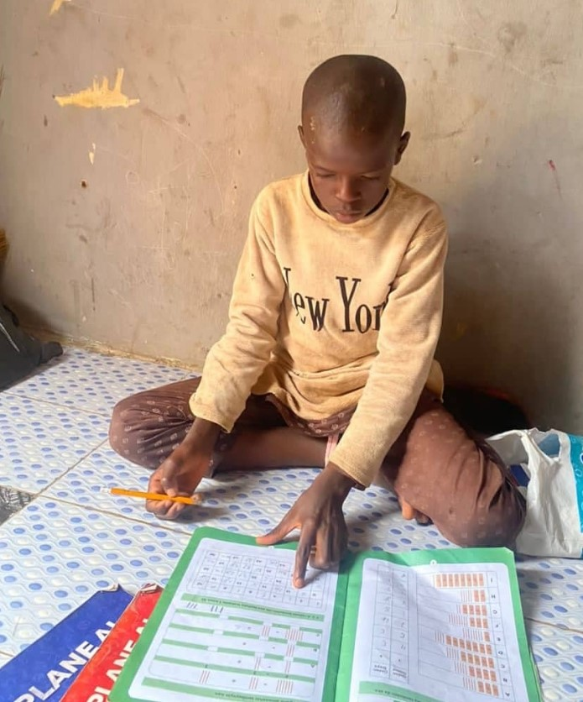
Case Study Two
Nabil Yusuf: P4 at Badume S&M PS
Actively participates in and enjoys using the HBL resources.
His mother ensures he has time to engage the content, while an older
sister supports his study by checking his completed worksheets and exercises
“I’m very happy. Nabil almost always used not to be at home; but with this learning resource he now stays at home and even helps in running
some errands after studying’’.

Slide 27
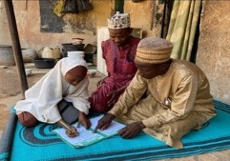
Case Study Three
Fatima Auwal: P5 pupil at Sabon Layi PS
Enjoyed the support of her mother whom she tragically lost halfway through the HBL Programme.
Learning support was taken over by her father and the Volunteer Teacher
“I wish to become a teacher like my father. I’m glad to be a part of the learning programme; I’ve learned
so many things and am very happy’’.

Slide 28
Challenges and Way Forward

Slide 29
What was challenging
Solutions
  Attendance and Punctuality:
  Are students attending enough PLANE-AL classes?
  In rural areas, attendance was affected by heavy rainfall and the farming season
  Inadequate and/or dilapidated school structures often led to congested classrooms and/or discourage pupils from coming to schools regularly
  Migration of pupils especially from Nomadic Schools during the raining season – Bunkure and Warawa highly affected.
  About 54% of classes observed started late because of issues with teachers/pupils’ punctuality.
Engaged with SBMCs and PTAs
Raise issues with the members of the SBMC and PTA, who have direct influence with the community and the government
1
Townhall Meetings
Series of sensitization meetings were held with parents and community leaders to discuss issues around enrollment and attendance. The meeting received active participation and feedback.
2
3
Created channels of dissemination
In some communities, announcements were made through loudspeakers after prayers to emphasize on the importance of pupils’ attendance

Slide 30
What was challenging
Solutions
  Tracking and Progression:
  Are teachers shifting children as they are making progress?
  Teachers do not pay particular attention to individual learners to note when they are making progress.
  As a result of:
  Low capacity of teachers to understand when learning has taken place
  High pupil to teacher ratio
  Congested classes in some schools which affected classroom management.
  Some teachers didn’t understand that they didn’t have to wait until midline before shifting children to a higher level.
  Low capacity of teachers themselves to handle higher level activities
More focus on Higher Level Activities, Tracking and Progression during refresher training.
During refresher trainings, more emphasis was given to higher level activities and teachers were asked to demonstrate progression using scenarios and as such better improvement at the endline.
1
2
Improved Mentoring Support
MTs and Mentors were encouraged to provide support to teachers to support those who were unable to make session plans.
3
Monitoring
Head Teachers provided more school based support to teachers.

Slide 31
What was challenging
Solutions
  Teachers Motivation and Economic Factor:
  Are teachers motivated and did they make the best use of the class time?
  Teachers do not feel motivated to conduct activities, while few prepare session plan before the class. As a result, they often
  went to school late/ started activities late
  underutilized the time available,
  failed to conduct activities effectively.
  Cash crunch, fuel crisis, and inflation in the country further exacerbated teachers’/mentors’ demotivation.
Self-Reflection for Teachers
During refresher trainings, teachers were made to understand the importance of learning time and proper planning ahead of classes.
1
Remote Monitoring
Mentors and Head Teachers were trained and supported on how to carry out remote mentoring through provision of airtime.
2

Slide 32
Discussion and Recommendation

Slide 33
Looking Ahead
Small incentives like school feeding have proven to improve attendance. What alternatives could be explored to improve pupils’ attendance and punctuality throughout the session?
About 31% of P6 could not read words while 20% could not recognize 2-digit numbers. How do we ensure this set of pupils catch up in junior secondary school?
How do we support mentors (esp. SSOs) to continue effective school monitoring and mentoring visits at times of economic hardships?

Slide 34
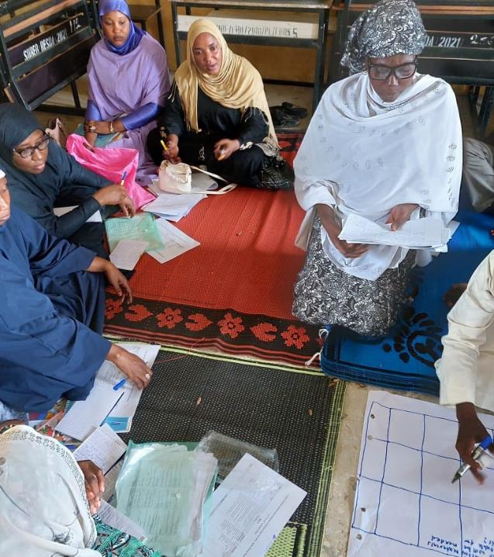
Thank You

