Slide 1


ESTIMATING LEARNING POVERTY LEVEL IN KADUNA STATE
PRESENTED BY
KADUNA STATE BUREAU OF STATISTICS

Slide 2
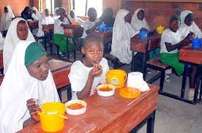
INTRODUCTION
Learning Poverty implies to the inability of children to read and understand a short, age-appropriate text by age 10 (or latest by the end of Primary School).
LP is usually measured by the Learning Poverty Indicator (LPI).
The LPI is based on two data sources, schooling deprivation (SD) and learning deprivation (LD).

Slide 3

LPI MEASUREMENT
The LPI is calculated with the following formula:
Where:
LPI = Learning Poverty
SD is defined as the proportion of primary aged children who were out-of-school. All out-of-school children were assumed to be below the MPL in reading.
LD is defined as the proportion of children at the end of Primary School who read at below the MPL, as defined by the Global Alliance to Monitor Learning (GAML) in the context of the SDG 4 monitoring.

Slide 4
RESEARCH QUESTIONS
What is the extent of Learning Poverty among basic school pupils in Kaduna State?
What were the main factors responsible for Learning Poverty in Kaduna?
What were the viable policy options to address Learning Poverty in Kaduna State?

Slide 5
OBJECTIVE OF THE RESEARCH
The broad objective of the research is to provide information on the extent of Learning Poverty in Kaduna State to guide policy designs, implementation, monitoring, quality assurance and education planning in general. More specific objectives include.
Determine the extent of Learning Poverty among Primary School pupils in Kaduna State.
Identify the main factors responsible for Learning Poverty in Kaduna.
Suggest viable policy options to address Learning Poverty in Kaduna State.

Slide 6
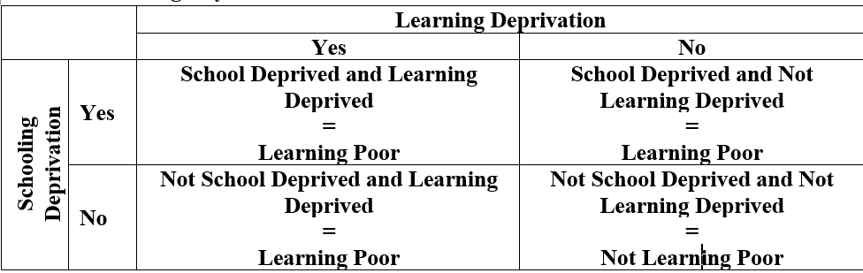
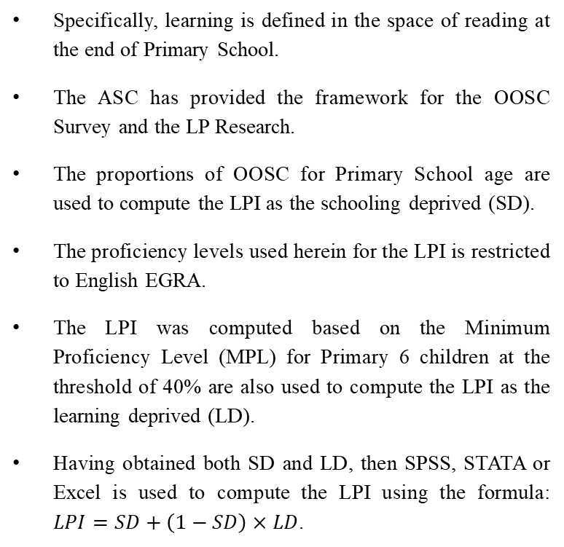
METHODOLOGY
This Learning Poverty research is typically a meta-analysis which pooled data from three diverse sources. In particular, data were pooled from Annual School Census (ASC), out-of-school children (OOSC) Mapping and the Learning Outcome Assessment.
Specifically, learning is defined in the space of reading at the end of Primary School.
The ASC has provided the framework for the OOSC Survey and the LP Research.
The proportions of OOSC for Primary School age are used to compute the LPI as the schooling deprived (SD).
The proficiency levels used herein for the LPI is restricted to English EGRA.
The LPI was computed based on the Minimum Proficiency Level (MPL) for Primary 6 children at the threshold of 40% are also used to compute the LPI as the learning deprived (LD).
Having obtained both SD and LD, then SPSS, STATA or Excel is used to compute the LPI using the formula: $LPI=SD+\left(1−SD\right)×LD$.
Contingency Table of SD, LD and LP

Slide 7
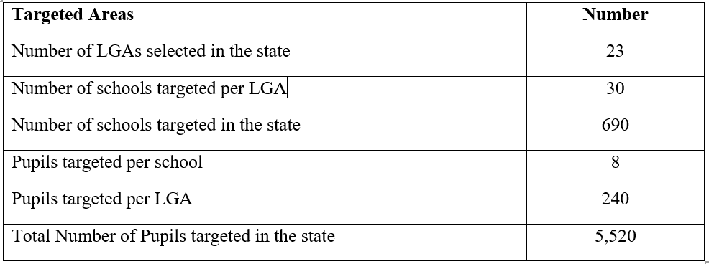
SAMPLE DESIGN FOR LEARNING ASSESSMENT

Slide 8
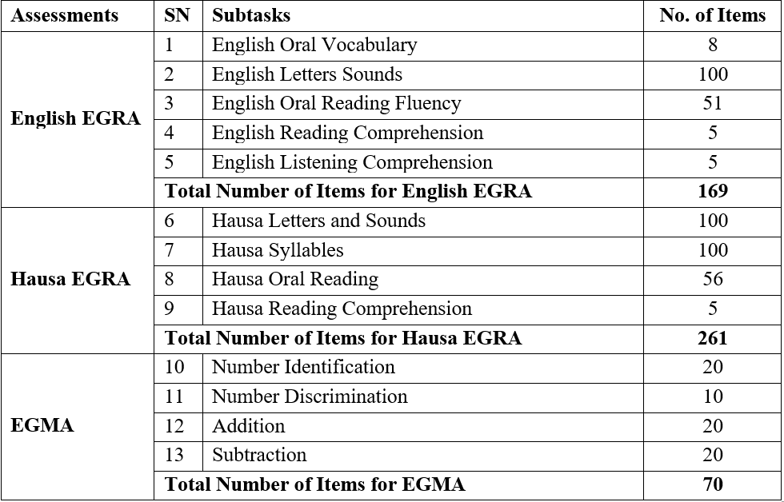
LEARNING ASSESSMENT SUBTASK
For each subtask, proficiency scores were calculated separately; thus, the results of the assessment will be first analyzed without reference to external benchmarks, and subsequently mapped on the proficiency levels defined in the Global Proficiency Framework.

Slide 9
SELECTION OF ENUMERATORS
A 4-days training was conducted for the enumerators, precisely, from 15th -18th November, 2022.
The training was based on a comprehensive agenda.
The training conducted a practice test in non-sampled schools.
During each school visit, enumerators practiced on pupils individually.
The Inter-Rater Reliability (IRR) test was conducted which was used to select the final enumerators.
The enumerators engaged for the LP research were drawn from State education institutions, in particular the State Universal Basic Education Board (SUBEB), LGEAs and KDBS after meeting the following selection criteria to participate in the training:
  Able to read and speak English language fluently,
  Able to read and speak Hausa language fluently,
  Able to read use electronic devices,
  Has experience in research and data collection processes.

Slide 10
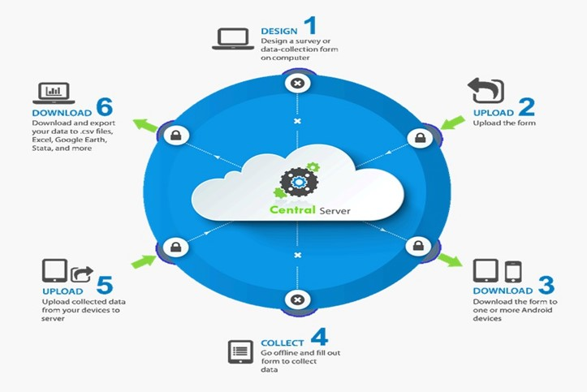
DATA CYCLE

Slide 11
KEY FINDINGS

Slide 12
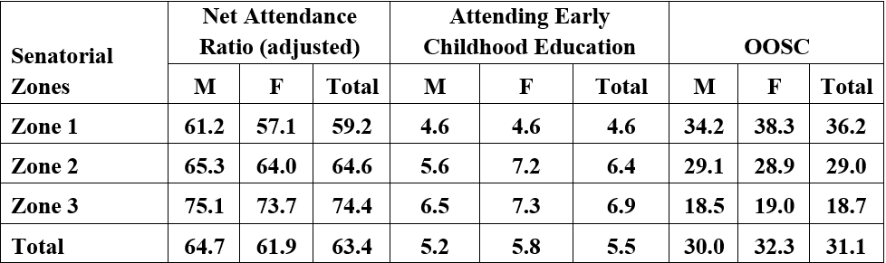
OUT OF SCHOOL CHILDREN
The major findings have revealed the status of OOSC for Primary School age (6-11 years) across the 23 LGAs of Kaduna State. At State level, the report shows that the overall percentage of OOSC of Primary School age in Kaduna State 31.1%. By gender, the percentage out-of-school girls of Primary School age is 32.3% while that of boys is 30.0%.
By LGA, the report shows that Kauru LGA has the highest percentage of OOSC of Primary School age of 51.8%, followed by Birinin Gwari with 48.3%, among others. On the other hand, Kaura LGA has the least percentage of OOSC of Primary School age of 0.9%, followed by Zangon Kataf with 2.0%, among others.
Percentage of Primary School Attendance and OOSC by Zones

Slide 13
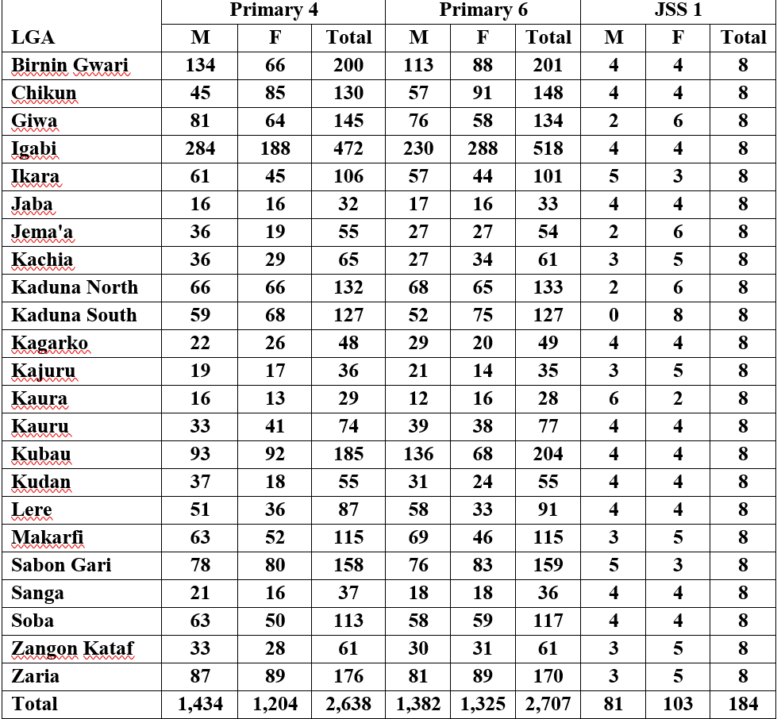
ASSESSMENT OF LEARNING OUTCOME:
Number of children assessed

Slide 14
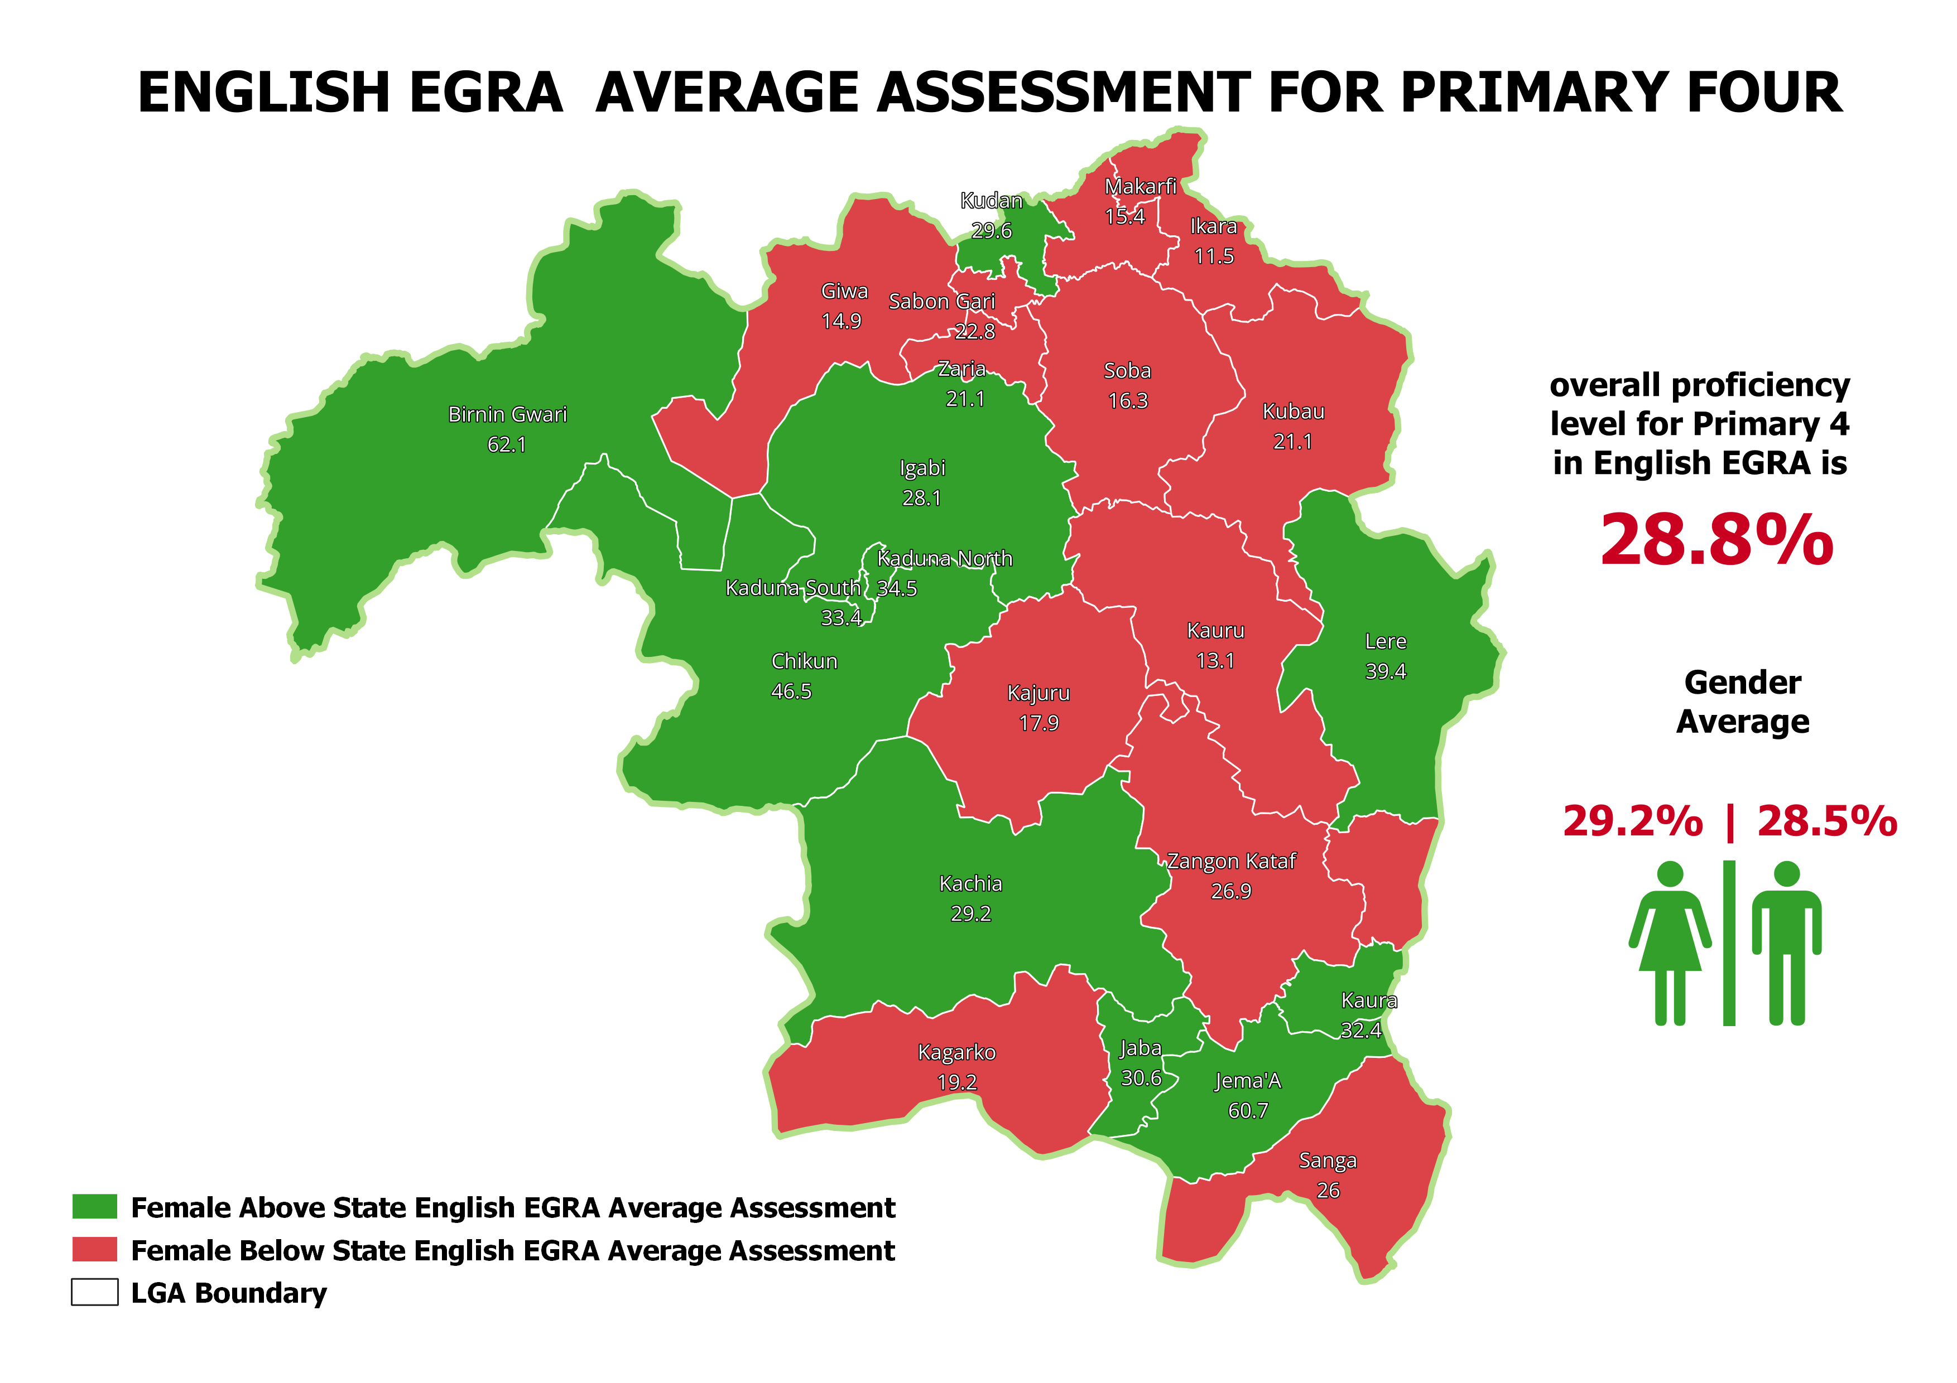
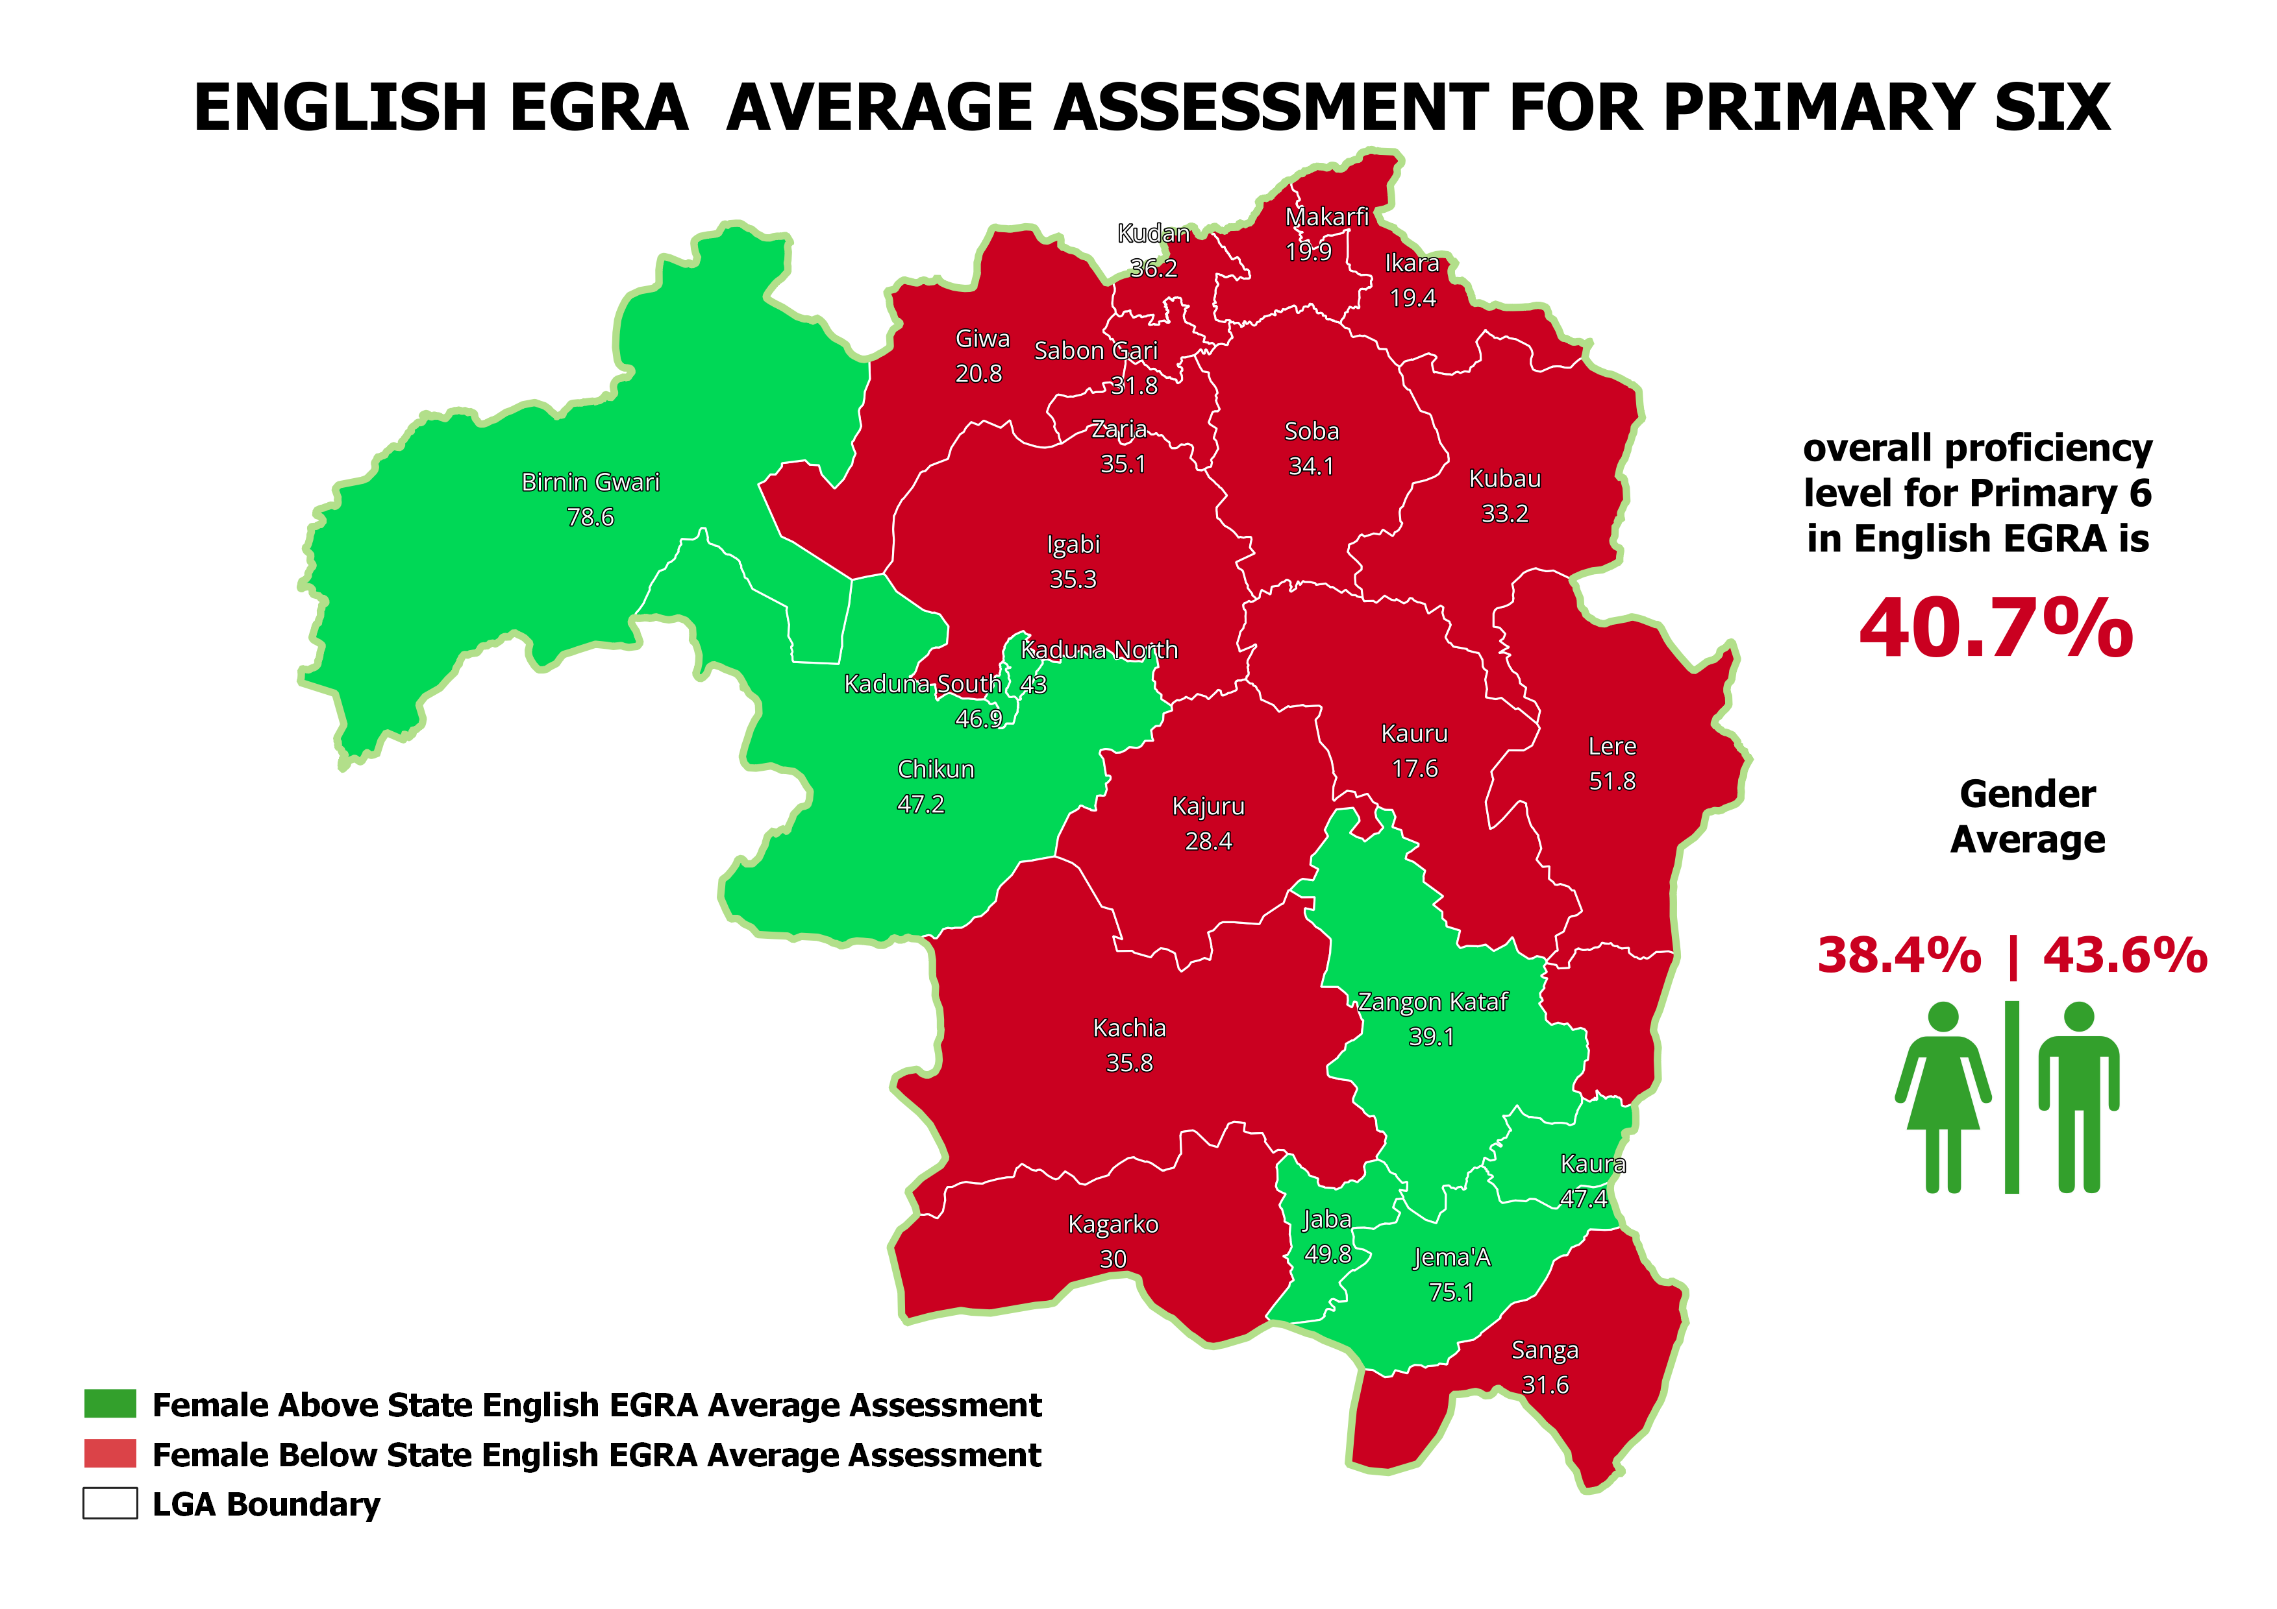
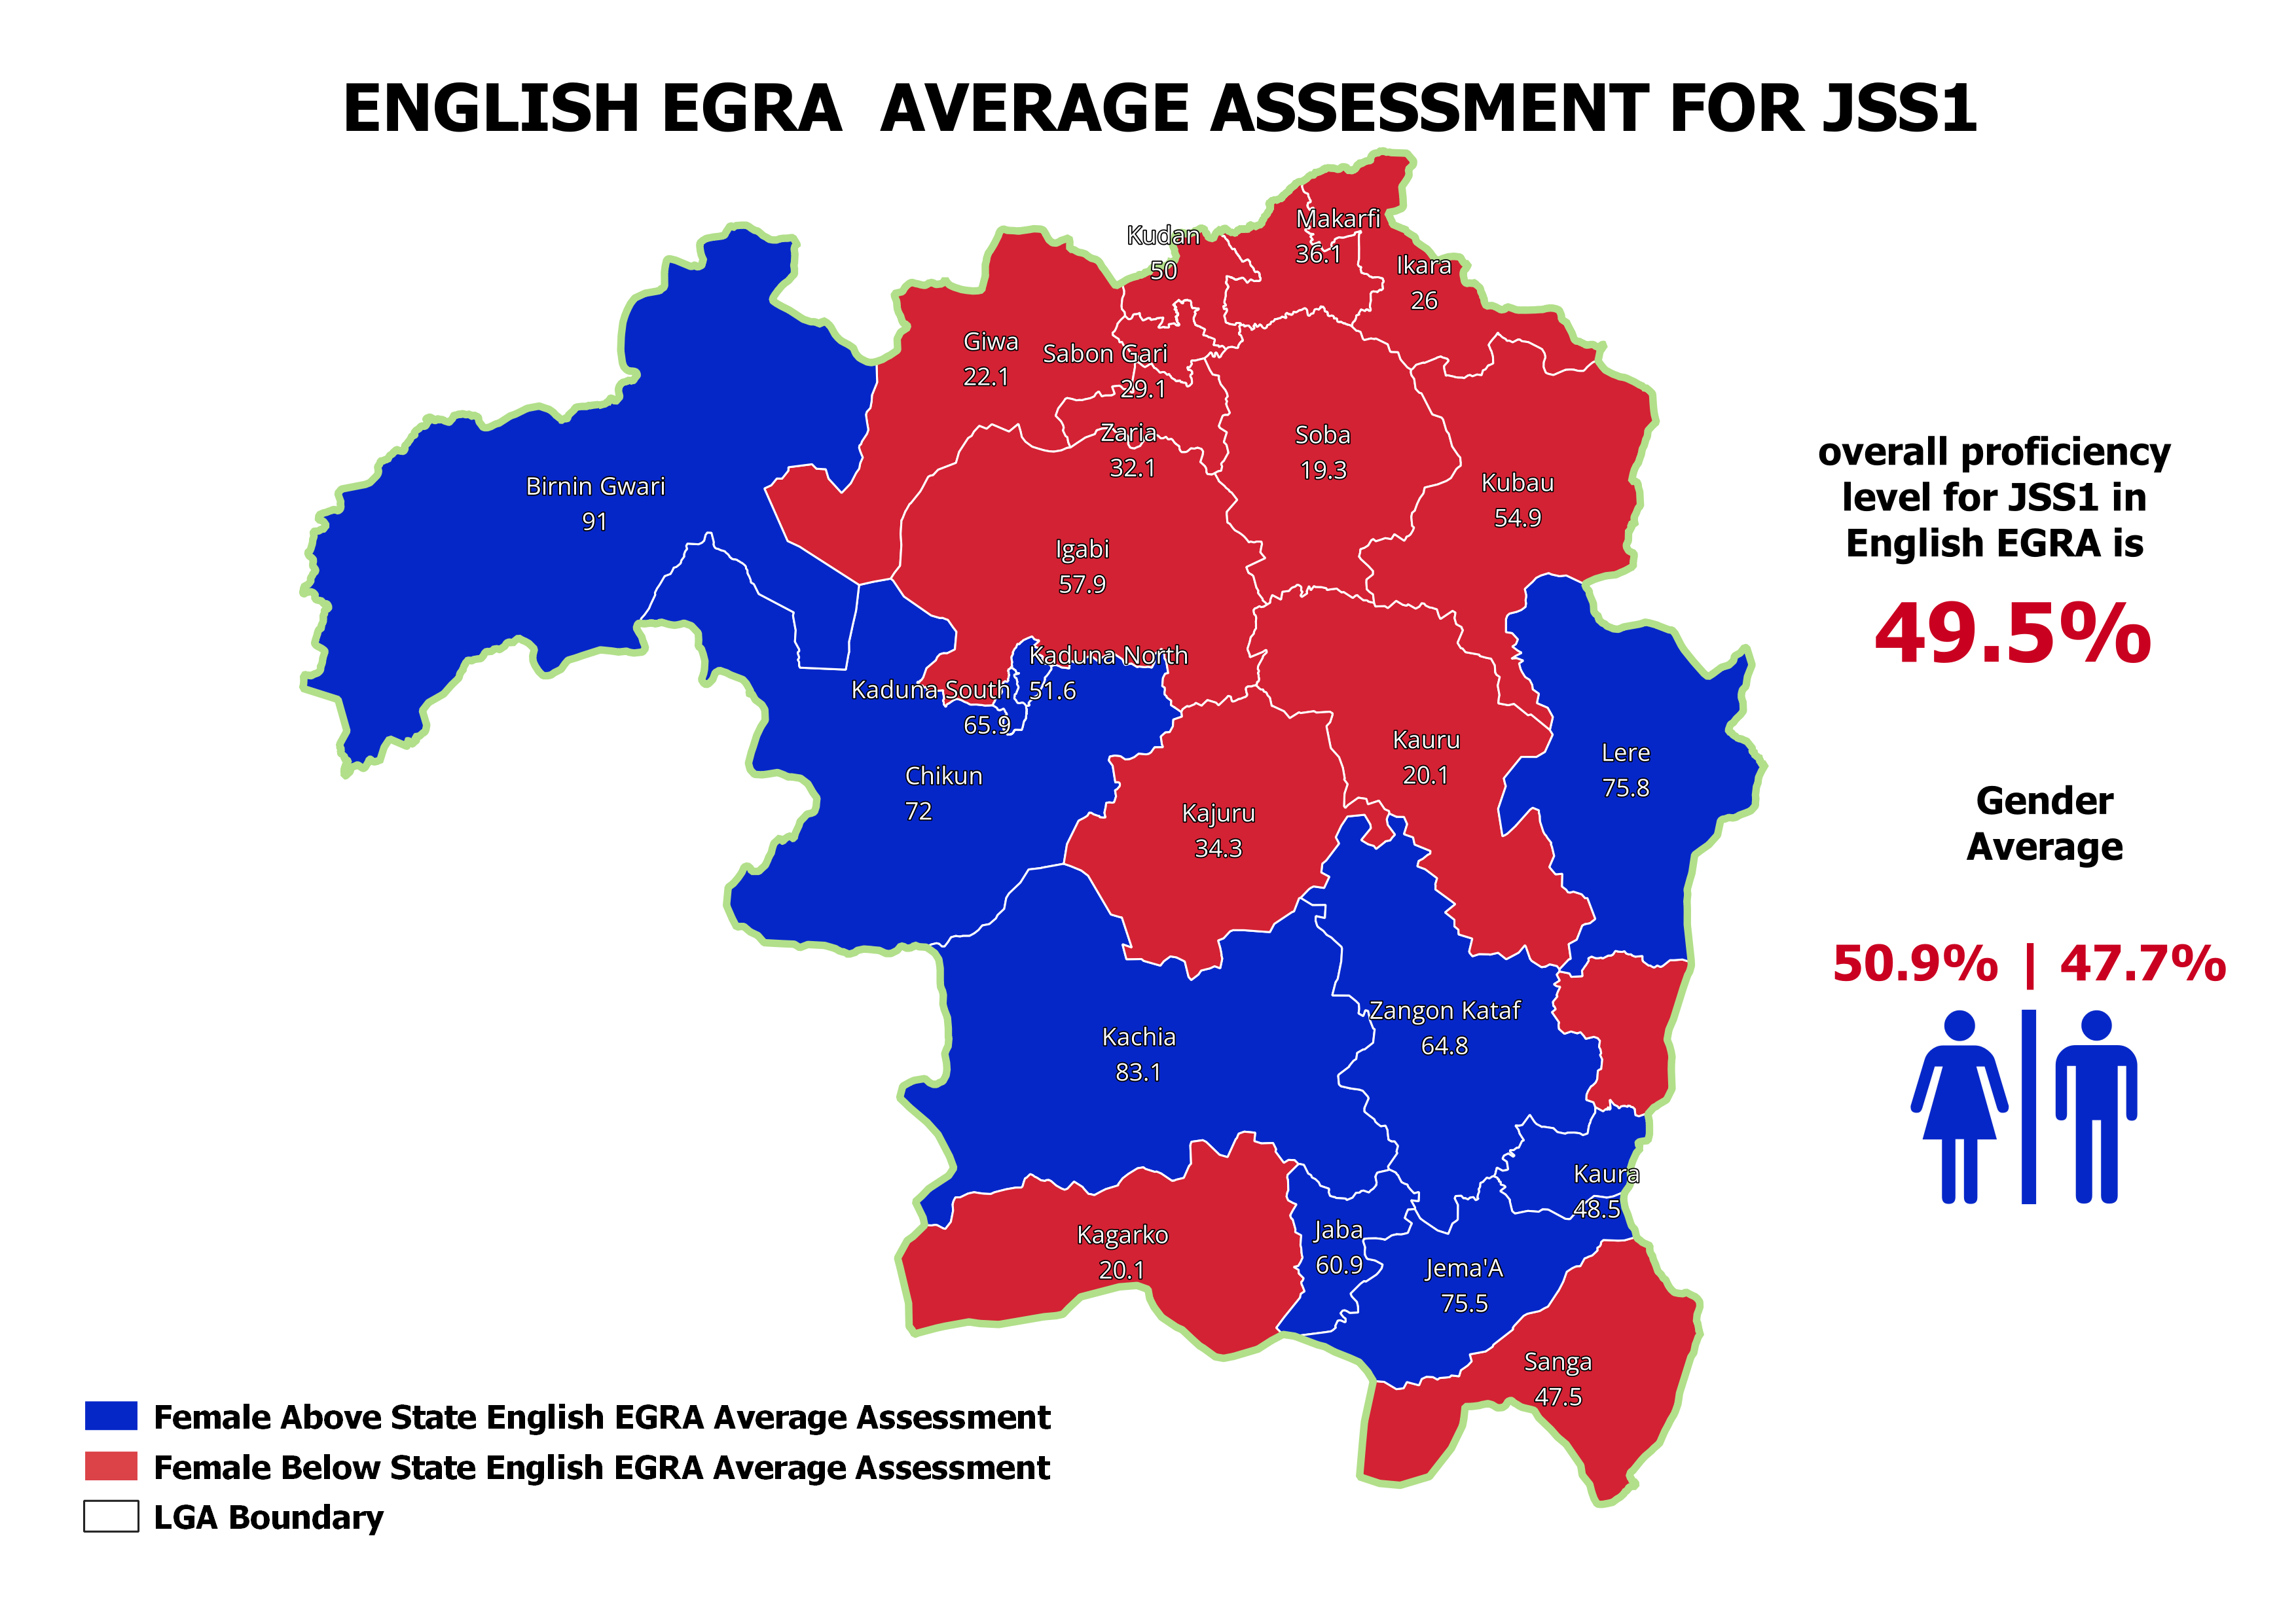
EGRA ENGLISH AVERAGE ASSESSMENT RESULT

Slide 15
English EGRA Average Assessment
LGA | Pri4 | Pri6 | JS1
Birnin Gwari | 62.1 | 78.6 | 91
Chikun | 46.5 | 47.2 | 72
Giwa | 14.9 | 20.8 | 22.1
Igabi | 28.1 | 35.3 | 57.9
Ikara | 11.5 | 19.4 | 26
Jaba | 30.6 | 49.8 | 60.9
Jema'a | 60.7 | 75.1 | 75.5
Kachia | 29.2 | 35.8 | 83.1
Kaduna North | 34.5 | 43 | 51.6
Kaduna South | 33.4 | 46.9 | 65.9
Kagarko | 19.2 | 30 | 20.1
Kajuru | 17.9 | 28.4 | 34.3
Kaura | 32.4 | 47.4 | 48.5
Kauru | 13.1 | 17.6 | 20.1
Kubau | 21.1 | 33.2 | 54.9
Kudan | 29.6 | 36.2 | 50
Lere | 39.4 | 51.8 | 75.8
Makarfi | 15.4 | 19.9 | 36.1
Sabon Gari | 22.8 | 31.8 | 29.1
Sanga | 26 | 31.6 | 47.5
Soba | 16.3 | 34.1 | 19.3
Zangon Kataf | 26.9 | 39.1 | 64.8
Zaria | 21.1 | 35.1 | 32.1
Total | 28.8 | 40.7 | 49.5

Slide 16
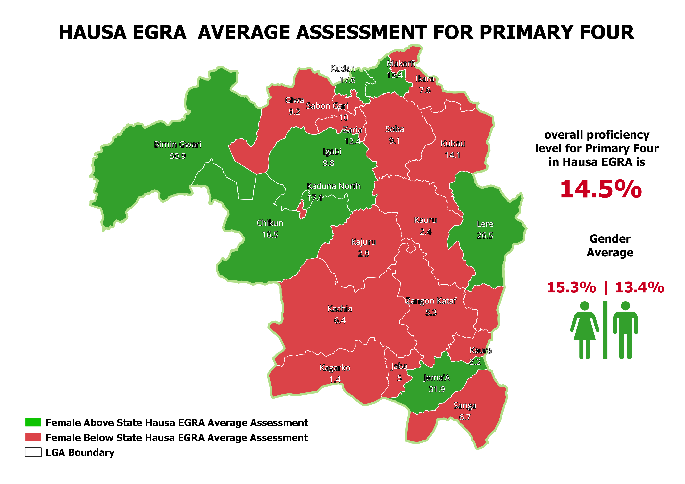
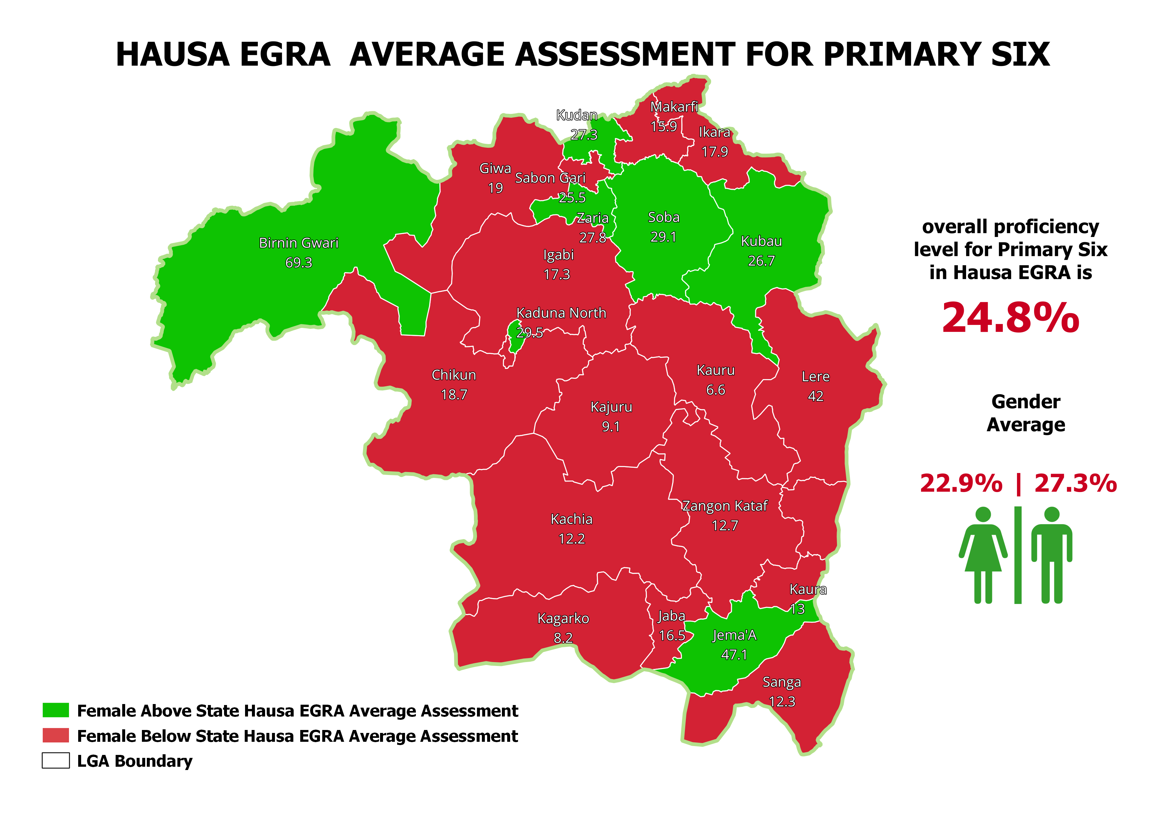
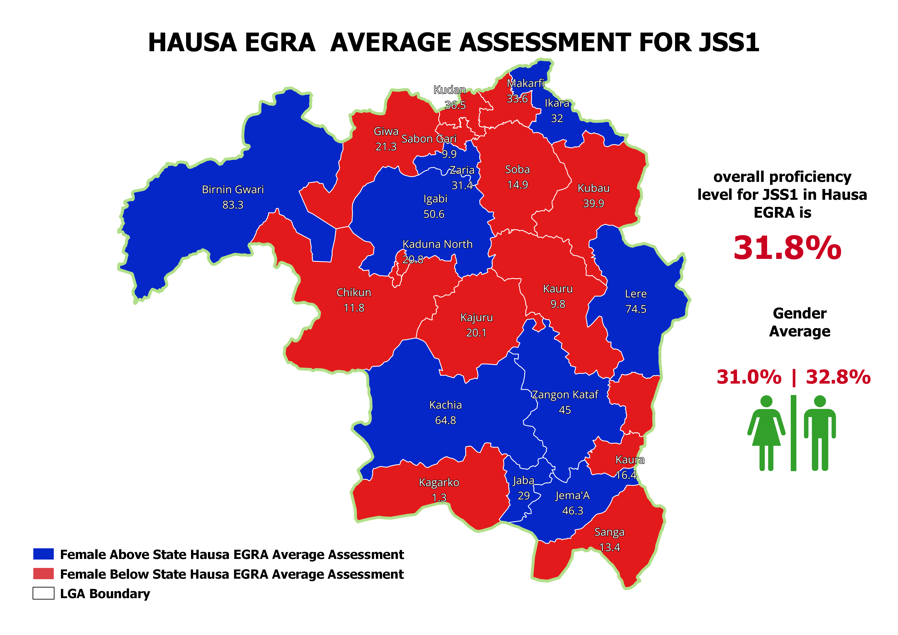
EGRA HAUSA AVERAGE ASSESSMENT RESULT

Slide 17
Hausa EGRA Average Assessment
LGA | Pri4 | Pri6 | JS1
Birnin Gwari | 50.9 | 69.3 | 83.3
Chikun | 16.5 | 18.7 | 11.8
Giwa | 9.2 | 19 | 21.3
Igabi | 9.8 | 17.3 | 50.6
Ikara | 7.6 | 17.9 | 32
Jaba | 5 | 16.5 | 29
Jema'a | 31.9 | 47.1 | 46.3
Kachia | 6.4 | 12.2 | 64.8
Kaduna North | 17.1 | 29.5 | 20.8
Kaduna South | 6.9 | 19.5 | 24.4
Kagarko | 1.4 | 8.2 | 1.3
Kajuru | 2.9 | 9.1 | 20.1
Kaura | 2.2 | 13 | 16.4
Kauru | 2.4 | 6.6 | 9.8
Kubau | 14.1 | 26.7 | 39.9
Kudan | 17.6 | 27.3 | 36.5
Lere | 26.5 | 42 | 74.5
Makarfi | 13.4 | 15.9 | 33.6
Sabon Gari | 10 | 25.5 | 9.9
Sanga | 6.7 | 12.3 | 13.4
Soba | 9.1 | 29.1 | 14.9
Zangon Kataf | 5.3 | 12.7 | 45
Zaria | 12.4 | 27.8 | 31.4
Total | 14.5 | 24.8 | 31.8

Slide 18
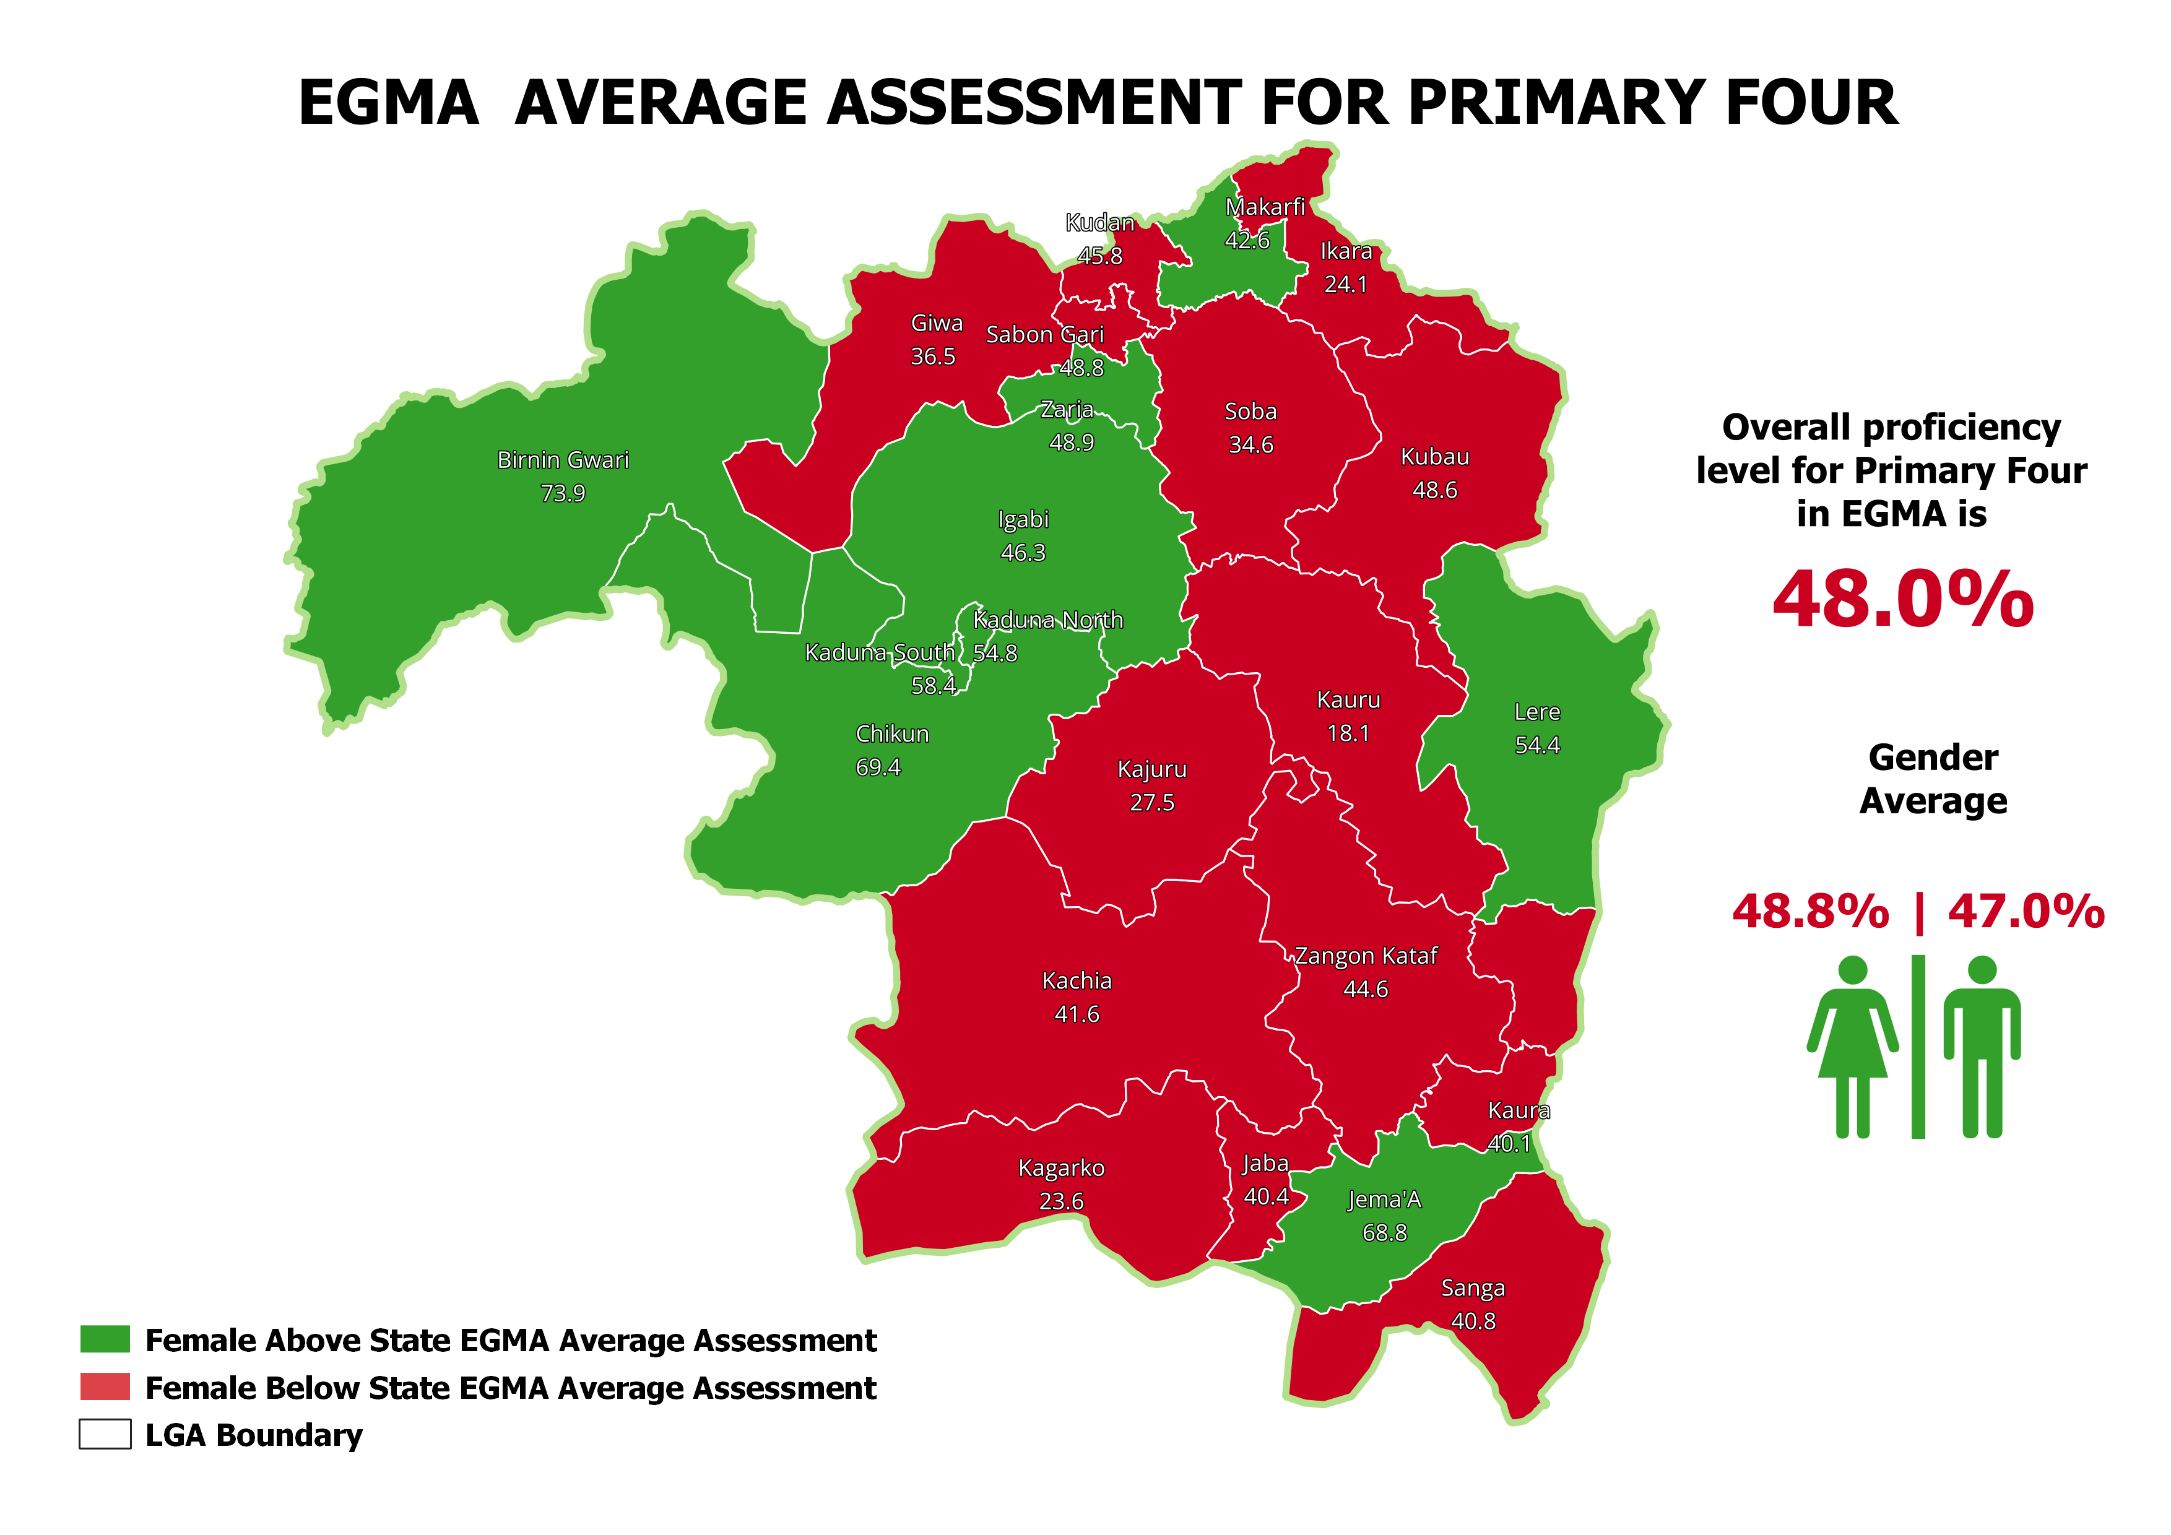
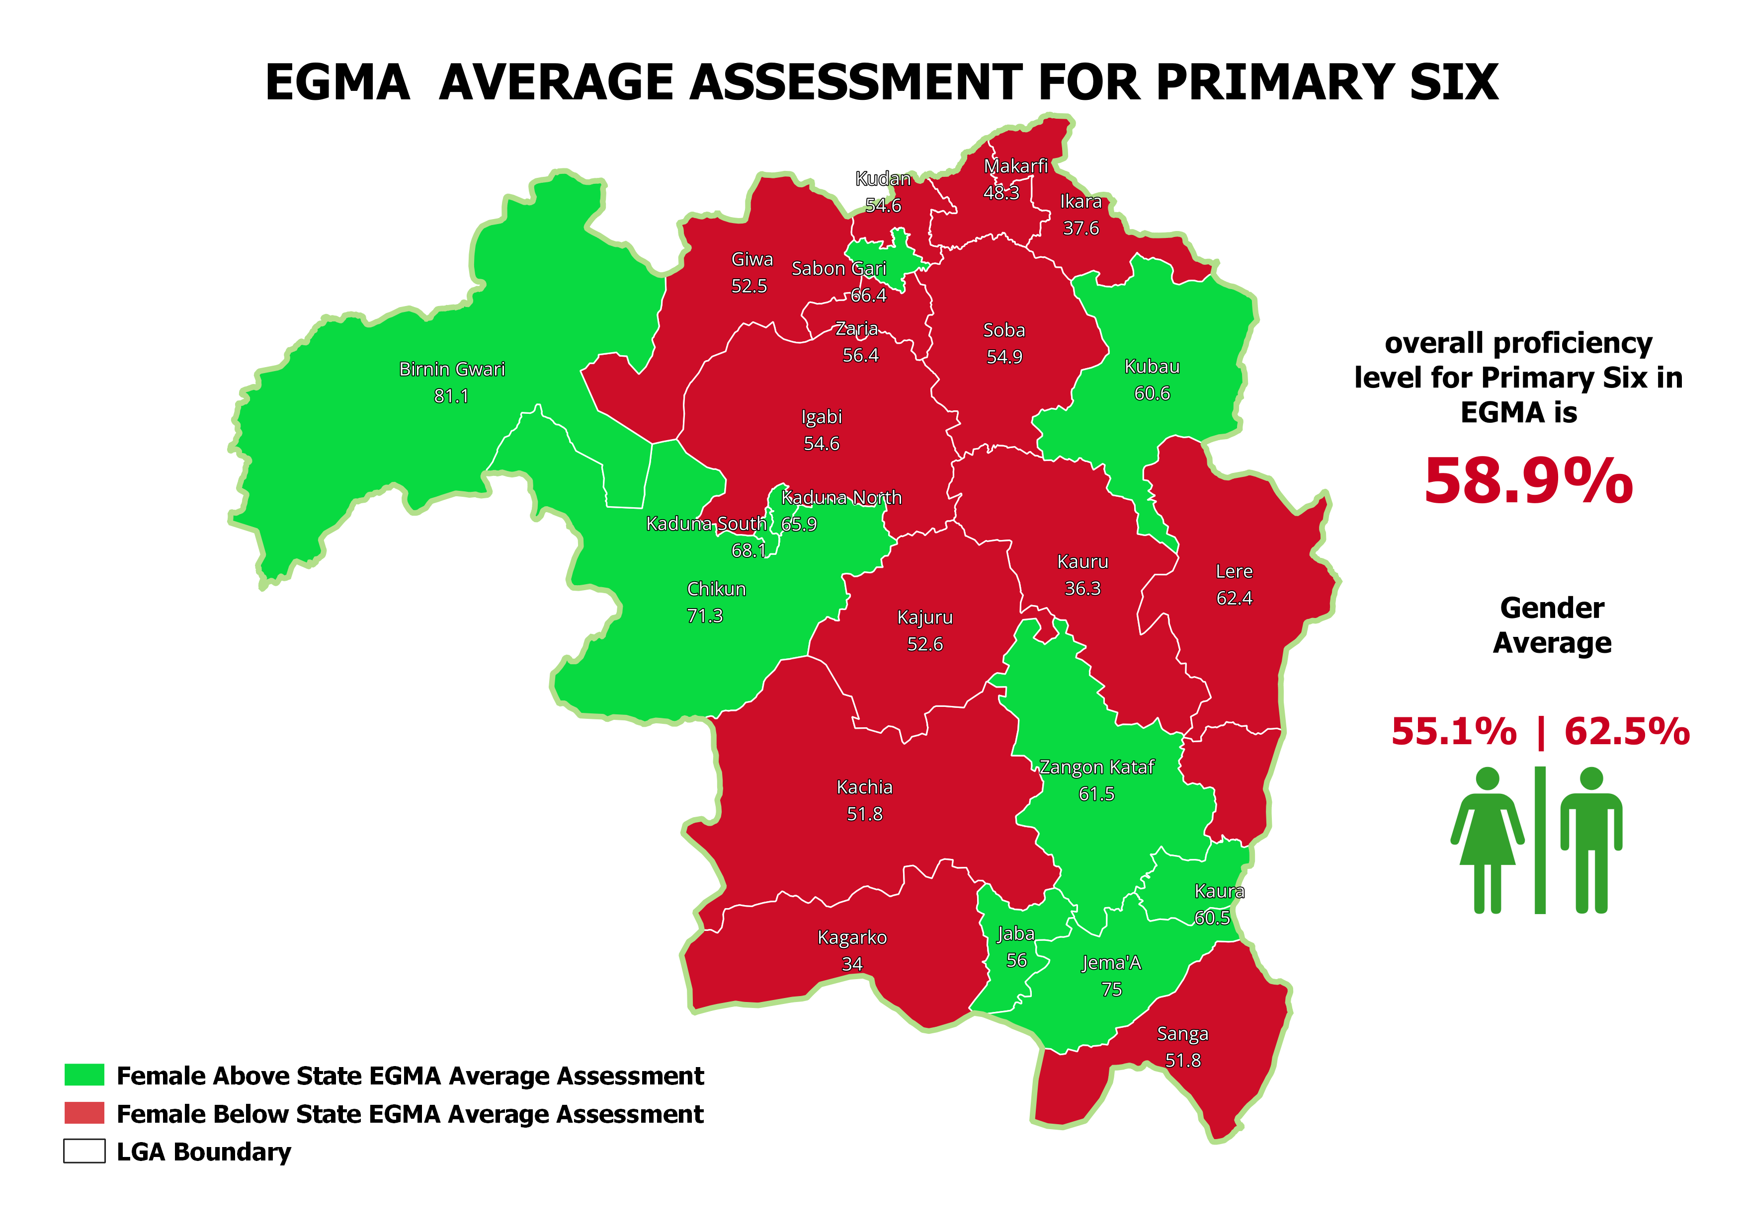
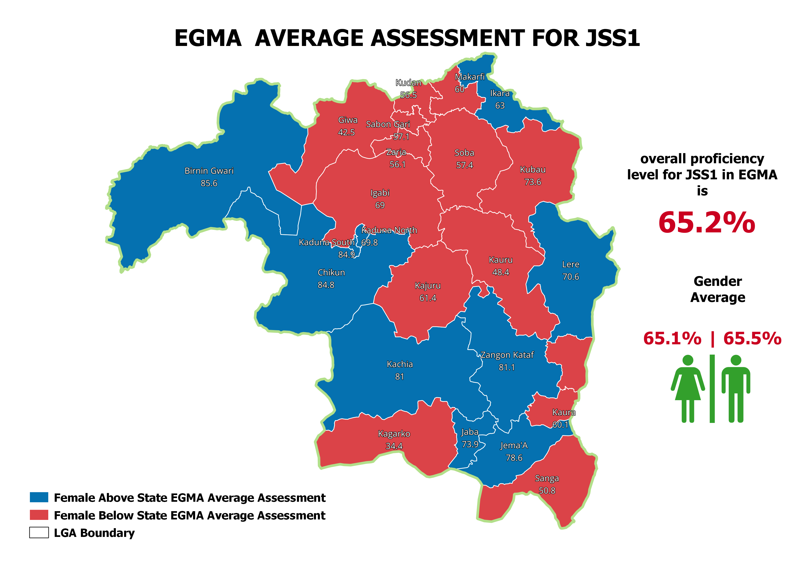
EGMA AVERAGE ASSESSMENT RESULT

Slide 19
EGMA Average Assessment
LGA | Pri4 | Pri6 | JS1
Birnin Gwari | 73.9 | 81.1 | 85.6
Chikun | 69.4 | 71.3 | 84.8
Giwa | 36.5 | 52.5 | 42.5
Igabi | 46.3 | 54.6 | 69
Ikara | 24.1 | 37.6 | 63
Jaba | 40.4 | 56 | 73.9
Jema'a | 68.8 | 75 | 78.6
Kachia | 41.6 | 51.8 | 81
Kaduna North | 54.8 | 65.9 | 69.8
Kaduna South | 58.4 | 68.1 | 84.9
Kagarko | 23.6 | 34 | 34.4
Kajuru | 27.5 | 52.6 | 61.4
Kaura | 40.1 | 60.5 | 60.1
Kauru | 18.1 | 36.3 | 48.4
Kubau | 48.6 | 60.6 | 73.6
Kudan | 45.8 | 54.6 | 56.5
Lere | 54.4 | 62.4 | 70.6
Makarfi | 42.6 | 48.3 | 60
Sabon Gari | 48.8 | 66.4 | 57.1
Sanga | 40.8 | 51.8 | 50.8
Soba | 34.6 | 54.9 | 57.4
Zangon Kataf | 44.6 | 61.5 | 81.1
Zaria | 48.9 | 56.4 | 56.1
Total | 48 | 58.9 | 65.2

Slide 20
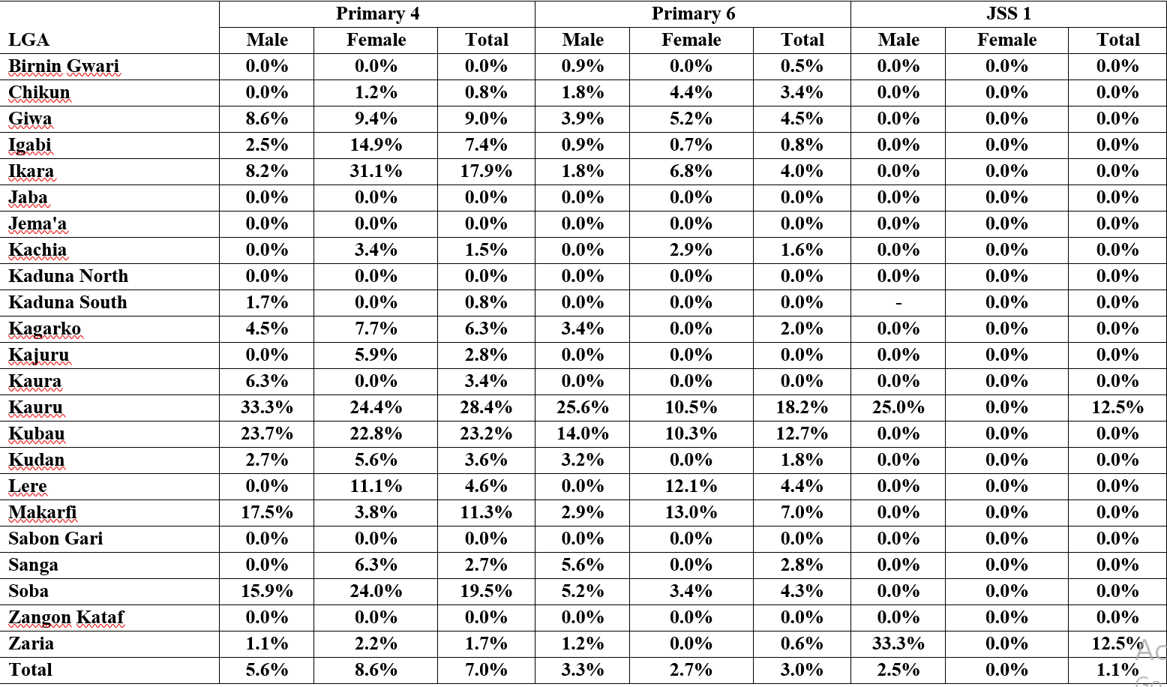
Percentage of Children with Zero Average Scores in English EGRA

Slide 21
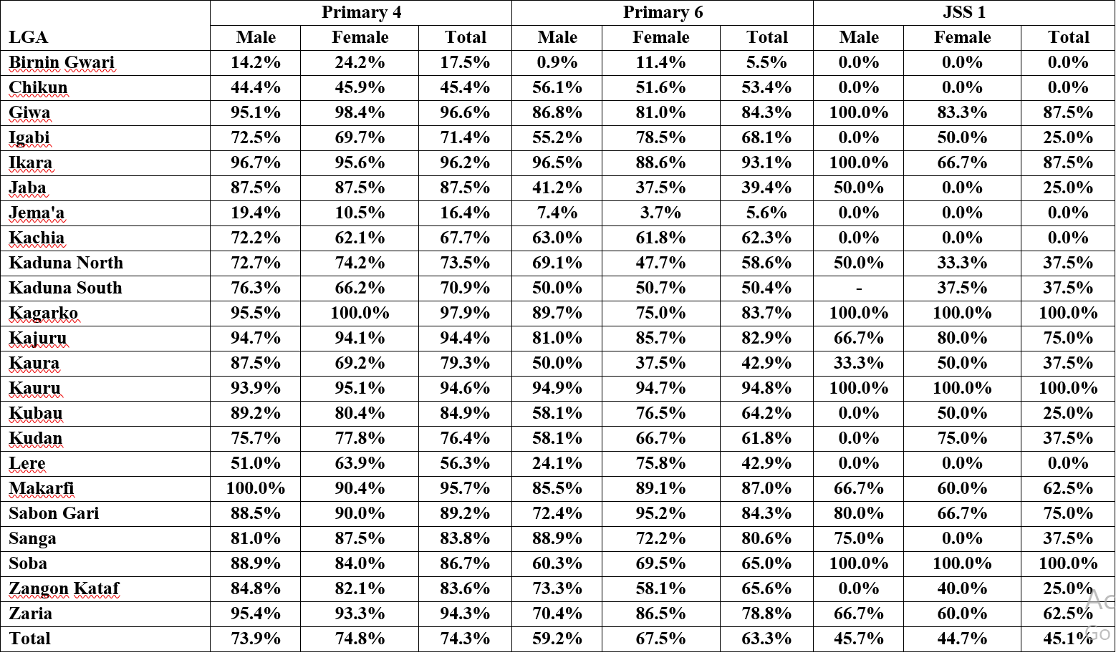
Percentage of Children with Average Scores Below MPL in English EGRA

Slide 22
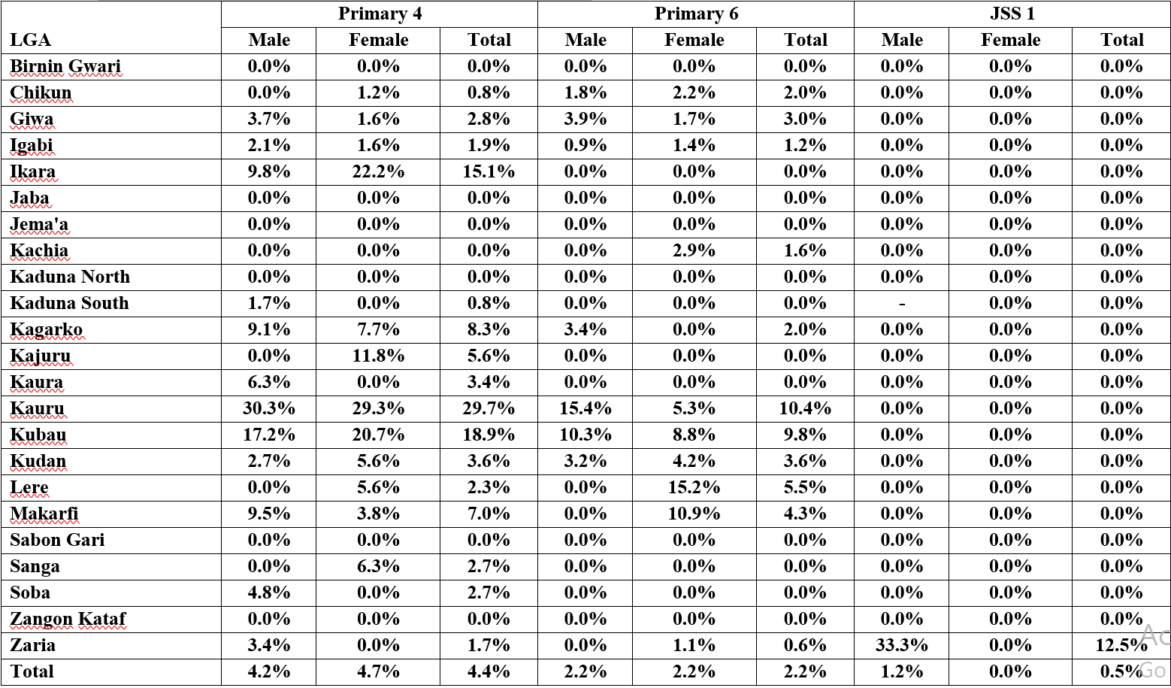
Percentage of Children with Zero Average Scores in EGMA

Slide 23
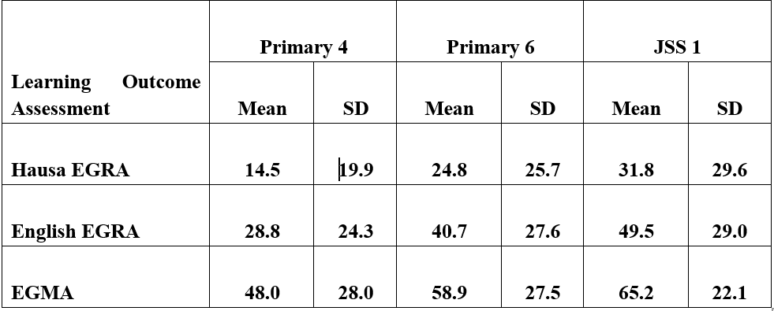
Comparison of English EGRA
A high standard deviation could suggest that there may be significant differences in student performance or abilities within the assessed population.
the student population being assessed is known to have diverse abilities or background characteristics, a standard deviation of 19 may be considered reasonable.

Slide 24
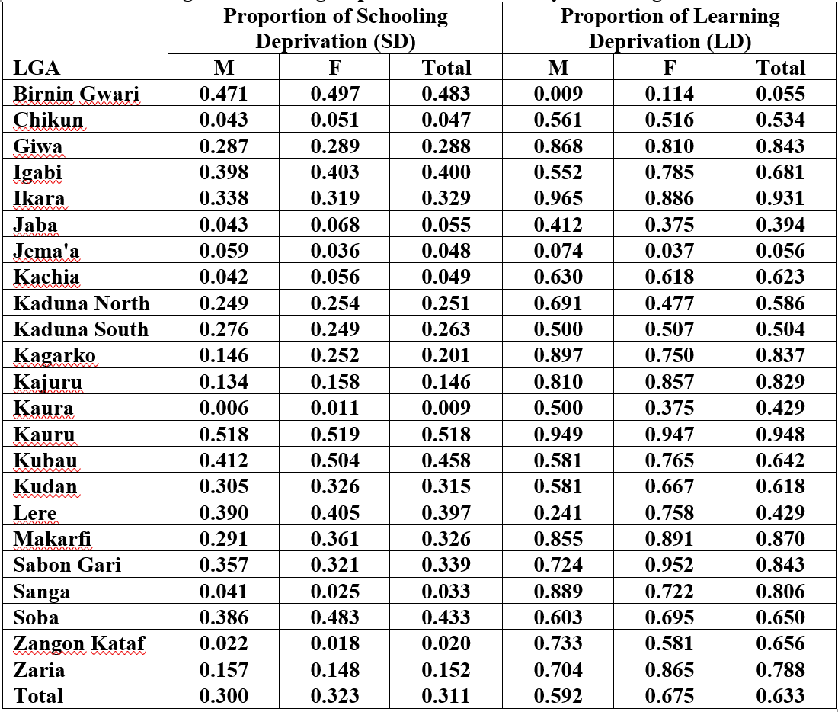
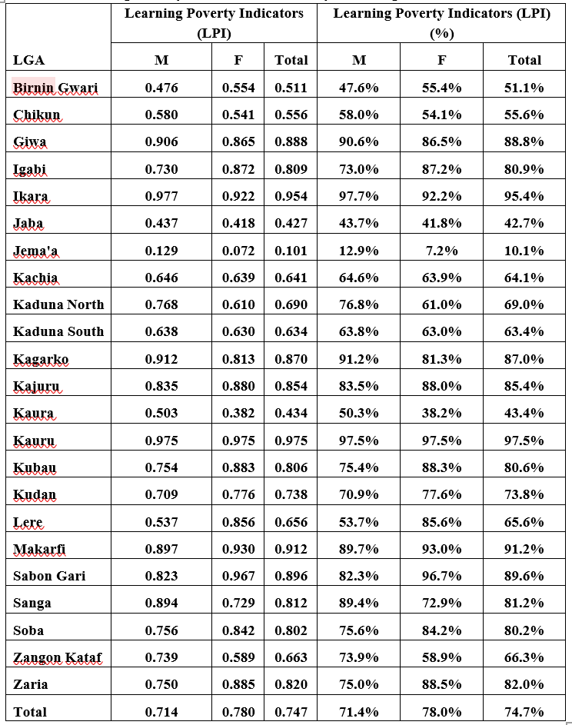
Proportions of Schooling and Learning Deprivation
Schooling and Learning Deprivation for Primary School Age
Learning Poverty Indicators for Primary School Age
The Learning Outcome Assessment used herein for the LPI was obtained through English EGRA for Primary 6 children using the MPL threshold of 40%.

Slide 25
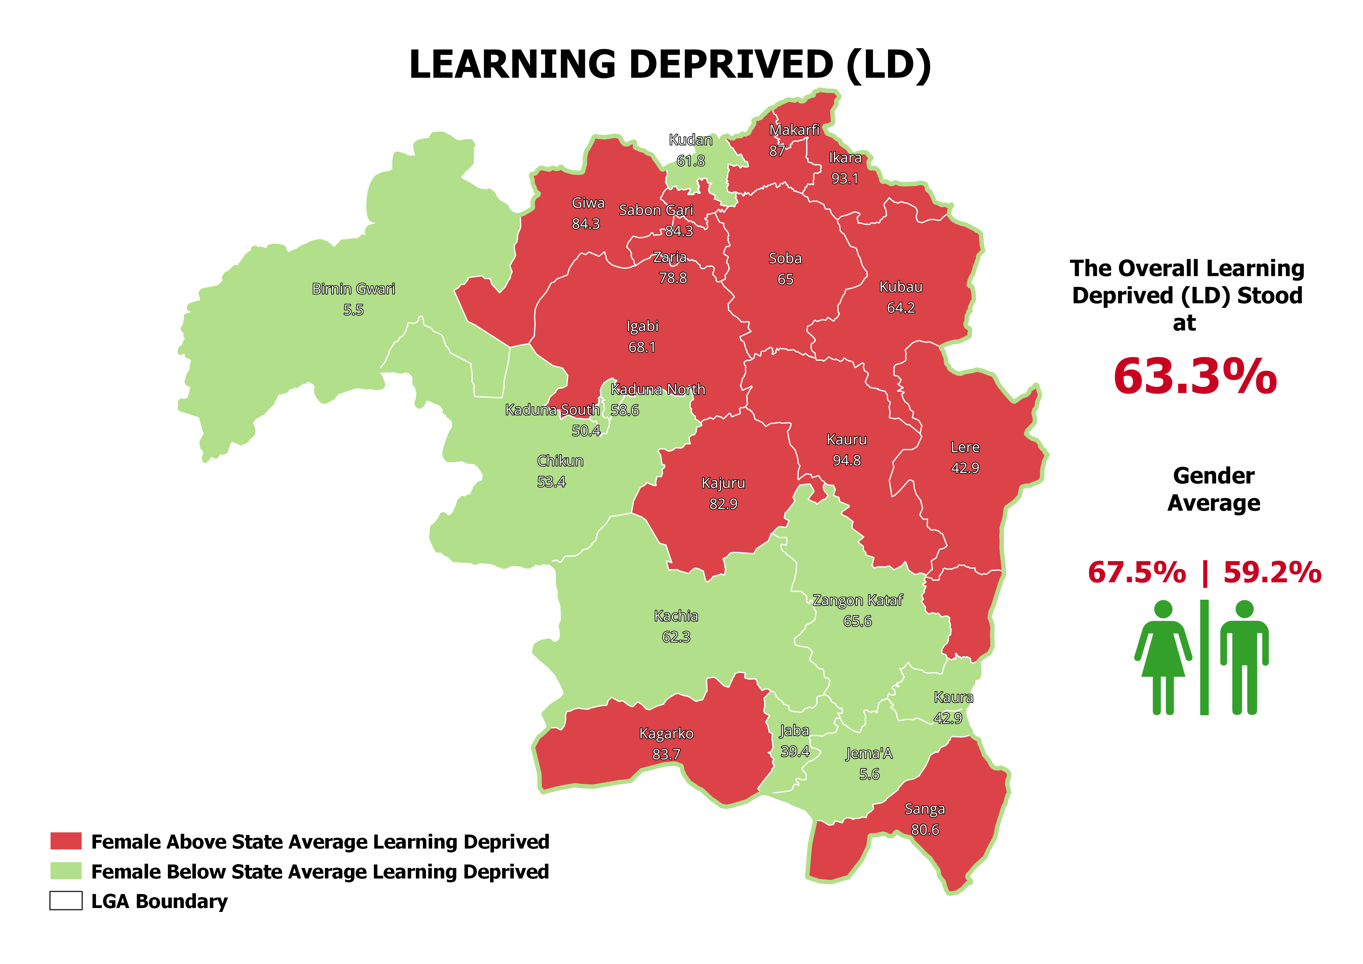

Slide 26
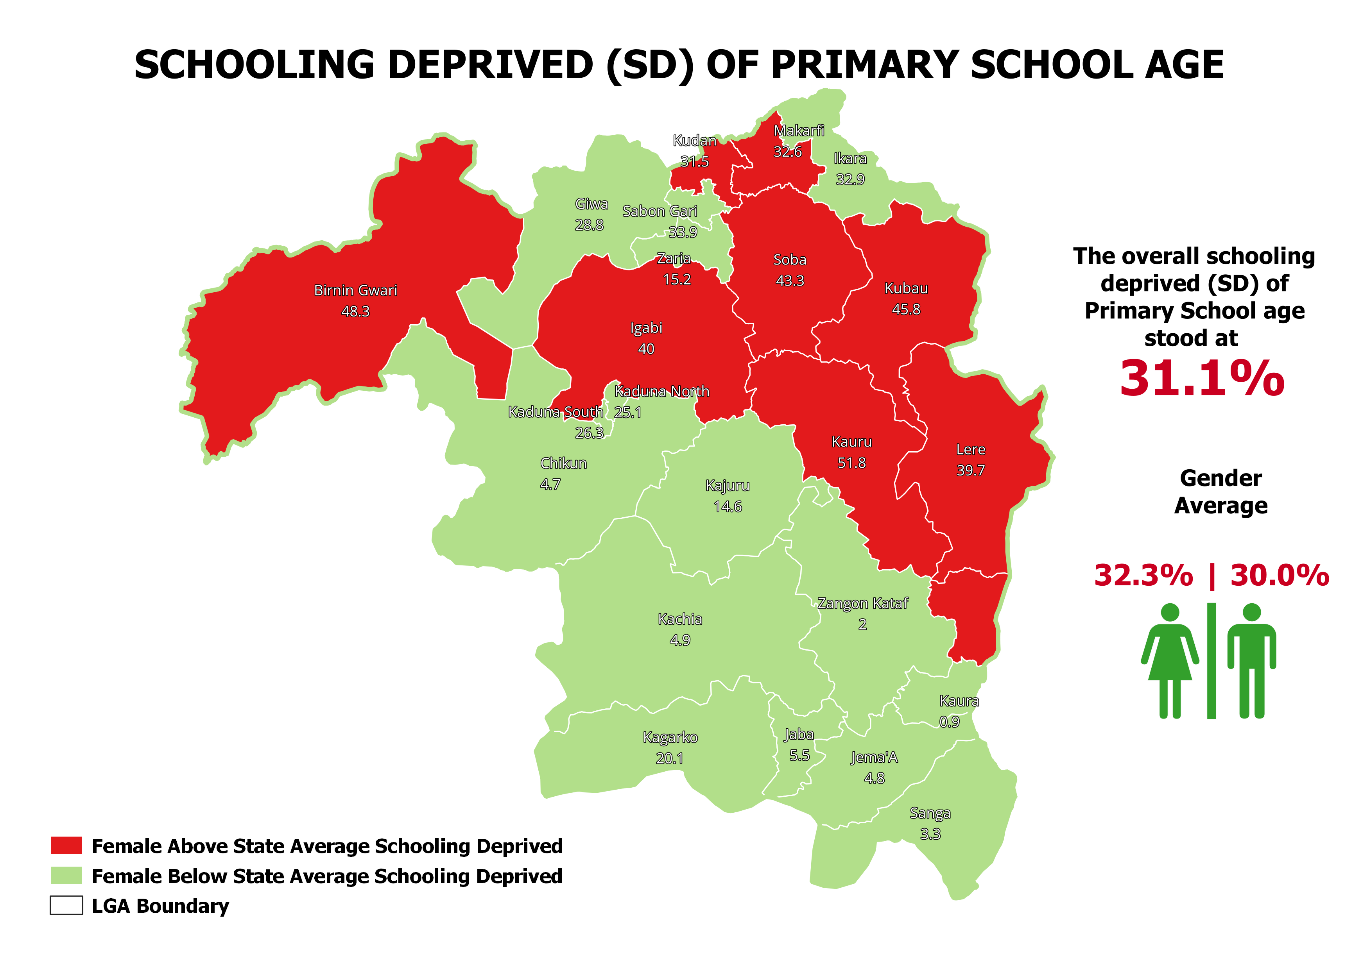

Slide 27
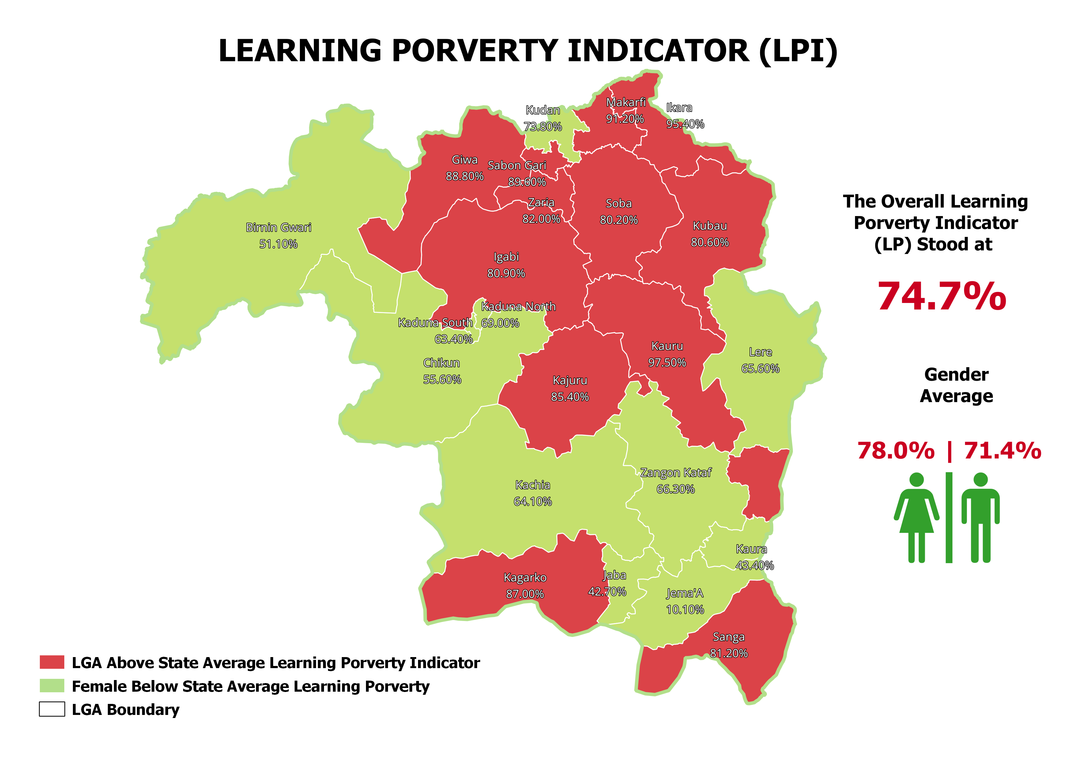

Slide 28
DISCUSSION
It was established that the overall LPI for the State is 74.7%.
Though the UNESCO estimated a whopping 87% for Sub-Saharan African.
This report has recommended the Learning recovery efforts.
This effort concentrates on both the children and the teachers.
For the children is to sustain active learning while for the teachers is to give them training and close supervision.

Slide 29
Recommendations
1. Set and monitor key targets focusing on foundational learning using any model that fits the State. Also, develop a clear, evidence-backed, and realistic plan on how to reach the targets.
2. Prioritize teaching the fundamentals. Learning recovery efforts should focus on essential missed content and prioritize the most foundational skills, particularly literacy and numeracy, that students need for active learning. Help teachers teach these skills by training and motivating them.
3. Increase the efficiency of instruction. Adopt effective teaching practices that support teachers cost-effectively in their immediate classroom challenges. Practices like structured pedagogy programs and tools to target instruction to students’ current learning levels.

Slide 30
Thank You

