Slide 1
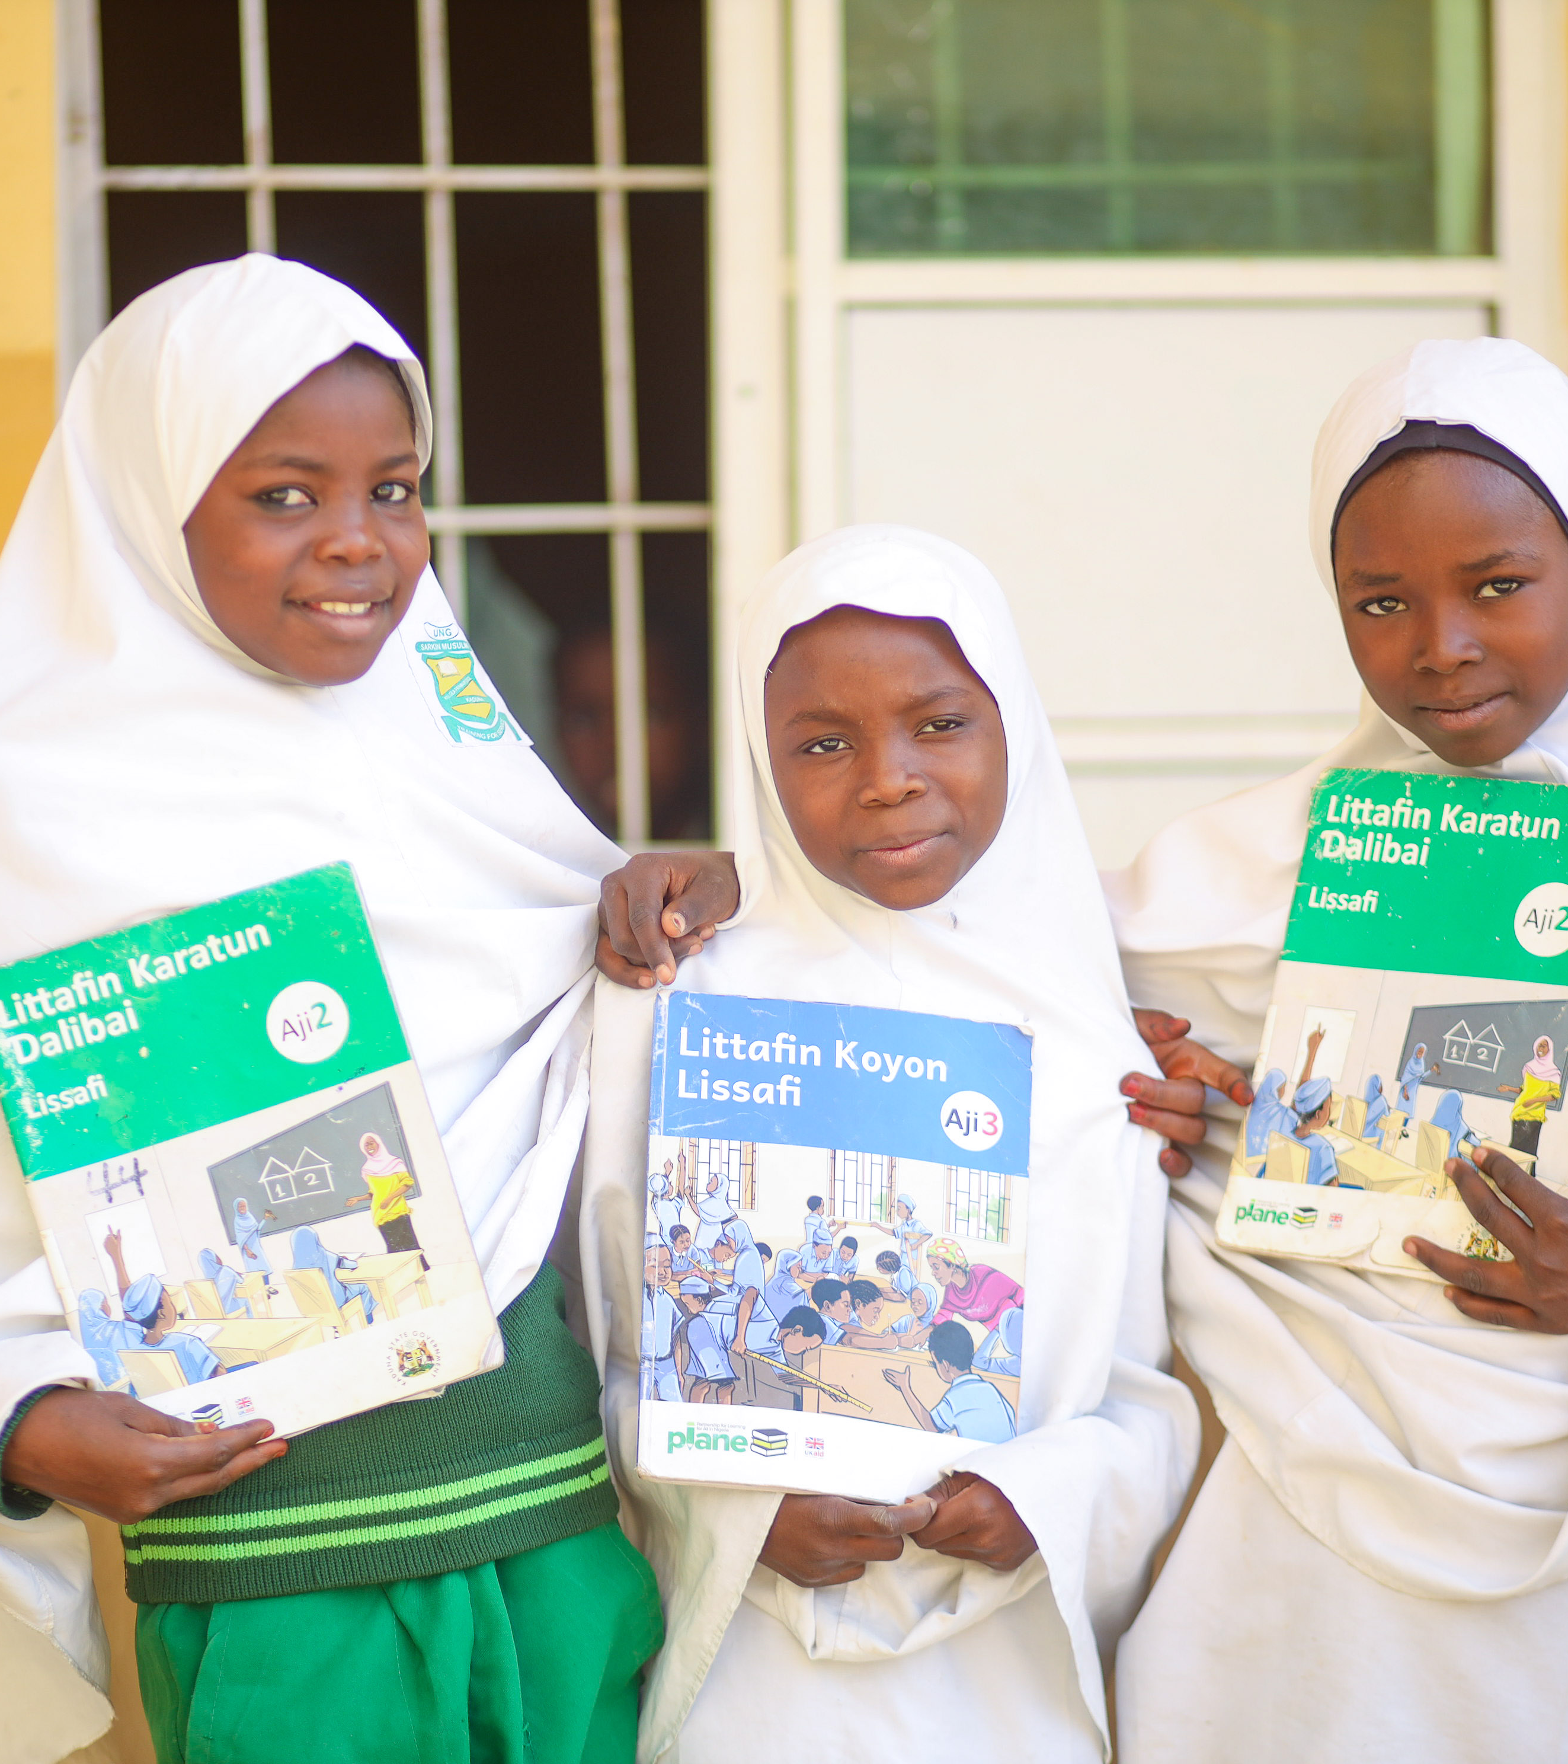
Foundational Learning outcomes in Kano
Presented at Kano Education Summit 2024
February 21, 2024

Slide 2
Presentation Outline
Assessment implementation overview
Key Baseline Findings and Recommendations.
Beginning of year one (Baseline) and end of year one learning outcomes
Beginning of year two learning outcomes

Slide 3
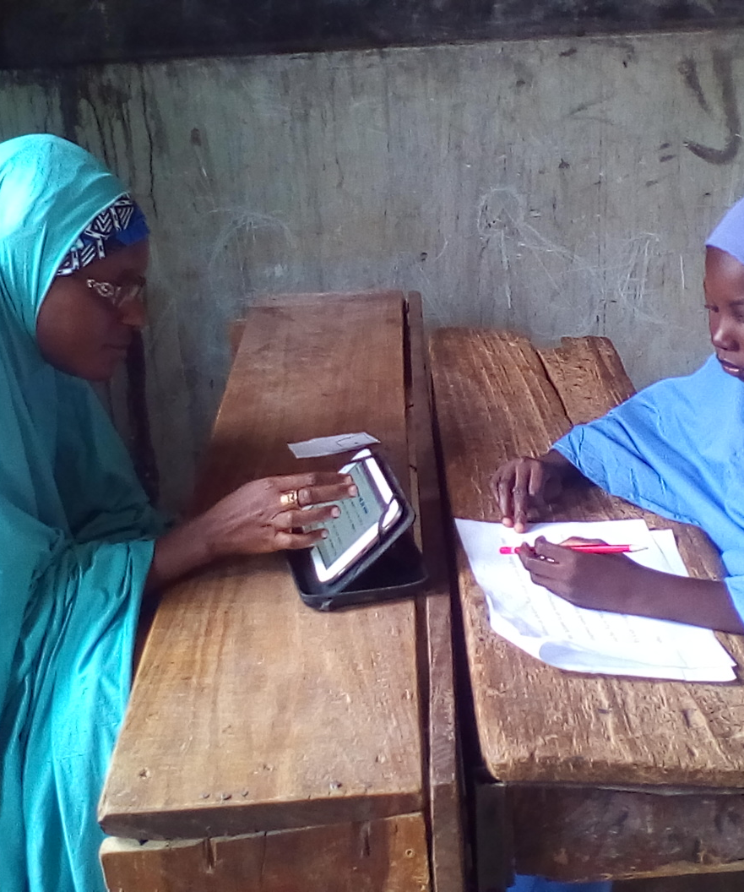
Assessment Implementation Overview
Representative sample of schools within each LGA where PLANE is implemented
Year 1
  Data collected in P2, P4, P6
  Data collection took place at the beginning of 2022/23 school year and the end of 2022/23 school year
Year 2
  Data collected in P2 and P3 only
  Beginning of year data collection is completed at start of 2023/24 school year
  End of year data collection will take place around June 2024

Slide 4
Key Baseline Findings and Recommendations

Slide 5
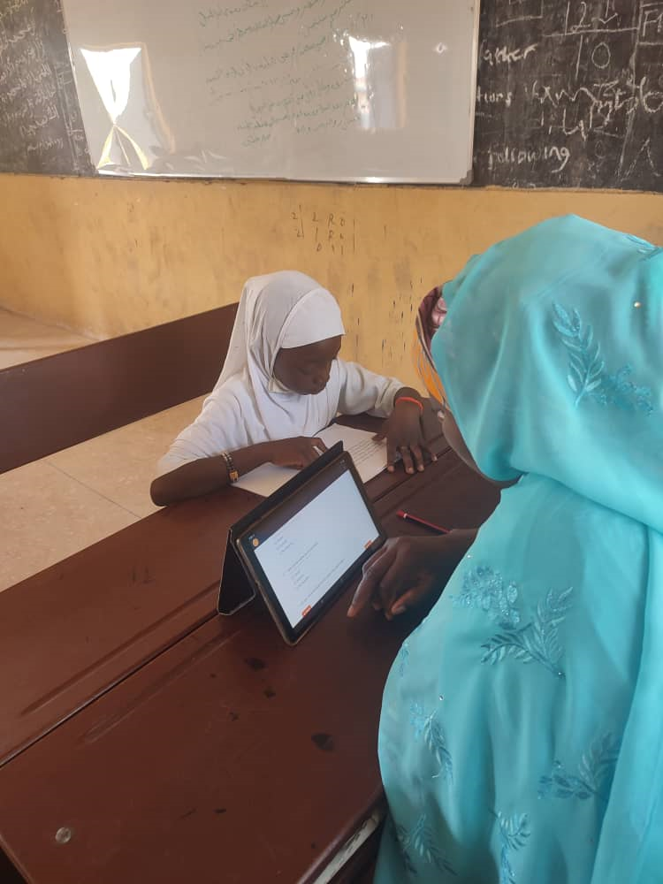
Key Baseline Findings: Pupil Performance
Baseline results indicated that learning achievement was very low, with 82.4% of Primary 2 pupils unable to identify any Hausa letter and only 2.2% can identify a number.
Similarly, 93.7% of Primary 4 pupil are unable to identify any English word.
These low starting points indicate the need for SUBEB to build foundational skills from the beginning of primary school.

Slide 6
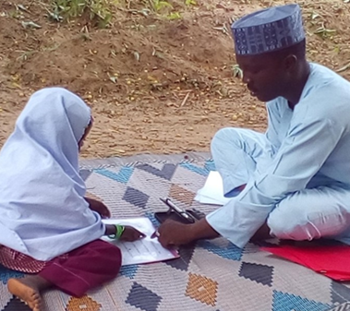
Key Baseline Findings: Inclusive Learning Environment
School, teacher, and pupil demographics indicate that government schools in Kano need support to provide not only the best environments conducive to pupil learning, but also support teachers in their efforts to provide the highest level of instruction in their classrooms.
A concerted effort to provide a more inclusive environment, including identifying GESI focal persons at the school level and ensuring appropriate facilities for learners with disabilities, may have measurable effects on learning outcomes.
As of now, enrolment of pupils with disabilities is extremely low, and school facilities are not available to support their physical inclusion

Slide 7
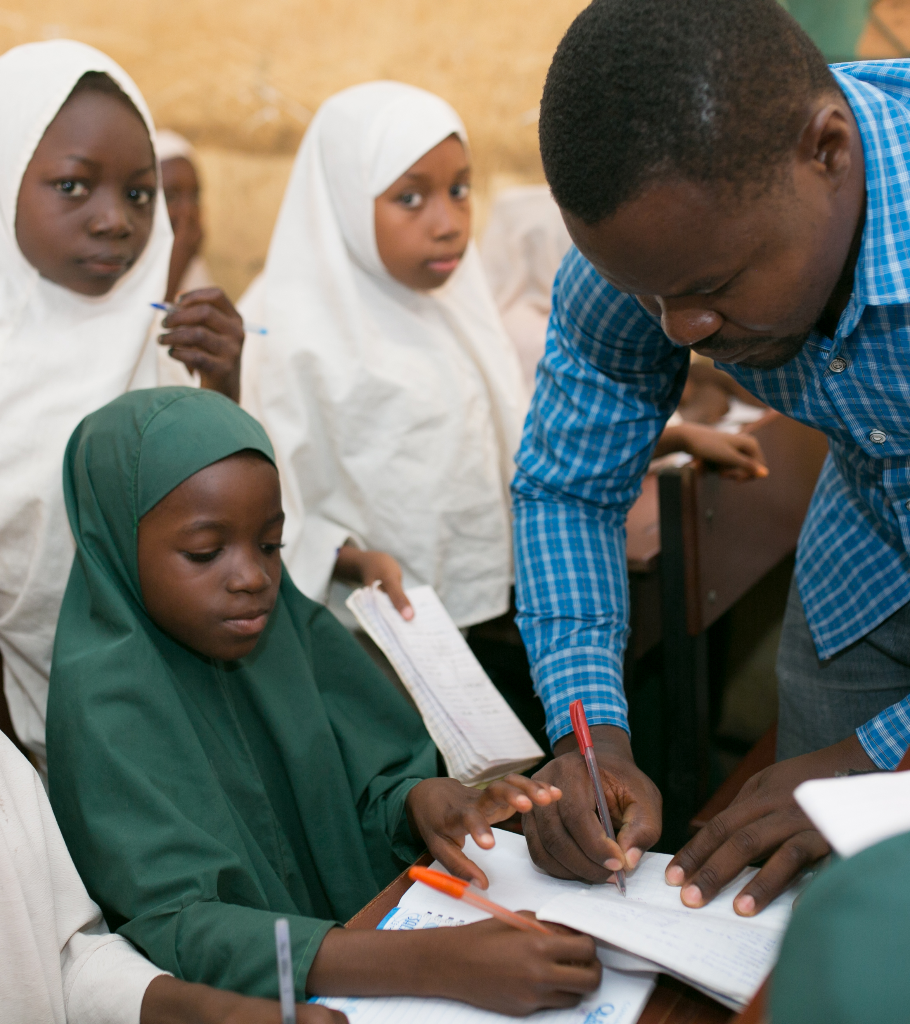
Key Baseline Findings: Teacher Performance
Teachers have varying levels of qualifications and experience, which can make it difficult to provide individualised training specific to their needs.
Evidence has shown that providing coaching and mentoring for all teachers is an important strategy to provide individualised teacher professional development.

Slide 8
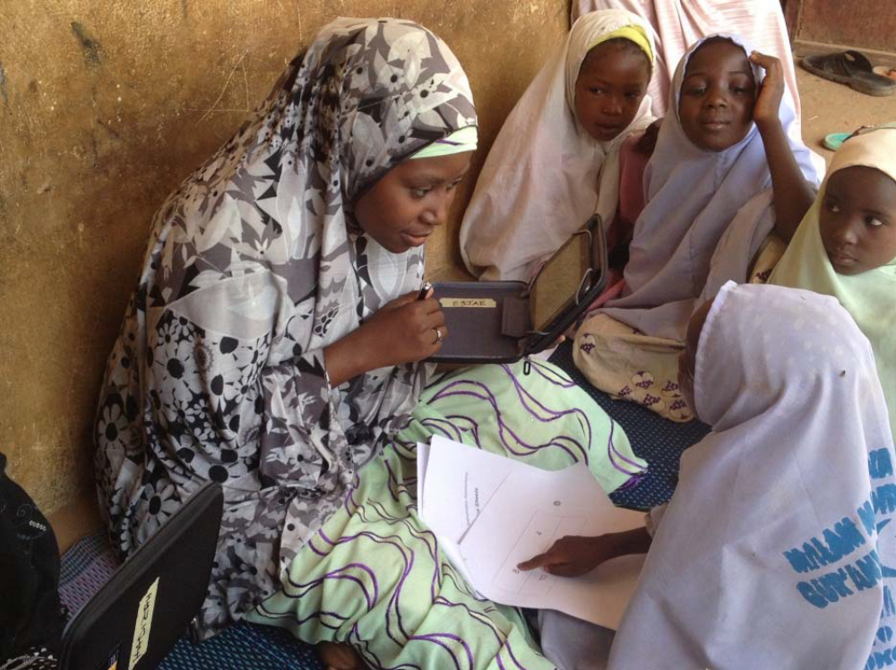
Key Baseline Findings: Learning at home
Even though the findings showed there was a general lack of books or reading materials present in the home, there were strong indications of familial support for learning.
More than half of pupils assessed had families that spent time reading to them and helped them study and complete their homework.
Though these percentages are still relatively lower than what is hoped for, it’s possible that leveraging on these strong connections outside the immediate school environment will have lasting impacts on learning outcomes.

Slide 9
Year 1: Learning Outcomes

Slide 10
Year 1 results: BoY to EoY comparison in P2
Notes:
Data

Slide 11
Year 1 results: BoY to EoY comparison in P4
Notes:
Data

Slide 12
Year 1 results: BoY to EoY comparison in P6
Notes:
Data

Slide 13
Year 1 results: BoY to EoY comparison in English
Notes:
Data

Slide 14
Year 1: Percent of pupils increasing a level by class and subject
P2 | Hausa | Math | English
P2 | 10.6% | 33.3% | n/a
P4 | 31.9% | 20.7% | 49.1%
P6 | 51.1% | 41.4% | 48.6%

Slide 15
Year 2: Learning Outcomes

Slide 16
Year 2 results: P2 and P3 Hausa
 | All PLANE: P2 | Kano P2 |  | All PLANE: P3 | Kano P3
Beginner | 82.84% | 89.24% |  | 64% | 64.98%
Pre-reader: letter knowledge | 10.16% | 8.68% |  | 19.18% | 21.3%
Pre-reader: syllable identification | 0.9% | 0% |  | 3.76% | 6.86%
Emergent reader (1-5 wpm) | 3.95% | 0% |  | 0.94% | 1.08%
Foundational literacy (6-10 wpm) | 0.79% | 0.35% |  | 2.0% | 0.72%
Progressing (11-20 wpm) | 0.56% | 1.04% |  | 4.47% | 1.44%
Progressing (21-30 wpm) | 0.34% | 0% |  | 4.0% | 1.08%
Progressing (31-40 wpm) | 0.23% | 0.35% |  | 0.47% | 0.72%
Reader (41+ wpm) | 0% | 0% |  | 0.12% | 0.36%

Slide 17
Year 2 results: P2 and P3 English
 | All PLANE: P2 | Kano P2 |  | All PLANE: P3 | Kano P3
Beginner | 83.18% | 97.22% |  | 66.94% | 77.34%
Pre-reader: letter knowledge | 14.79% | 1.74% |  | 19.41% | 9.35%
Pre-reader: syllable identification | 1.58% | 0.69% |  | 6.24% | 8.99%
Emergent reader (1-5 wpm) | 0.23% | 0% |  | 0.82% | 1.8%
Foundational literacy (6-10 wpm) | 0.23% | 0.35% |  | 1.41% | 1.08%
Progressing (11-20 wpm) | 0% | 0% |  | 2.59% | 0%
Progressing (21-30 wpm) | 0% | 0% |  | 1.88% | 0.36%
Progressing (31-40 wpm) | 0% | 0% |  | 0.47% | 0.36%
Reader (41+ wpm) | 0% | 0% |  | 0% | 0%

Slide 18
Year 2 results: P2 and P3 Math
 | All PLANE: P2 | Kano P2 |  | All PLANE: P3 | Kano P3
Beginner | 55.01% | 62.63% |  | 38.86% | 38.86%
Pre-Numeracy | 22.72% | 22.49% |  | 24.04% | 24.04%
Emergent Numeracy | 5.06% | 4.15% |  | 7.0% | 7%
Foundational Numeracy | 2.59% | 2.08% |  | 3.5% | 3.5%
Progressing Numeracy​ | 13.39% | 7.61% |  | 15.75% | 15.75%

Slide 19
Partnership for Learning
for All in Nigeria
Thank You

Slide 20
Questions and Answers

