Slide 1
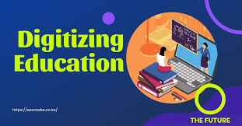

Utilizing Technology for Education:
Exploring innovative ways to integrate technology into education to bridge the digital divide in underserved communities
By
Tanimu Adam Ibrahim, PhD
Federal University Dutsin-Ma
aitanimu@fudutsinma.edu.ng \ tanimuai@gmail.com +2348069350274

Slide 2
Outline of the presentation
Introduction
Tracing the Evolution of Technology Utilization in Education in Nigeria
Importance of Technology Integration in Education
Innovative ways to integrate technology into education system in Nigeria
Bridging the digital divide and providing access to technology in underserved communities in Nigeria
Gender concerns in technology integration in education
Major challenges of Technology Utilization in Education in Nigeria
Conclusion
Recommendations
References

Slide 3
Tracing the Evolution of Technology Utilization in Education in Nigeria
Pre-Independence (Pre-1960s) and
Post-Independence Era (1960s-1980s)
NERDC
UPE
Late 20th Century (1990s-2000s) to
21st Century (2000s-Present)
ICT POLICY
NTI
NOUN
NITDA
JAMB-CBT

Slide 4

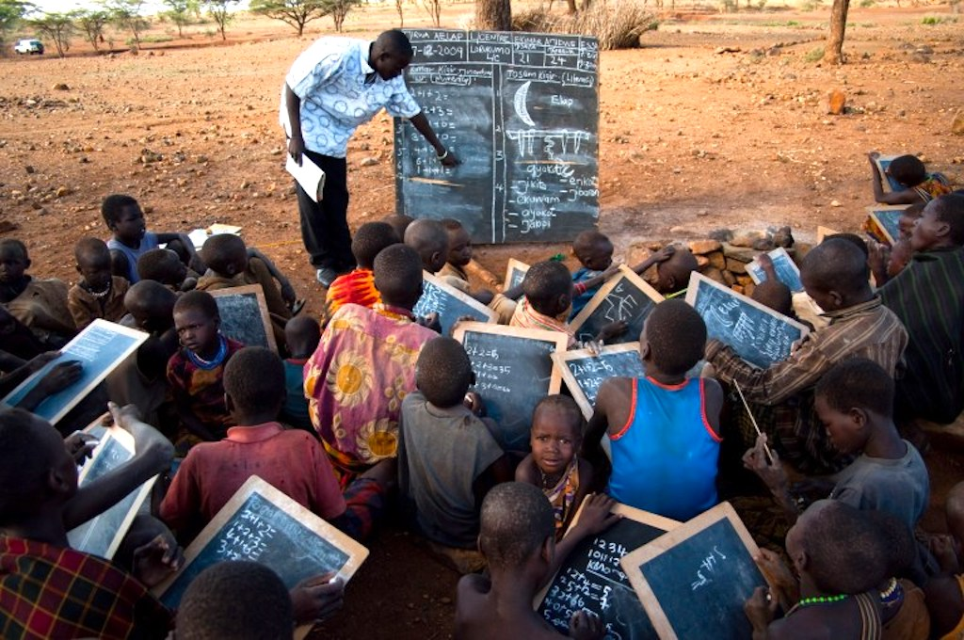
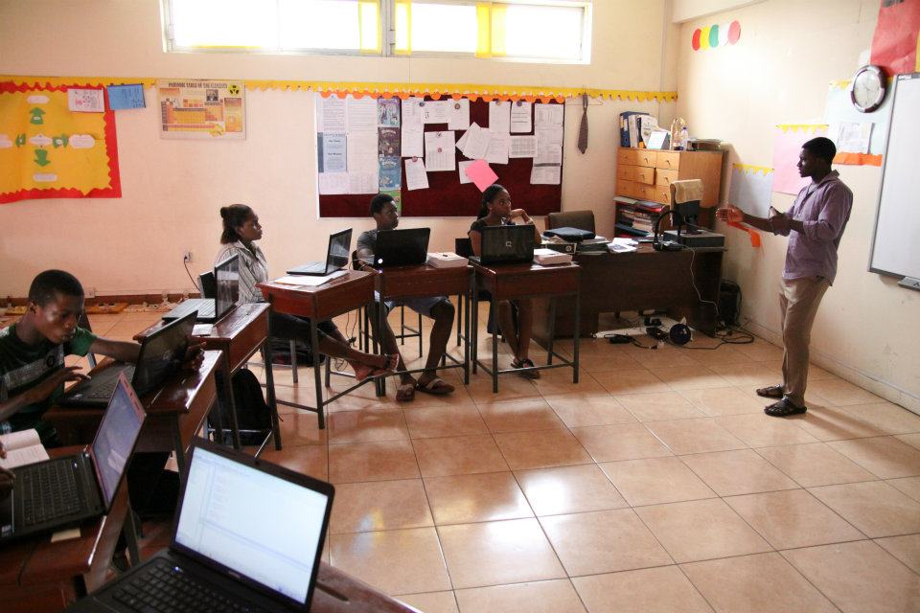
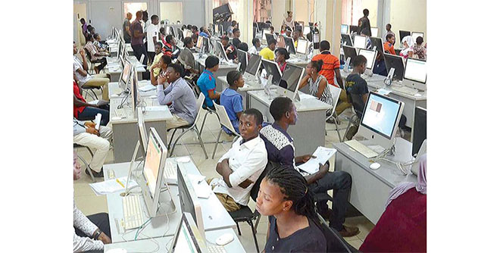

Slide 5
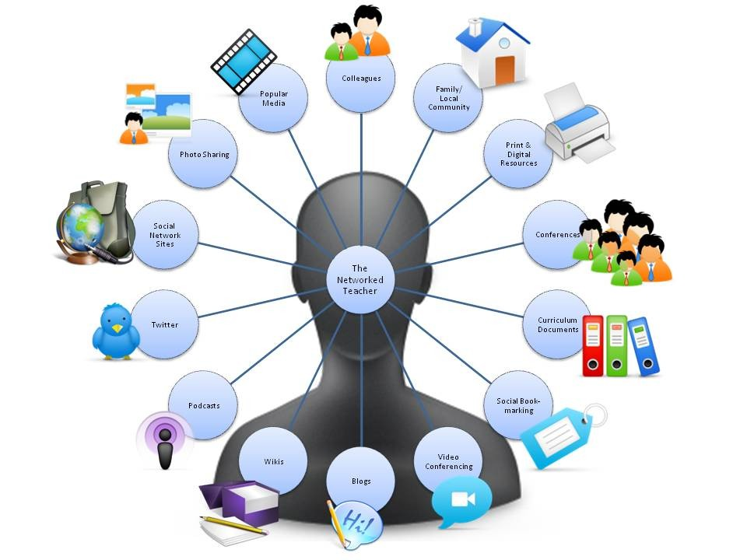

Slide 6
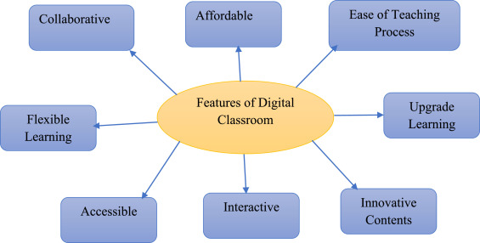

Slide 7
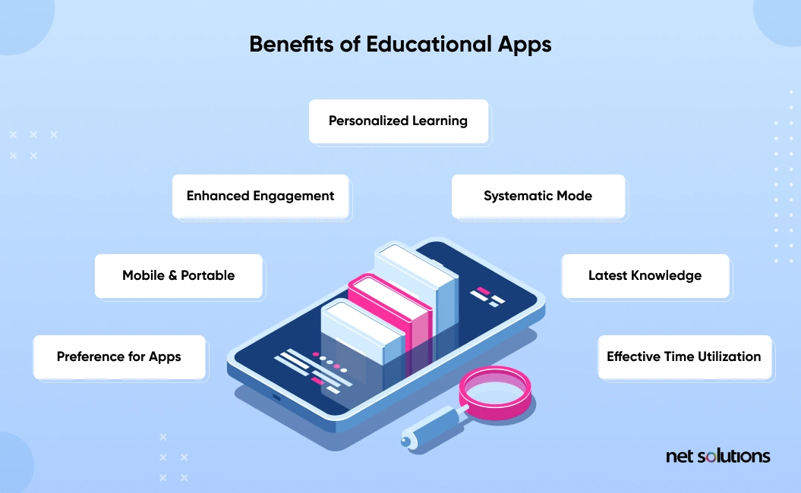

Slide 8
Innovative ways to integrate technology into education system in Nigeria
Online Learning Platforms
Educational Apps, Software and E-Learning Platforms
Digital Libraries and Open Educational Resources (OER)
Interactive Whiteboards and Smartboards (Magic boards)
Gamification
Virtual Reality (VR) and Augmented Reality (AR)
Flipped Classroom Model
Remote Learning and Video Conferencing

Slide 9
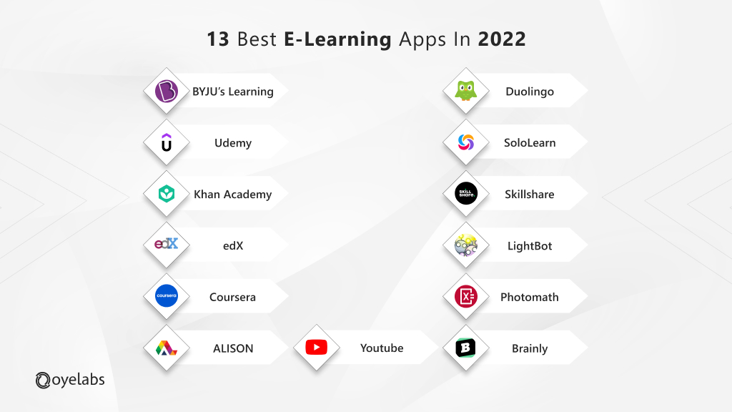
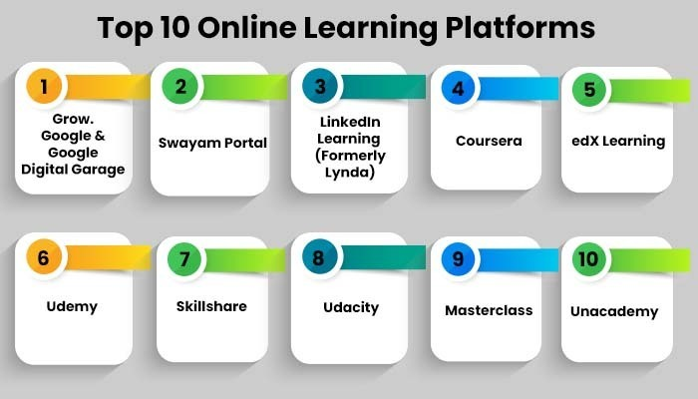

Slide 10
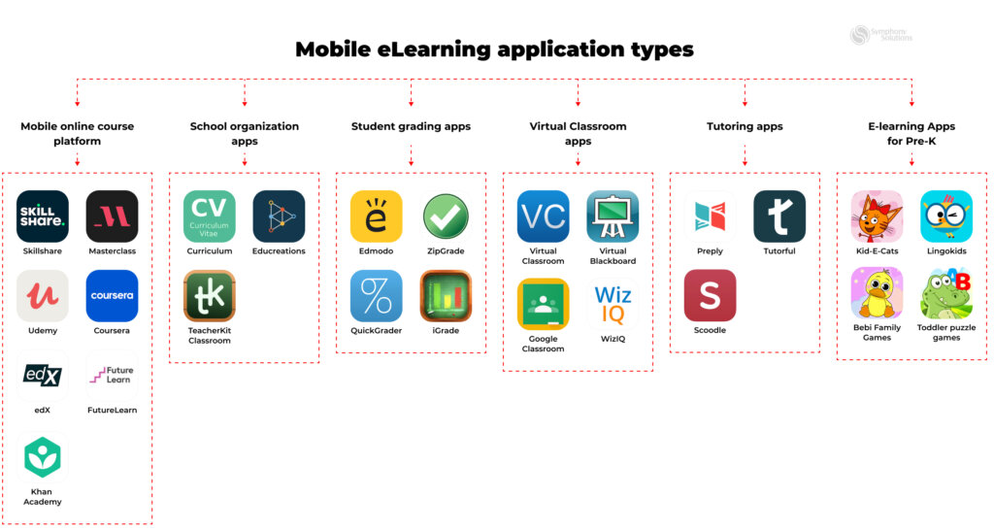

Slide 11
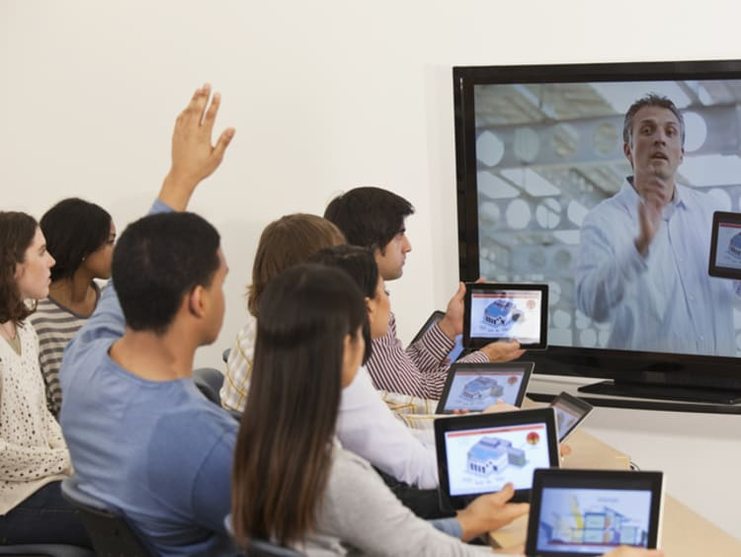

Slide 12
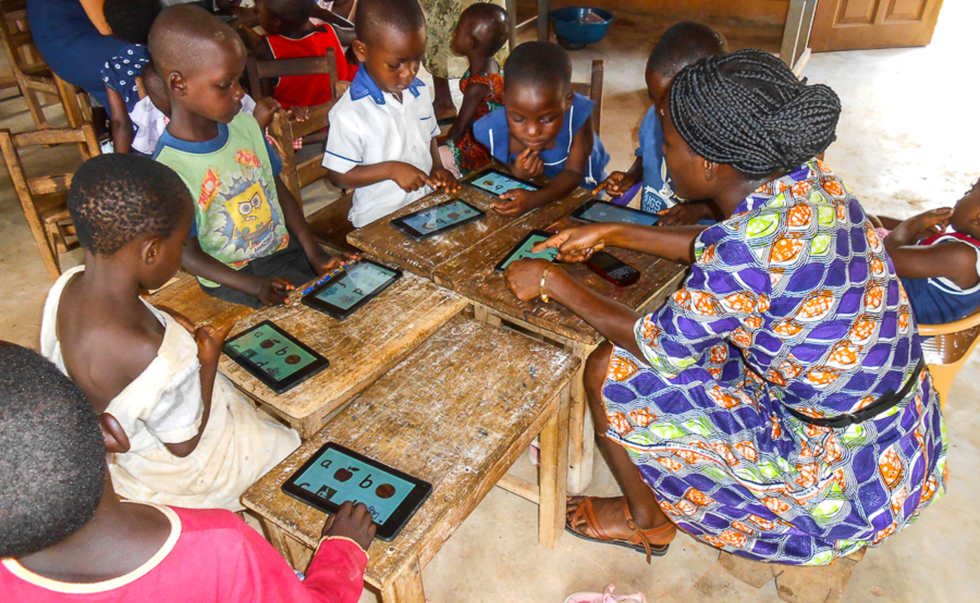
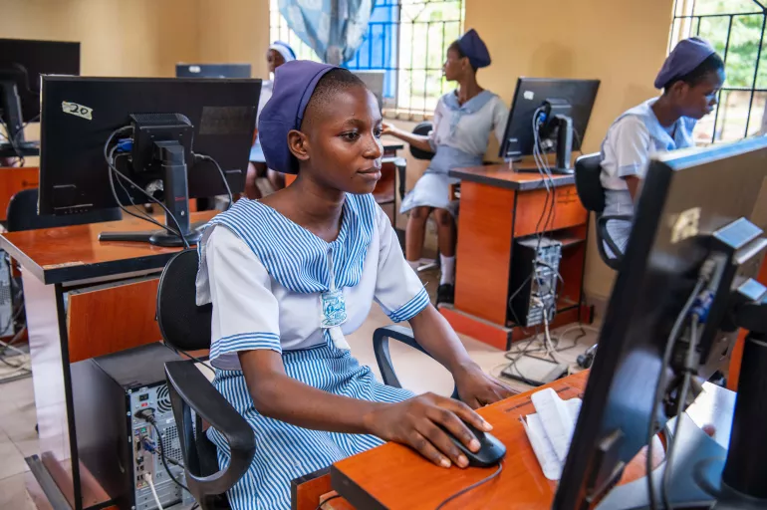

Slide 13
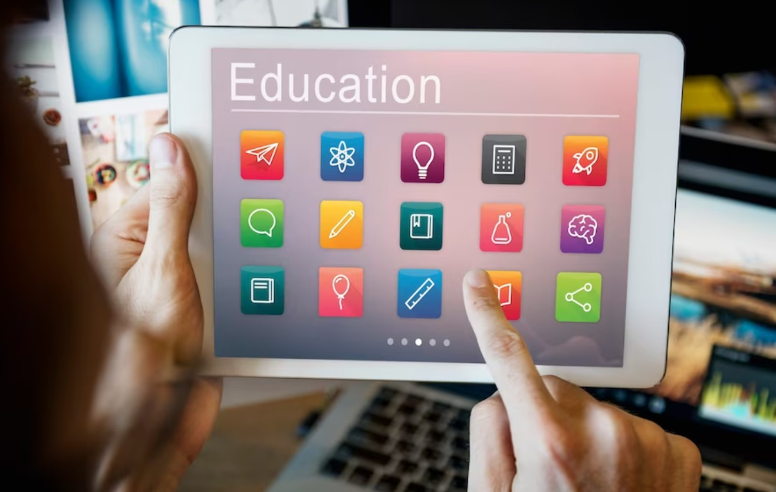

Slide 14
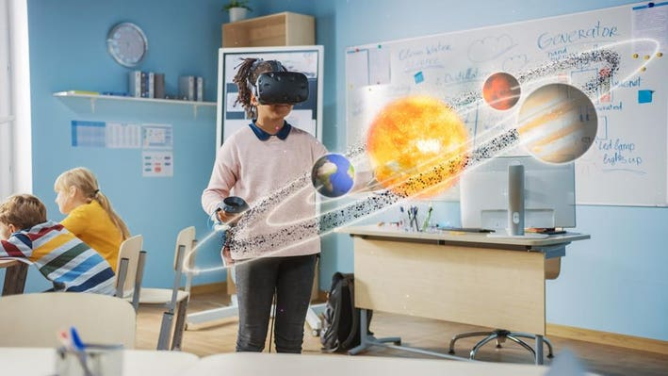
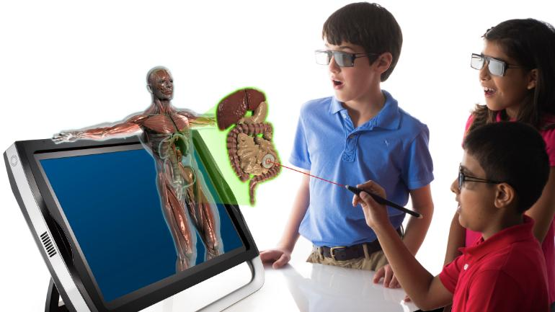

Slide 15



Slide 16



Slide 17
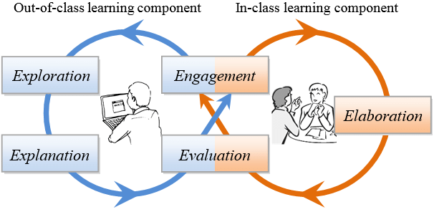
Flipped Classroom Model

Slide 18
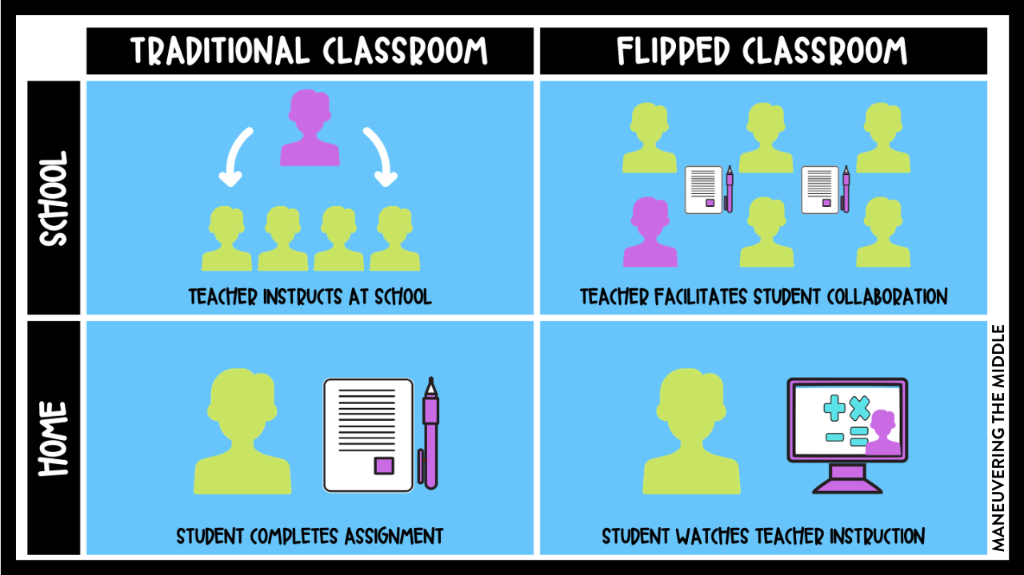
Flipped Classroom Model

Slide 19
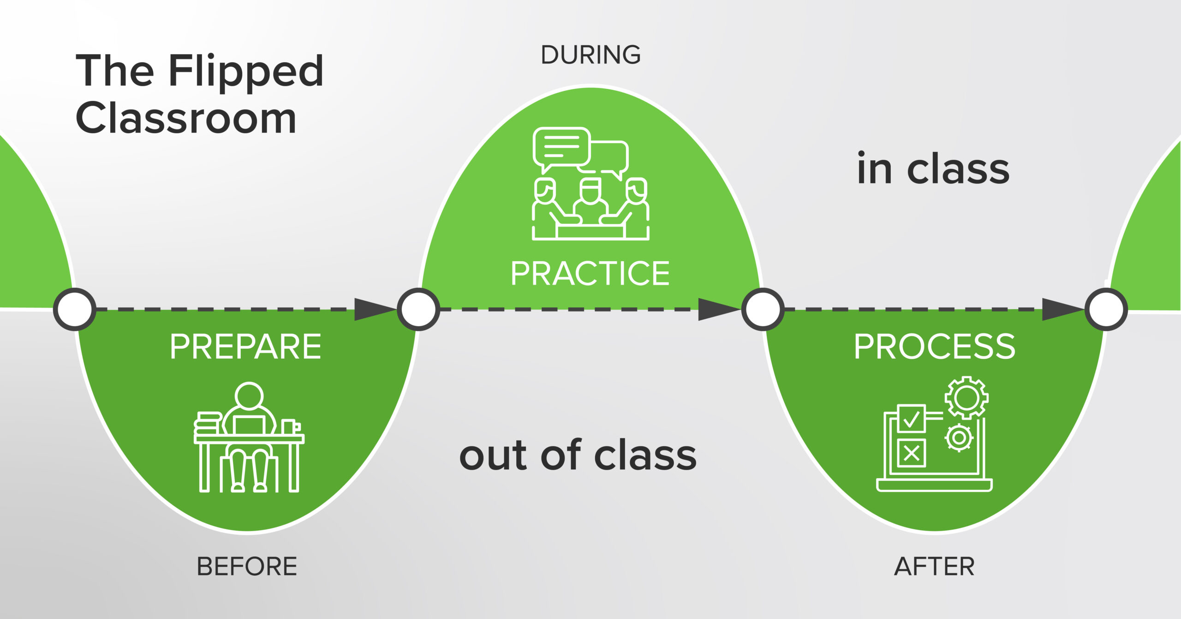

Slide 20
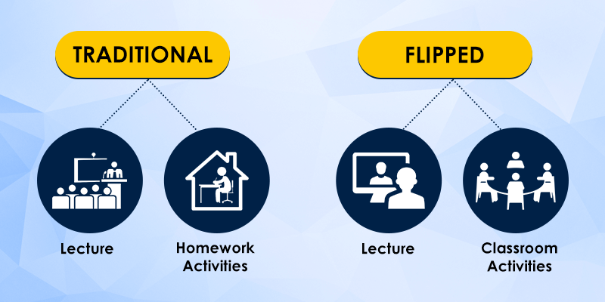

Slide 21
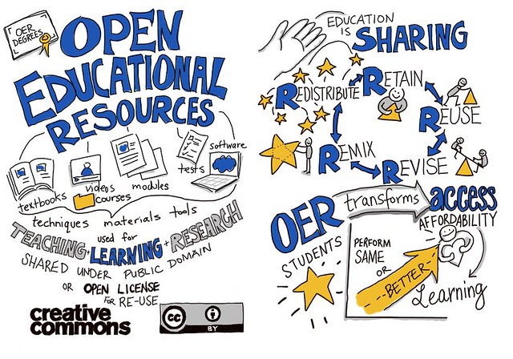

Slide 22
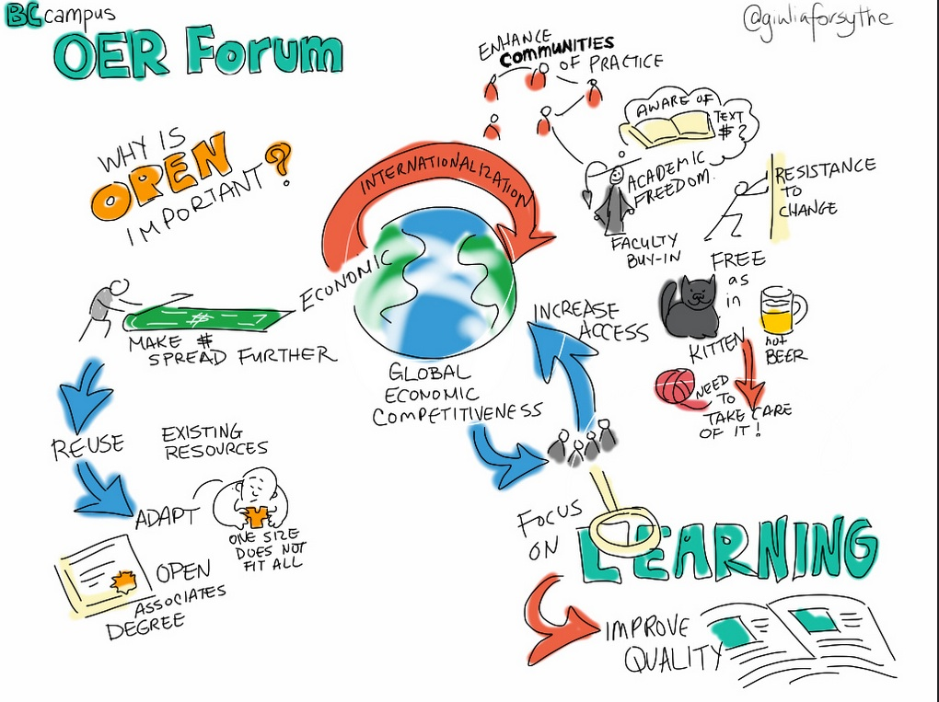

Slide 23
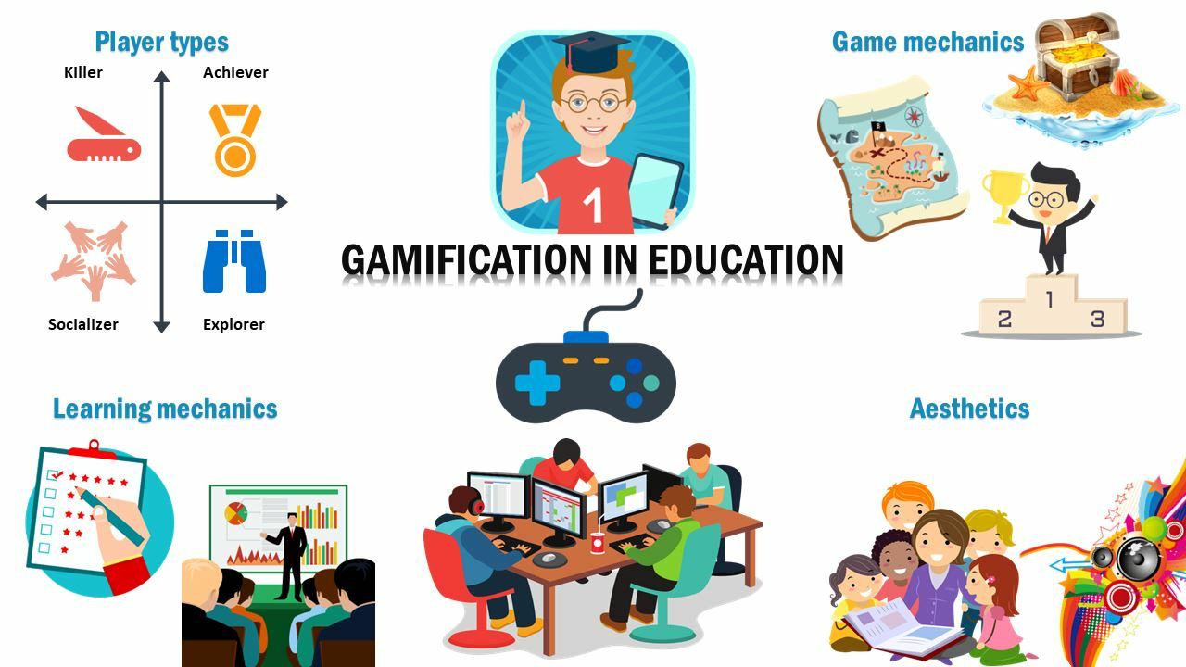

Slide 24
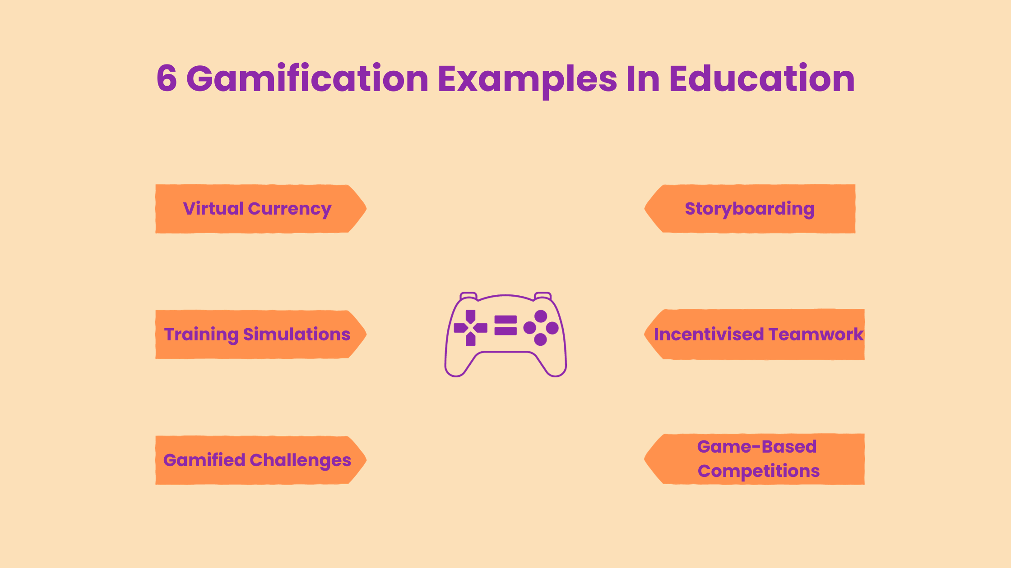

Slide 25
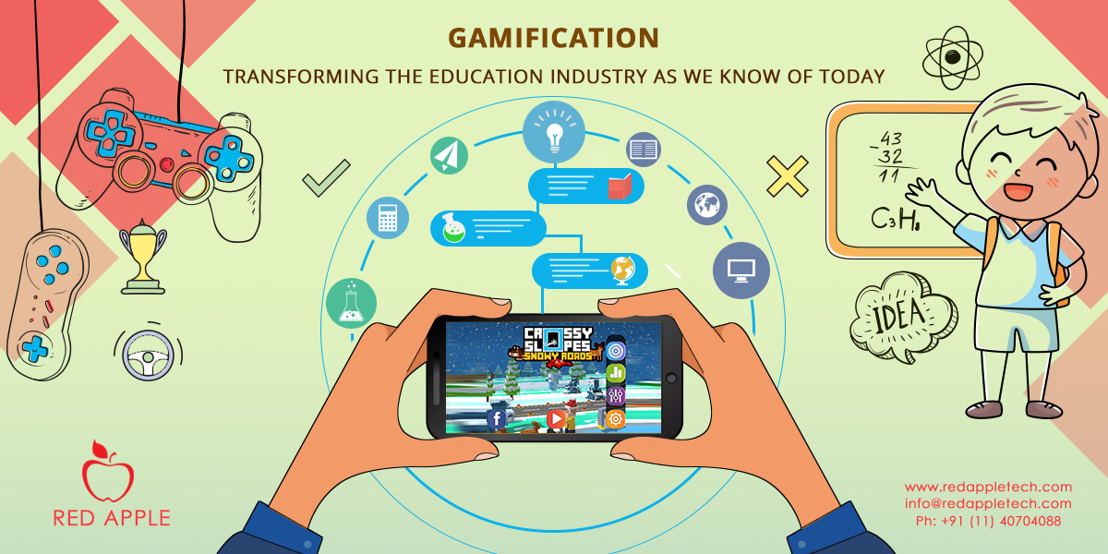

Slide 26
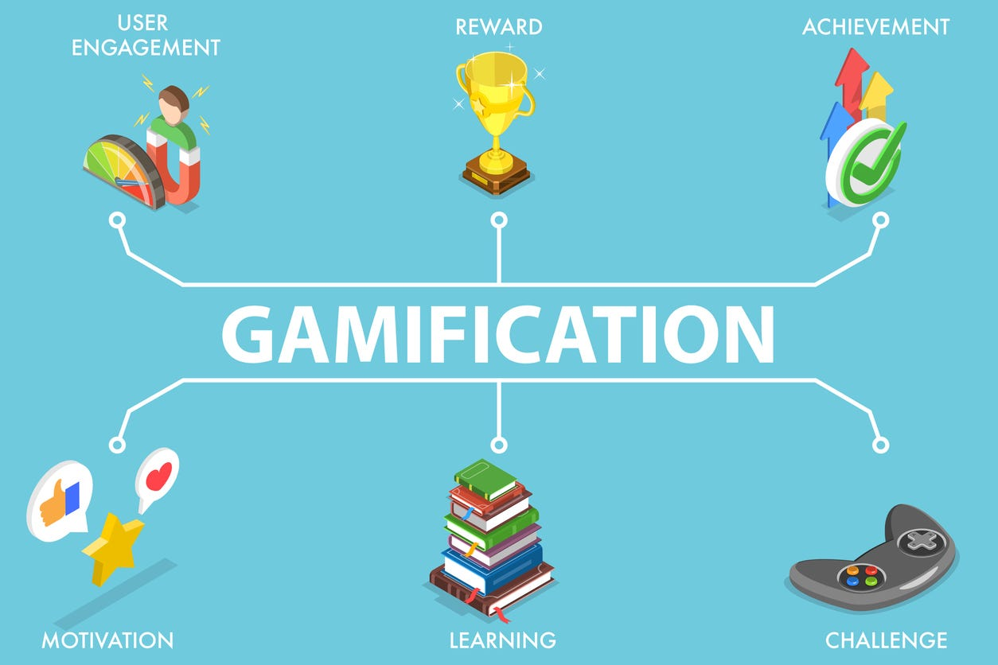

Slide 27
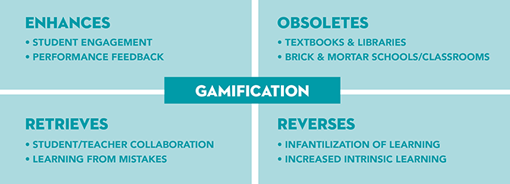

Slide 28


Slide 29


Slide 30
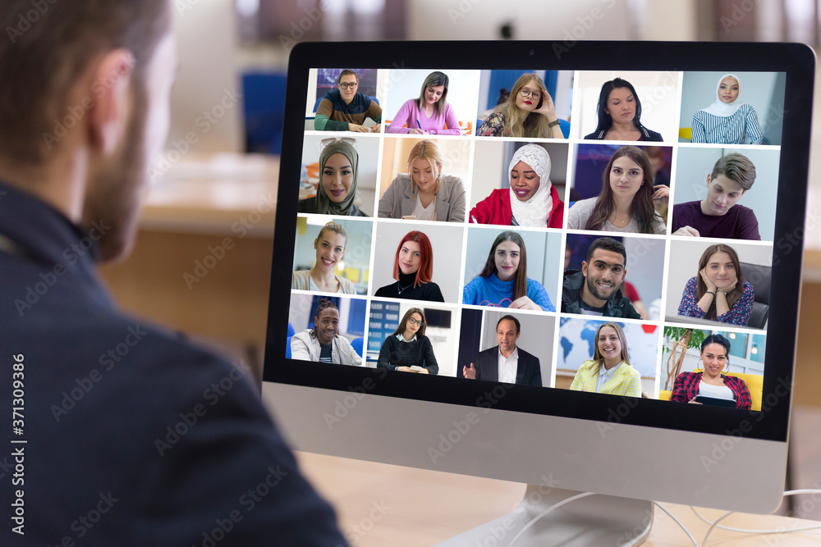

Slide 31


Slide 32

Bridging the digital divide and providing access to technology in underserved communities in Nigeria
Community Technology Centers (CTCs)
Mobile Technology Solutions
Low-Cost Computing Devices
Public-Private Partnerships (PPPs):
Internet Connectivity Initiatives
Digital Literacy Training Programs
ICT Infrastructure Development

Slide 33
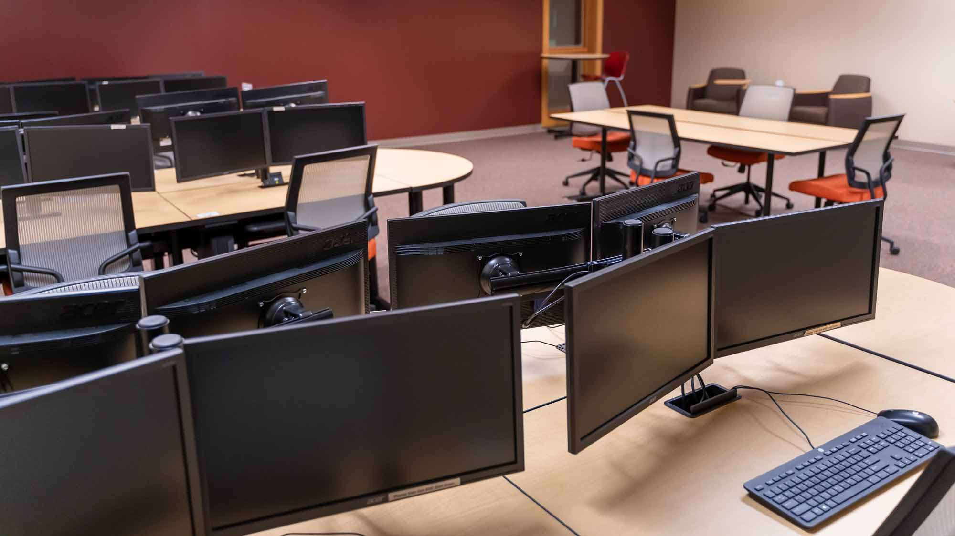

Slide 34
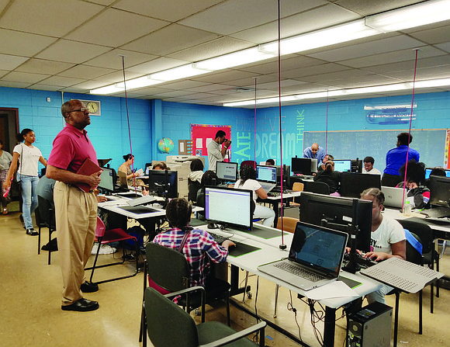

Slide 35
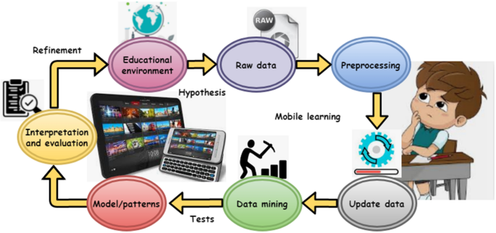
Mobile Technology Solutions

Slide 36
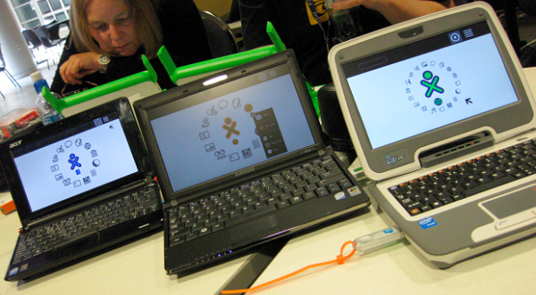
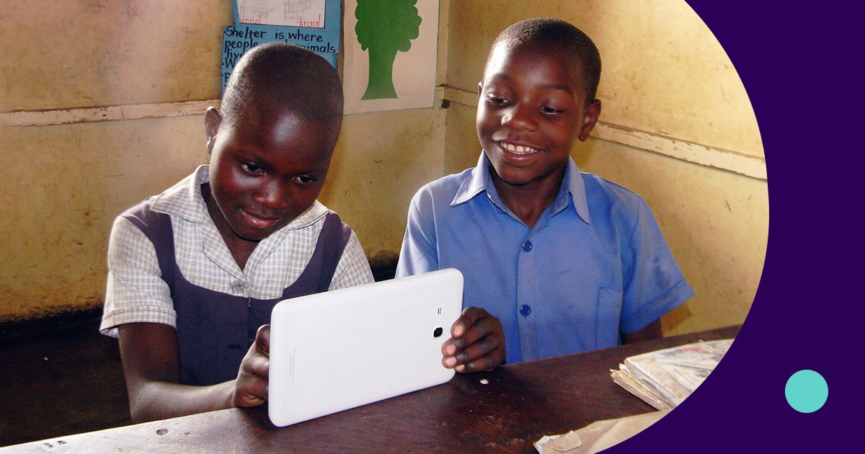
Low-Cost Computing Devices

Slide 37


Slide 38
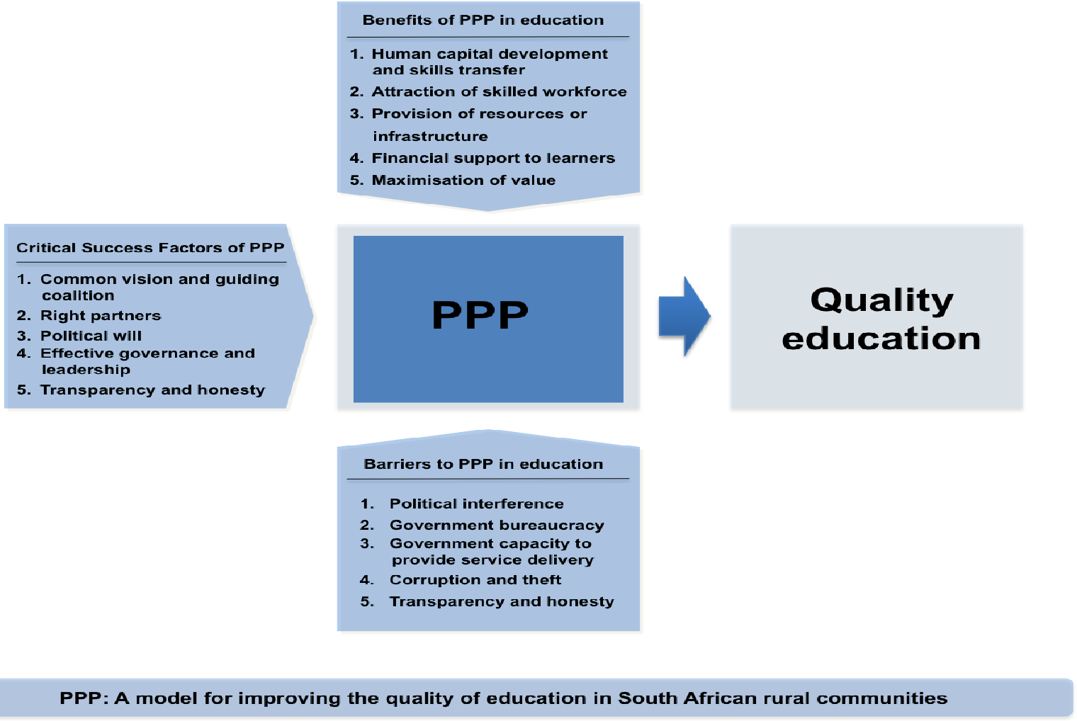

Slide 39

Mobile Technology Solutions

Slide 40
Gender concerns in technology integration in education
Gender Disparities in Access
Stereotypes and Biases
Digital Skills Gap
Gender Bias in Curriculum and Content
Representation in STEM Fields
Differential Use of Technology
Gendered Classroom Dynamics

Slide 41
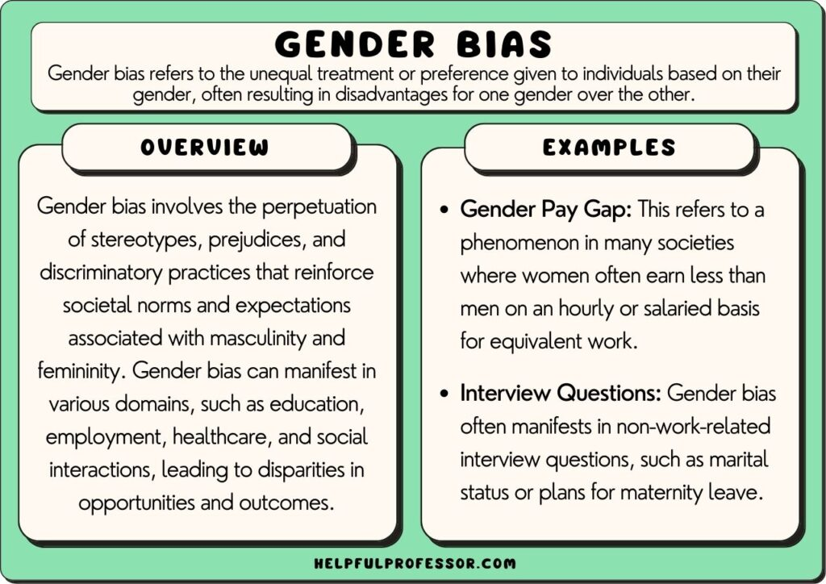

Slide 42

Gender perspectives in science, technology

Slide 43



Slide 44
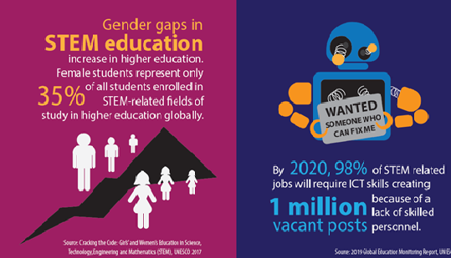

Slide 45
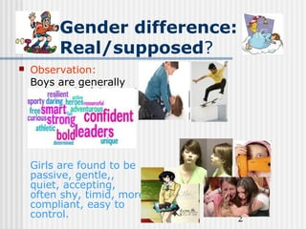

Slide 46
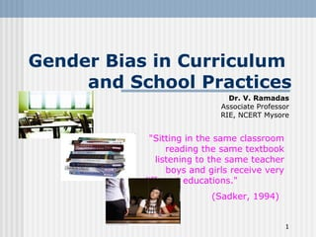

Slide 47
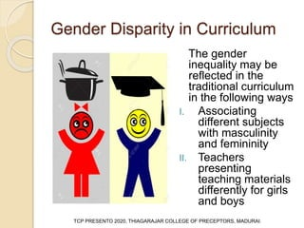

Slide 48
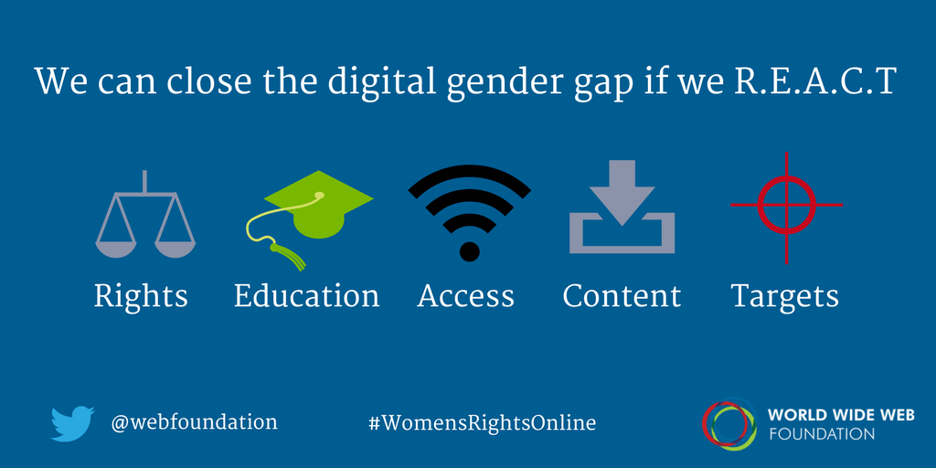

Slide 49
Major challenges of Technology Utilization in Education in Nigeria
Digital Divide
Infrastructure Constraints
Limited Funding and Resources
Digital Literacy Gaps
Teacher Training and Professional Development
Content Relevance and Localization
Cybersecurity and Privacy Concerns
Maintenance and Technical Support
Policy and Regulatory Framework
Resistance to Change

Slide 50
Enhanced Learning Experiences
Personalized Learning
Global Connections
Importance of Technology Integration in Education
Collaborative Learning
Accessibility and Inclusivity

Slide 52
Conclusion
Nigeria's education sector has evolved significantly with the integration of technology, transforming traditional methods and fostering digital inclusion.
This integration can create interactive, personalized learning experiences, bridge the digital divide, and improve educational outcomes.
However, challenges like infrastructure constraints, digital literacy gaps, and teacher training need to be addressed.
A holistic approach, guided by evidence-based practices and collaborative partnerships, is needed to harness the transformative power of technology in education, paving the way for a brighter future for students and contributing to the nation's socio-economic development.

Slide 53
Recommendations
Comprehensive Professional Development
Accessible Technology Infrastructure
Equitable Access to Devices and Resources
Personalized Learning Opportunities
Collaborative Learning Environments
Innovative Teaching Strategies
Digital Citizenship and Safety Education
Continuous Evaluation and Improvement
Community Engagement and Partnerships
Policy Support and Funding

Slide 54


