Slide 1
BALA ADO KOFARMATA
Professor of Entrepreneurial Studies
DanGote Business School,
Bayero University Kano
ENTREPRENEURSHIP FOR SUSTAINABLE DEVELOPMENT FOR GIRLS

Slide 2
AGENDA
Introduction​
Quick Facts
Entrepreneurship Education
Benefits of Entrepreneurship Education for Girls
Approach to Develop sustainable entrepreneurship
Summary/Conclusion

Slide 3
Introduction
We live in an age of unprecedented global and technological transformation.
Today’s Girls face an uncertain future full of complex global, political, economic, social, and environmental issues.
The education system must enable in-school girls to develop entrepreneurial characteristics and competencies as early as possible to help them deal with this uncertain global happenings.

Slide 4
Quick Facts about Kano
Schooling: According to the Nigerian Education indicators, primary school enrolment in Kano is among the highest.
Not in school: NEDIS 2022 estimated that there are 18 million out-of-school children in Nigeria, over 10 million are girls, and there is no doubt that urgent steps need to be taken to ensure the girl child stays in school and get quality education.
A total of about 3 million children were out of school in Kano in 2017, subsequently making it the state with the highest number of out of school children in Nigeria. Factors responsible for girls not staying in school include fear for their safety, early child marriage, poverty, lack of mentorship among others

Slide 5
Completion and Transition: Primary school completion rate is at 56.9% compared to the national average of 63%, while transition rate into Senior Secondary School 39.7% compared to national average of 49% (Multiple Indicator Cluster, 2017)
Literacy: youth literacy in Kano is recorded at 66.0%, 72.5% for women and 46.1% for men (Multiple Indicator Cluster, 2017).
These statistics have implication for policies regarding sustainable development.

Slide 6
Entrepreneurship Education
“a collection of formalized teachings that informs, trains, and educates anyone interested in participating in socioeconomic development through a project to promote entrepreneurship awareness, business creation, or small business development’’.
Entrepreneurship education focuses on developing real-world skills that will help girls to lead exceptional lives in a rapidly changing world.

Slide 7
What is Entrepreneurship Education?
The teaching of skill, knowledge and attitude for people to go out and
Create their own returns and solve their problems”.
Entrepreneurship education is categorized in 3 ways:
Education 'about' enterprise (Awareness Creation),
Education 'for' enterprise (The preparation of aspiring entrepreneurs for innovation); and
Education 'in' enterprise (The growth and development training for established entrepreneurs)

Slide 8
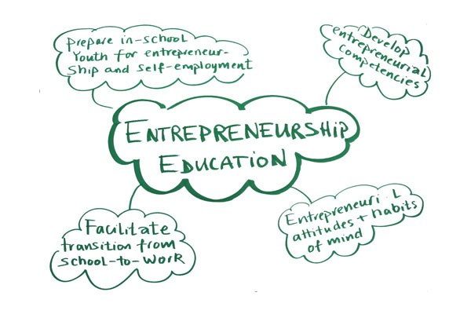

Slide 9
Importance of Entrepreneurship Education to Students
Entrepreneurship education teaches students crucial life skills, such as:
How to collaborate, form and work with a team
How to speak in public and prepare an effective presentation
How to collect and analyze data
How to use social media as an advocacy tool
How to solve real, complex problems that don’t have a definitive answer
How to use curiosity and creativity to find an innovative approach to difficult problems

Slide 10


Slide 11
Benefits of Entrepreneurship Education for Girls
Prepare Girls for uncertain future
We live in an age of unprecedented global and technological transformation.
Today's students face an uncertain future full of complex global, social, and environmental issues.
According to the World Economic Forum's Future of Jobs survey, half of today's work activities could be automated by 2055, creating completely new roles, responsibilities, and challenges for the future workforce.
Therefore, we cannot predict exactly what our students will need to know after they graduate.
Entrepreneurship-focused programs teach students crucial life skills that will help them navigate this uncertain future.
These skills include problem-solving, teamwork, empathy, as well as learning to accept failure as a part of the growth process.

Slide 12
Provides Room for Creativity and Innovation
Entrepreneurship education encourages:
Creativity – develop concept
Innovation – making the concept to work
Collaboration – reap the benefits of the concept/product/service

Slide 13


Slide 14
Creativity
Creativity is the ability to come up with new ideas and to identify new and different ways of looking at a problem and opportunities.
A process of assembling ideas by recombining elements already known but wrongly assumed to be unrelated to each other.

Slide 15

Jobberman is a Nigerian based job portal and career platform that lists candidate job applications for employers and helps connect people looking for jobs with companies hiring.

Slide 16


Folarunsho Alakija
Hajiya Bola Shagaya

Slide 17
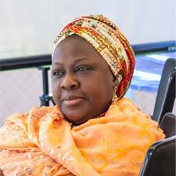

Intercontinental Schools

Slide 18

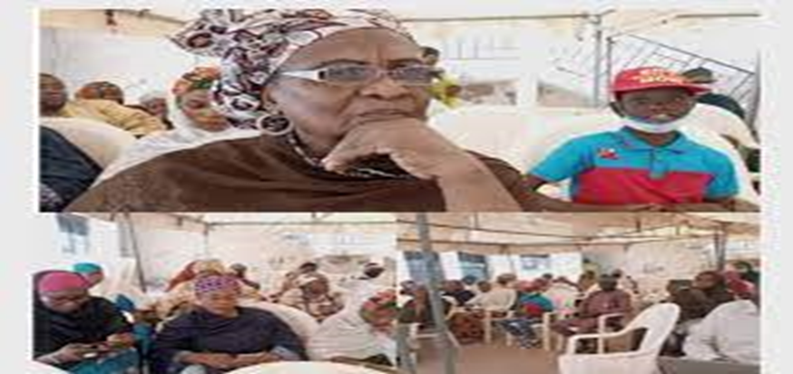

Slide 19

Flutterwave, its goal is brilliant and heroic — enable payments across platforms for businesses, big and small, across the continent. One of its most beloved products, Barter, makes it possible for Nigerian users to buy dollars with the naira in their local accounts.

Slide 20

PAYSTACK AND CO-INVESTORS

Slide 21

Youths are the Key To Achieve Progress

Slide 23

Hanu Agbodje’s Patricia has become a leading e-Commerce platform that trades unused iTunes, Amazon, and Google Play gift cards and it is arguably the first of its kind in sub-Saharan Africa.

Slide 25

Collaboration is the process of two or more people, entities or organizations working together to complete a task or achieve a goal. Collaboration is similar to cooperation. Most collaboration requires leadership

Slide 26
Teach Problem Identification
Students need to learn how to identify problems before they learn how to solve them.
Problem-solving has been taught in schools for decades — but the same cannot be said for problem identification.
Traditionally, problem-solving is taught by presenting students with issues that are already clearly defined by someone else.
In the real world, problems can only be solved when they have been properly identified and described.
Entrepreneurship education teaches students to identify problems they have never encountered before — a skill that will be very useful in tomorrow’s world.

Slide 27
Develop Grit
In her bestselling book “Grit,” researcher and professor of psychology at the University of Pennsylvania, Angela Duckworth states that “grit” may be the single most important factor in a person’s long term success.
Her research shows that grades, intelligence, and socioeconomic status do not stack up to the characteristic she defines as “grit.”
According to Duckworth, grit consists of passion and sustained persistence applied toward long-term achievement.
The demanding and uncertain entrepreneurship journey requires more passion and sustained persistence than most other activities.
This makes an entrepreneurship focused program ideal for developing grit in your students

Slide 28
Make the World A Better Place
Entrepreneurs seek to solve problems, meet needs, and ease pain points with the help of their products and services.
They are hard-wired to make a difference and make the world a better place.
By participating in entrepreneurship programs, students don’t just become ready to create their own futures — they become ready to change the world.
Do you wish to transform your village/country etc.., then be entrepreneurial.

Slide 29
The majority of the people may think that the term entrepreneurship has one single meaning.
However, the term is quite elastic and has a wide range of different meanings.
Two most popular kinds of entrepreneurship are:
Business entrepreneurship and
Social entrepreneurship.

Slide 30


Slide 31
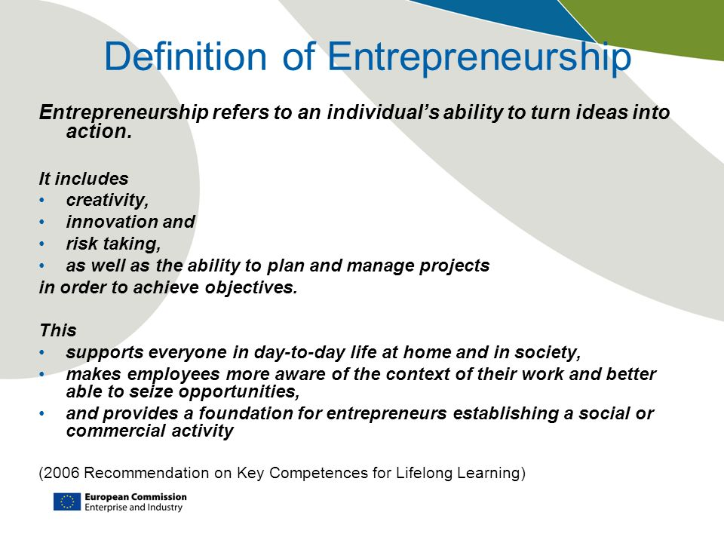

Slide 32
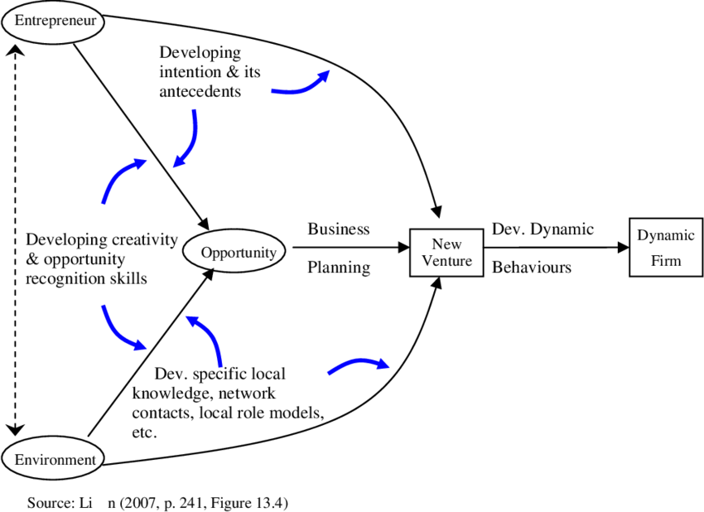
Role of Entrepreneurship Education

Slide 33
Who is an Entrepreneur?
An Entrepreneur is somebody who is in search of change, who identifies it and exploit it.
Entrepreneurs build many of the things you use and love today.
Think about it. Someone had to come up with an idea and then make the effort to build it up.
Someone had to believe in that idea and fork over the money to make it reality.
And when you finally unveil your creation, you have to hope that it will be successful to justify the effort put into it.
Entrepreneurship is a really laborious and time consuming effort.

Slide 34
Characteristics that successful Entrepreneurs Share.
Among them are:
a personal passion to solve a problem
a vision for what’s innovative
the skills to build a product or service, and a business around it
the tenacity to constantly seek feedback, iterate and pivot
the ability to empathize with and inspire those around you.

Slide 35

Can You Make Things Happen?

Slide 36
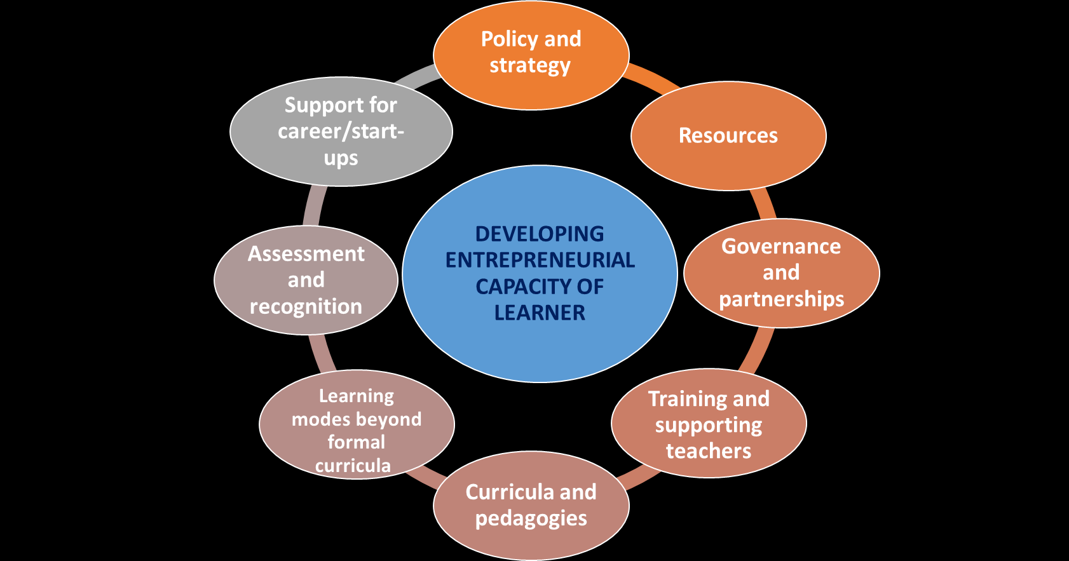
Approach to Develop Sustainable Entrepreneurship Education for Girls in Kano State Schools

Slide 37
Summary
Research tells us that girls perform better in girl-only environments, so it is imperative that we develop more entrepreneurship opportunities for young girls.
Business leaders can do their part by volunteering by launching mentoring programs for young girls at their companies.
Parents can include their daughters in family decision-making around money, and we can all talk to the girls in our lives about the importance of financial literacy and financial empowerment.

Slide 38
The young girls of today are preparing for careers in industries that have not yet been invented. We need them to have the courage and the confidence—along with the business acumen and technology skills—to create the solutions that are remaking our world.
But they also need to know how to sell that solution so that it gets adopted.
Girls need to learn both the hard entrepreneurial skills and those softer leadership skills when they are young so that they can practice them through adolescence and into adulthood.

Slide 39
Conclusion
To improve better outcomes in promoting girls entrepreneurship, there is the need for:
More Collaborations – especially with Multi – lateral agencies, Donor agencies, Civil Society orgs., NGO’s, are required to support and scale up interventions.
New Innovative Approaches – geared towards improving the entrepreneurial eco-systems.
Entrepreneurial Management – that emphasize the search for new opportunities to improve sustainable development outcomes.

Slide 40

THANK YOU

