Slide 1
Assessment of the Current State of Education in Kano State: Ideal Situation, Challenges and Prospects for an Improved System
MUSTAPHA Isyaku
Mambayya House
Aminu Kano Centre for Democratic Studies
Bayero University, Kano
misyaku.mambayya@buk.edu.ng
Tuesday, February 20, 2024

Slide 2
Introduction
Education is central to development and a key to attaining the Sustainable Development
According to the World Bank (2009), it is one of the most powerful instruments for reducing poverty and inequality
This is partly why governmental policies are directed towards ensuring that citizens are provided with enabling environments that will facilitate education for all.
In Nigeria, Section 18 of the 1999 Constitution (as amended) enjoins equal and adequate educational opportunities are granted to its citizens at all levels
Unfortunately, right to education in Nigeria is just a directive principle and not enforceable

Slide 3
Introduction (Cont)
The National Policy on Education (2013) considers education to be instrumental to national development and social change
It thrives to enhance a sustained and unfettered access to quality education at all levels that will promote skill acquisition, job creation and poverty reduction
In spite of these, providing adequate access to education is still problematic
These challenges manifest more in the areas of funding, human capital resources, pedagogy, quality assurance and relevance, curriculum reforms, attitudinal dispositions and among others (Aliyu and Bichi, 2019)
The girlchild’s right to education especially in sub-Saharan Africa remains an issue or concern

Slide 4
Introduction (Cont)
According to UNICEF (2023), Kano State has the highest number of out-of-school children in Nigeria which stands at 989,234
This is in addition to enormous challenges such as dilapidated structures, lack well-trained teachers, poor funding, poor teacher recruitment and deployment policies, inadequate curriculum which aid poor educational outcomes, etc.
Enrolment in Basic Education in Kano state has increased significantly since 2011.
However, quality of education as well as learning outcomes has been an issue of concern

Slide 5
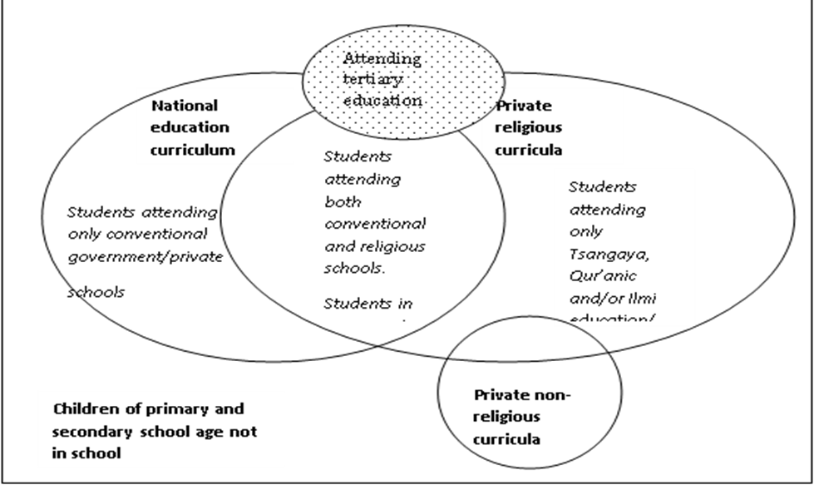
Types of Education Obtainable in Kano State

Slide 6
Quality Education: The Ideal Situation
Since education is a service and not a product, its quality cannot lie exclusively in its final output
It should also be manifested in the delivery process
Grisay and Mahlck (1991) posited that, quality of education has a three-dimensional approach comprising of:
*Quality of human and material resources available for teaching (inputs),
Teaching practices (process)
*Results (outcomes)
    *In order to achieve this, UNESCO has recommended at least 26% budgetary allocation to education

Slide 7
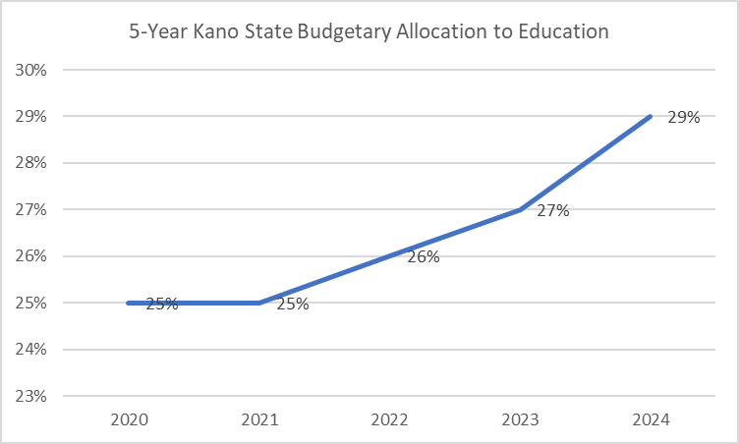
Kano State 5-Year Budgetary Allocation to Education

Slide 8
Challenges of Education in Kano State
According to Ahmed et al (2020), Education in northern Nigeria faces challenges including but not limited to the following:
Inability to mobilize school-age children to access education
Poor implementation of curriculum
High number of unqualified teachers
Low/Poor infrastructure
Poor teaching and learning resources
Poor release of funds
Lack of political will

Slide 9
Education Policy Environment in Kano State
The Kano State Ministry of Education has domesticated and implemented almost all the Federal Ministry of Education policies
Additionally, it has the:
  Girl Child Policy (Revised 2021)
  Kano State Teacher Policy
  Home Grown School Feeding Programme
  Inclusive Education Policy (Revised 2021)
  Policy on School Uniform and so on (SESOP, 2022)

Slide 10
SWOT Analysis of the Current Situation of Education in Kano State
STRENGTHS
Improved level of school enrolment
Improved budgetary allocation (29% in the 2024 Budget)
Existence of multi-dimensional policies on education
Existence of Education Strategic Plans for the state
Demonstration of an appreciable level of political will by the State Government
Demonstration of commitment to girlchild education in the state

Slide 11
SWOT Analysis (Cont)
WEAKNESSES
Shortage of teachers
Uneven distribution of teachers
Recruitment of unqualified teachers in the educational system
Dilapidated and overcrowded classrooms
Inadequate logistics for supervision and monitoring of schools
Negative perception of the IQTE by a few conservatives

Slide 12
SWOT Analysis (Cont)
OPPORTUNITIES
Improved Federal allocation due to fuel subsidy removal
High level of interests by donors to intervene in the state
Availability of manpower that will aid the recruitment of quality teachers in the state
Prioritization of education by the state government

Slide 13
SWOT Analysis (Cont)
THREATS
Corruption
Insecurity especially in rural communities
Interference of the political class in recruitment, deployment and training of teachers
Poor teacher effectiveness and commitment
Lack of Water, Sanitation and Hygiene in schools
School land encroachment
Gender-based violence in schools
Challenges of retention, transition and completion

Slide 14
Conclusion
Education in Kano state has recorded significant improvement especially in recent years.
But there are ongoing challenges in the system.
Stakeholder engagements especially through strategic means can adequately improve existing strengths, address weaknesses, explore opportunities and manage threats.
Hence, creating an ideal situation for education to thrive with desired quality and expected impact for overall individual and national development.

Slide 15
Recommendations
Adequate and timely release of funding
Monitoring of education related projects by CSOs/CBOs/FBOs to ensure judicious utilization of funds
Quality should also be emphasized as against quantity only
Adequate teachers with utmost quality be provided in strict compliance with the Kano State Teacher Recruitment Policy
Teacher and Learning facilities should be provided and adequate mechanism for maintenance be put in place

Slide 16
Thank You

