Slide 1
Addressing Education disparities and Inclusion
Dr Suwaiba Said Ahmad
Centre for Gender Studies, Bayern University, Kano

Slide 2

“Education is the premise of progress in every society, in every family”
Kofi Annan

Slide 3

1.
Outline
Introduction
Conceptual clarifications
Factors contributing to education disparities and barriers to inclusion
Addressing education disparities in Nigeria
Conclusion
Recommendations

Slide 4
Introduction
Education is a fundamental right of every child regardless of their
Gender,
Race,
Ethnicity,
Religion,
Social class,
Location
Living with a disability
etc

Slide 5

UNESCO Convention against Discrimination in Education (1960)
Universal Basic Education act (2004) and the associated State UBE laws
National Policy on Education (2014) section 4
Policy addressing the educational needs of nomadic groups
etc

Slide 6
Why?
Education is a proximate determinant of development: Educated forcework is needed to keep up in a modern world driven by technology.
A means of upward social mobility, socio-economic development, quality of life, and general wellbeing.
Give people a voice, promote social cohesion, tolerance and understanding.
Reflect global commitment towards ensuring quality education for all.

Slide 7
Yet,
Educational disparities and inequalities are the biggest problems in Education.
Unequal access to quality education remains a significant obstacle to achieving equitable opportunities for all.
A global problem, which put some at disadvantage, affecting their life chances and opportunities.
When not designed to ensure inclusion, educational disparity promote the very thing it is suppose to prevent - Inequality!

Slide 8
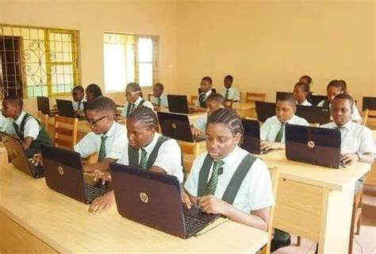
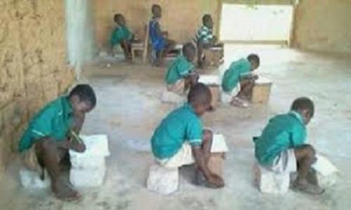
Conceptual Clarifications

Slide 9
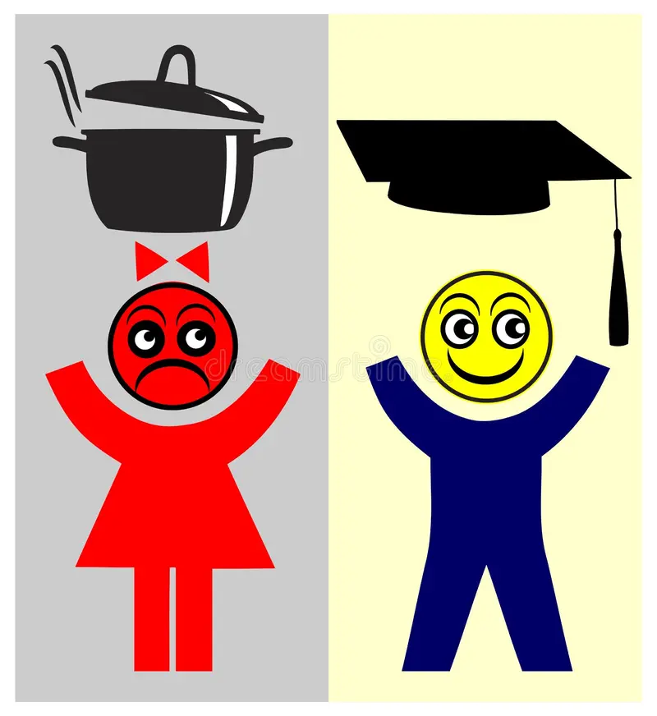
Educational disparities
Refers to unequal access to quality education in terms of its affordability, funding, teachers, library, instructional materials and technology.
It also encompasses the differences in access to schooling, retention and learning.

Slide 10
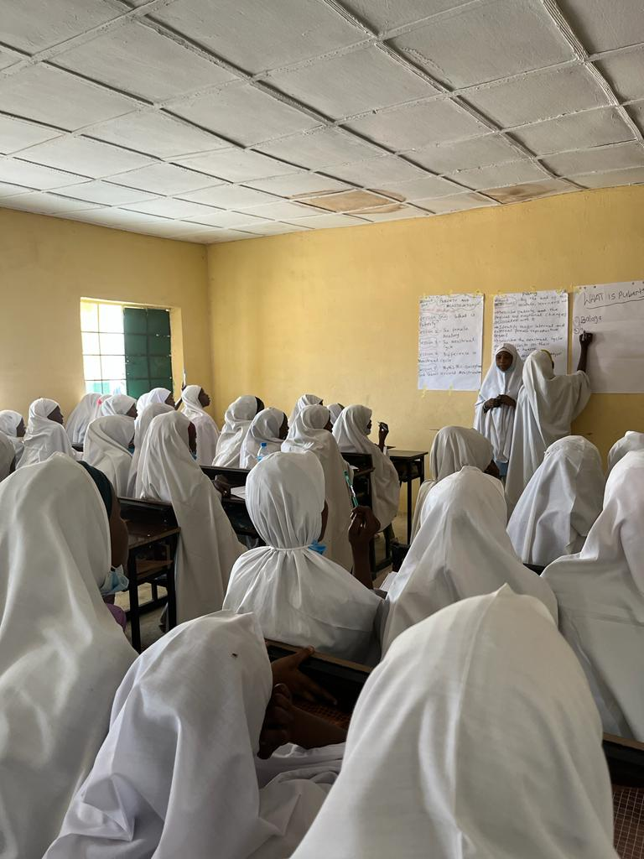
Addressing Education disparities
Means ensuring equitable access to quality and affordable education for all, regardless of social status, gender, location or disability.

Slide 11

Inclusion in Education
Refers to addressing all barriers and providing access to quality education to meet the diverse needs of all learners in the same learning environment.

Slide 12
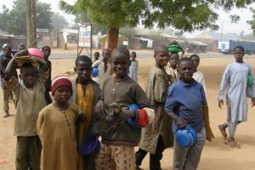
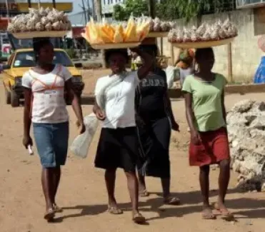
Education disparities and the problem of Inclusion in Nigeria
Nigeria accounts for 15% of global OOS children (UNESCO, 2023)
10.5 million primary school-aged children and 8.1 % of junior secondary school-aged students are out of school, 58% of whom are from poor households (UNICEF, 2022).

Slide 13
The educational system In Nigeria reflects the vast divide between rural and urban, the rich and the poor, boys and girls, the southern and northern regions, and socioeconomic and sociocultural backgrounds.
The COVID-19 pandemic brought to the forefront the disparities in the Nigerian educational sector, with the number of out-of-school children rising to over 50 million when schools closed down (UNICEF, 2020).
Although the government implemented remote learning, children living in rural areas were mostly left out.

Slide 14

Until recently, inclusion in education in Nigeria was mostly focused on disability issues, as reflected in the Special Education Policy of 1977.
Unfortunately, the institutional and financial support for special education has been weak, leading to inefficiency.

Slide 15
Other dimensions of equality are:
Gender
Girls account 50% of OOS in Nigeria, and 66% northern region (Cambridge Education, 2021).
Geographical location
OOS population is predominantly from rural areas (86%) (UNICEF, 2022).
Many rural schools lack essential resources for learning,
66% of OOS are from the northeast and the northwest.
Socioeconomic status
SES determines the type and quality of education a child gets irrespective of their academic performance and efforts).
Educated households are more likely ensure that their children benefit y from public investments in education.

Slide 16
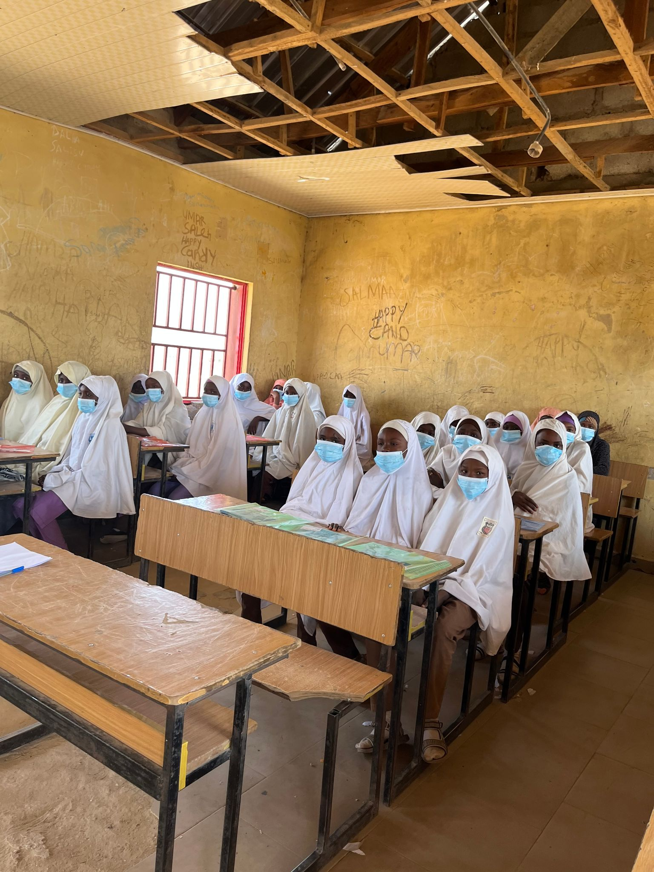
Factors Contributing to Education Disparities in Nigeria and barriers to inclusivity
Systemic Inequality
Gender Norms
Corruption
Insecurity
Poor funding of education
Lack of implementation of policy/poor implementation
Since the Chibok girls kidnapping in 2014, violence and mass kidnapping have targeted schools in the north, and more than 11,000 schools have been closed, (Hawkins, 2022).

Slide 17

Conclusion
Inequities in access to education tend to reinforce socioeconomic disadvantage and limit intergenerational mobility,
To reduce education disparities and achieve equitable access to education, socially disadvantaged children, such as girls, those with disabilities, and children from poor households, must be able to access quality education.
Achieving this requires a comprehensive approach where governments, donor agencies, the Ministry of Education, communities, families, and other stakeholders work together to ensure equitable distribution of education resources.

Slide 18
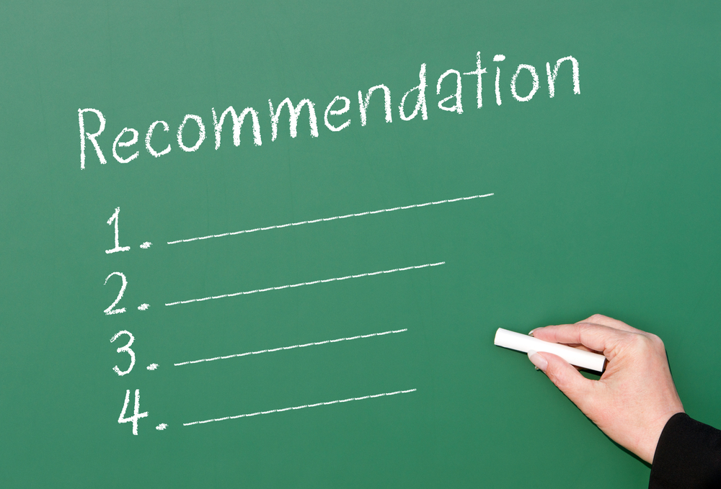

Slide 19
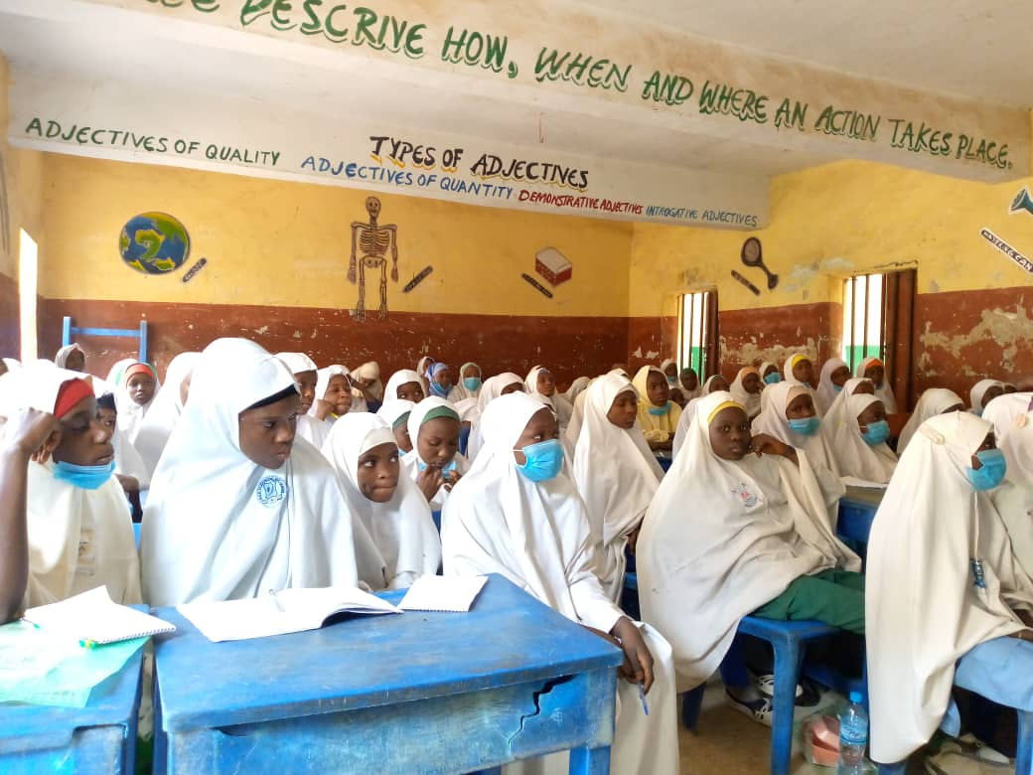

Cambridge Education. (2021). Investment case for out-of-school children in Nigeria. Cambridge: UNICEF. In United Nations Education Fund (UNICEF) (2022). Education opportunities for out-of-School children (OOSC). UNICEF Nigeria.
Hawkins, P. (2022). UNICEF: Insecurity has caused the closure of 11, 536 schools in Nigeria since Dec. 2020. In The Cable (April, 2022). https://www.thecable.ng/unicef-insecurity-has-caused-closure-of-11-536-schools-in-nigeria-since-dec-2020
UNESCO (2023), Out of school numbers are growing in sub-Saharan Africa. https://www.unesco.org/gem-report/en/2022-out-school
UNICEF (2020). COVID 19: Education transform through remote learning. https://www.unicef.org/nigeria/stories/covid-19-education-transformed-through-remote-learning
UNICEF (2022). Country office official report: Nigeria. https://https://www.unicef.org/media/136256/file/Nigeria-2022-COAR.pdf
Reference

Slide 20


4. Closing
Build confidence around your product or idea by including at least one of the these slides:
Milestones
What has been accomplished and what might be left to tackle?
Testimonials
Who supports your idea (or doesn’t)?
What’s next?
How can the audience get involved or find out more?

